Slide 1
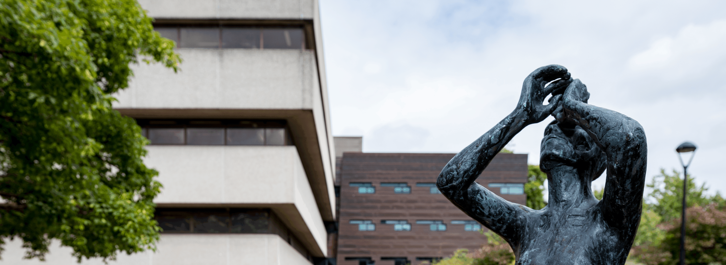
What does Librarianship mean to you?
Putting your values into practice
Stephanie Chen, Learning and Teaching Librarian, UCC Library
stephanie.chen@ucc.ie / @stephaniechen.bsky.social

Slide 2
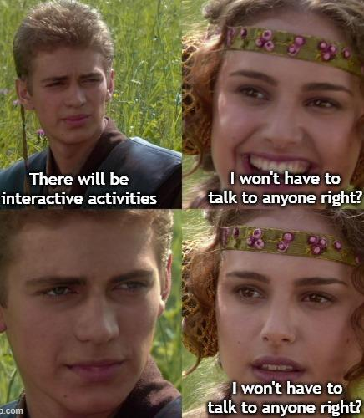
Before we get started…
I am asking you to participate in Vevox polls, Padlet, and individual reflection
Hoping to share some of the insights and outputs in a LibFocus blog post.
By participating in the Vevox polls and Padlet, you are providing consent for your contributions to be used anonymously. No names or identifying information will be included in any shared materials.

Slide 3
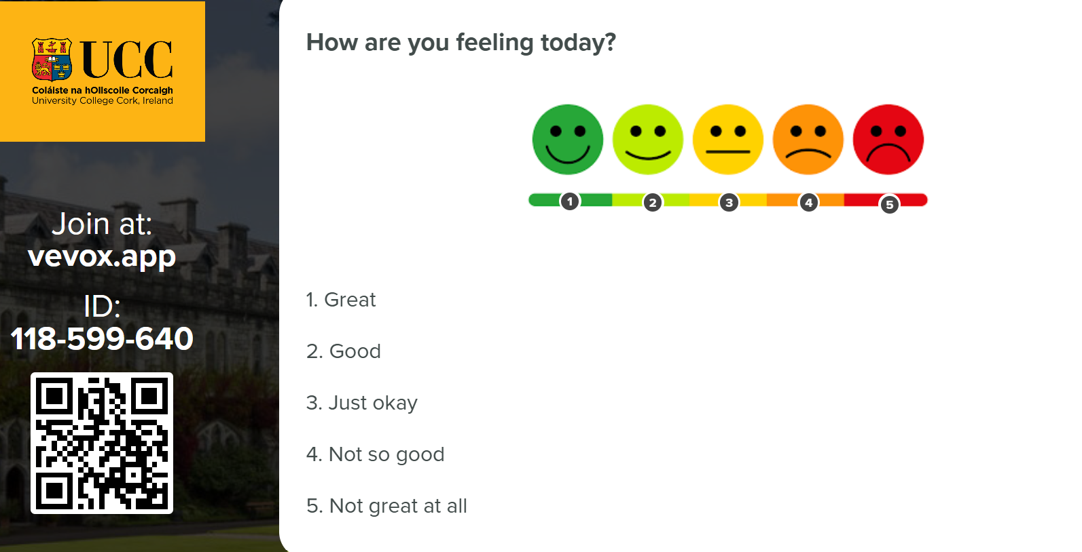
Vevox: How are you feeling today?

Slide 4

Values
Beliefs and ideals shared by members of a group¹
Societal values, personal values, values of users, professional values²
For this presentation, I would like us to think of professional values
¹Gorman, M. (2015) Our Enduring Values Revisited: Librarianship in an Ever-Changing World. Chicago: American Library Association
²Crowe, L. and Anthes, S.H. (1988) “The Academic Librarian and Information Technology: Ethical Issues,” College & Research Libraries, 49(2), pp. 123–130. Available at: https://doi.org/10.5860/crl_49_02_123.
Notes:
Professional values = what is important to you as a librarian/library staff member

Slide 5
Examples of professional values
Gorman’s enduring values (2015)
stewardship
service
intellectual freedom
rationalism
literacy and learning
equity of access to recorded knowledge and information
privacy
democracy
Lankes’ New Librarianship (2016)
service
learning
openness
intellectual freedom and safety
intellectual honesty
Gorman, M. (2015) Our Enduring Values Revisited: Librarianship in an Ever-Changing World. Chicago: American Library Association
Lankes, R. D. (2016). The new librarianship field guide. Cambridge: MIT Press.

Slide 6

Identifying your values (reflect)
Think of a time when you felt proud of your work or a sense of achievement at work.
What was the situation?
What did you do?
What was the underlying value?

Slide 7
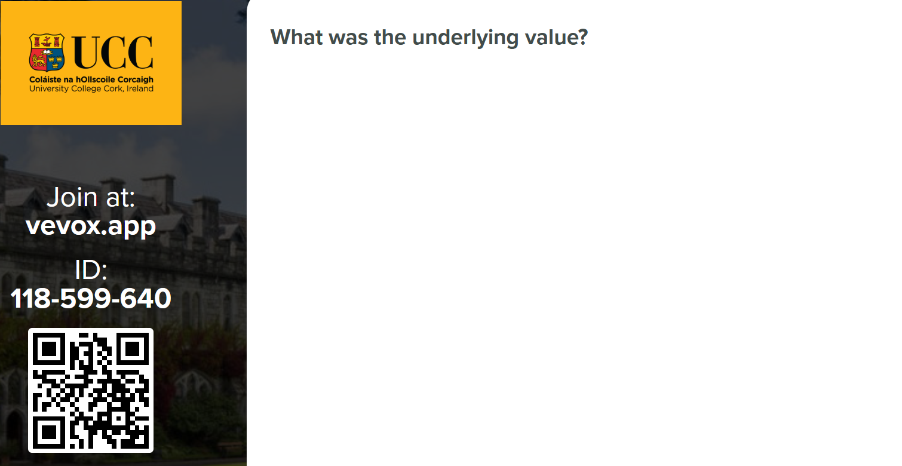
Vevox: What was the underlying value?

Slide 8

What do library associations say?
Notes:
“At the group level, ethics reflect shared values and beliefs.” (Shachaf, 2005) aka professional ethics as a way to articulate professional values

Slide 9
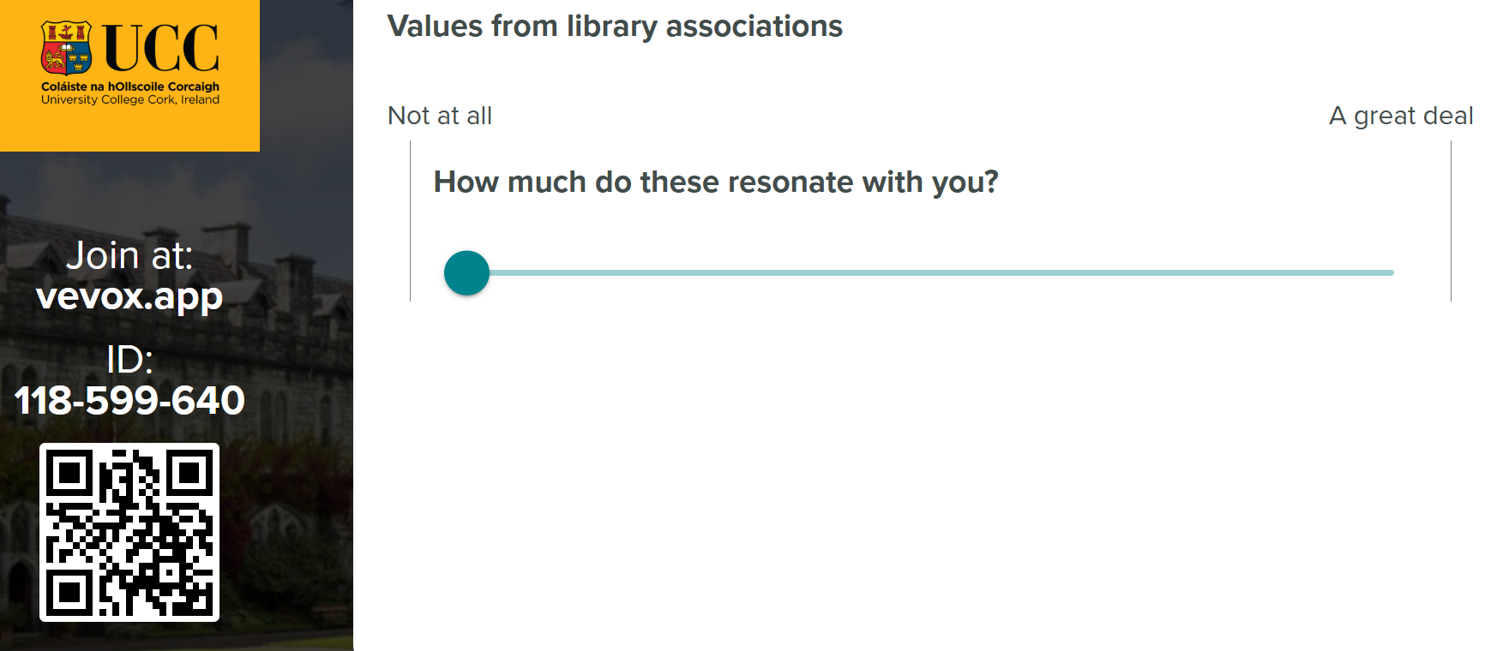
Vevox: values from library associations

Slide 10
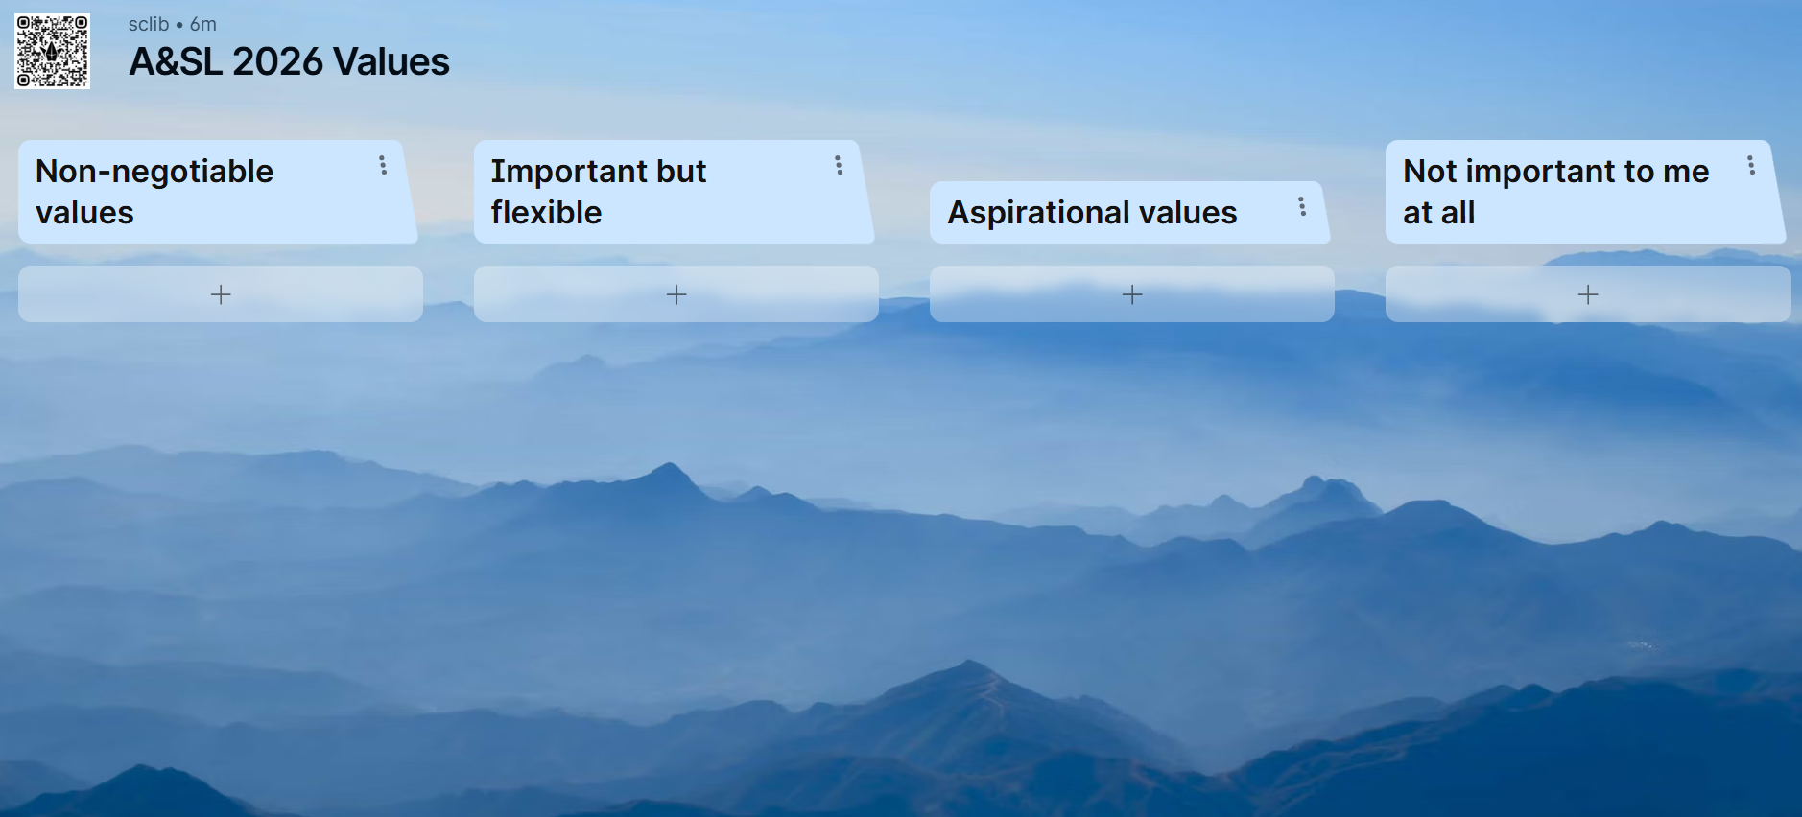
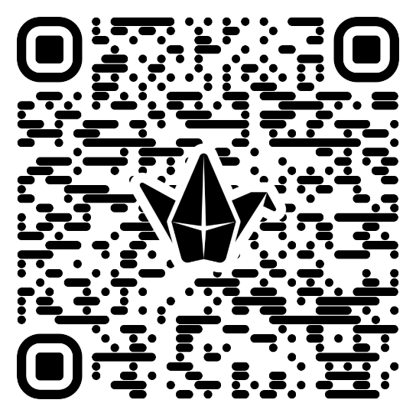
Are all values equal?
tinyurl.com/asl2026values
Notes:
Which values are non-negotiables for us? What might the aspirational values say about the environments we work in?

Slide 11
What happens when values clash or don’t align?
How much do you agree with these statements?
Librarians should be neutral
Librarians have a responsibility to be active agents of social change
User privacy should never be compromised, even for improved services
Complex! Values don’t always align and other values will take priority
Code of ethics can address, or fail to address these tensions, especially when our own values don’t align with what code of ethics might say
No easy solution or answer but our own values can be the guide for ourselves

Slide 12
Values into practice
Examples
Exercise: being intentional with putting your values to action

Slide 13
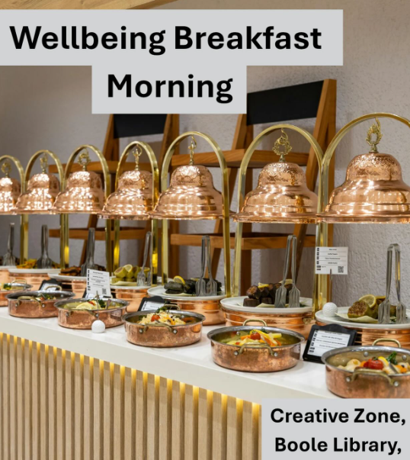
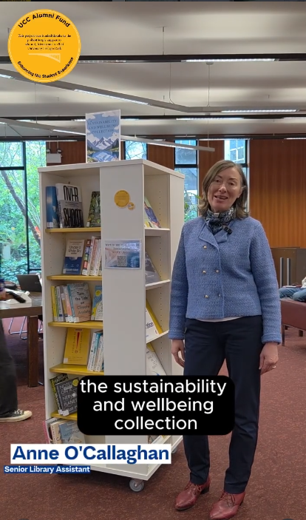
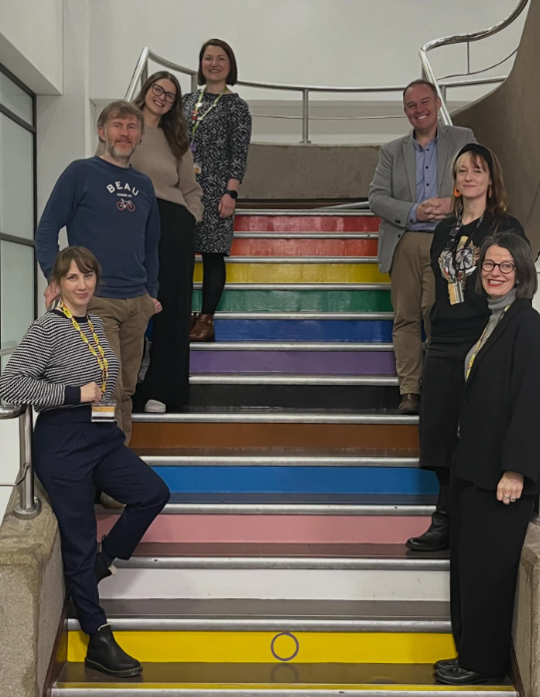



Examples from UCC Library

Slide 14

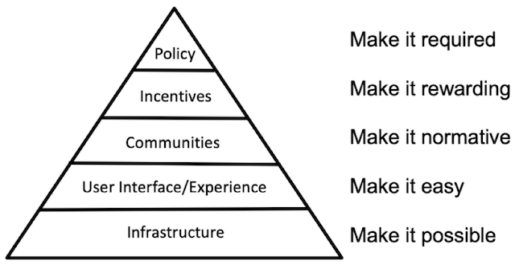

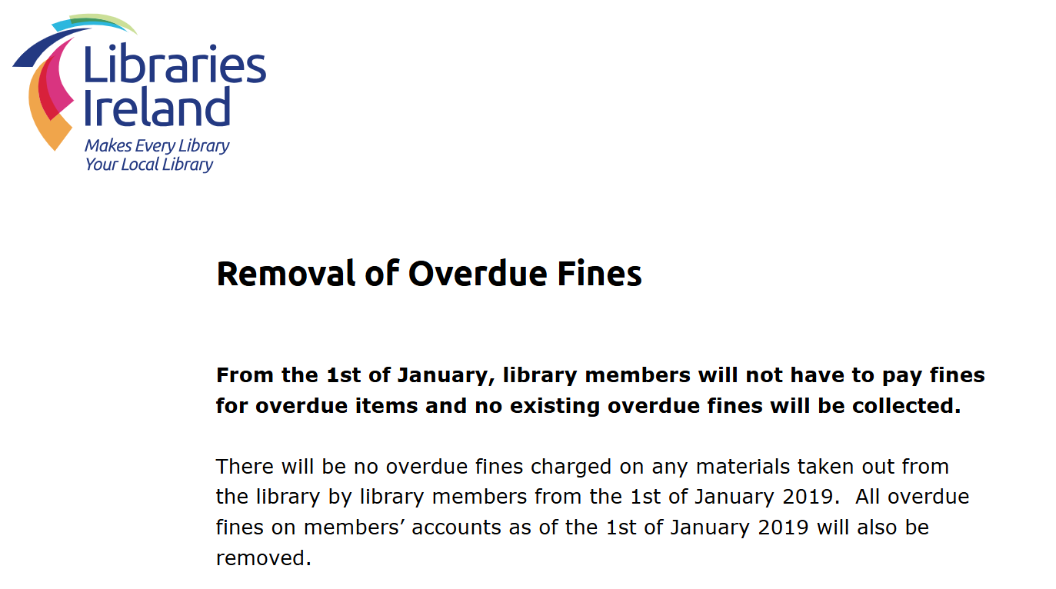

Other examples
Notes:
RCSI job advert
Center for Open Science: Strategy for culture change: https://www.cos.io/blog/strategy-for-culture-change
Intentional collection development policies

Slide 15

Your values into action
Value I care about
Tiny action I can take next week
Medium-scale change I can influence this year (project, service, policy)
Big/aspirational change I’d love to see
Share on Padlet if you feel comfortable doing so
Notes:
Consciously foreground your values – values into intentional practice

Slide 16
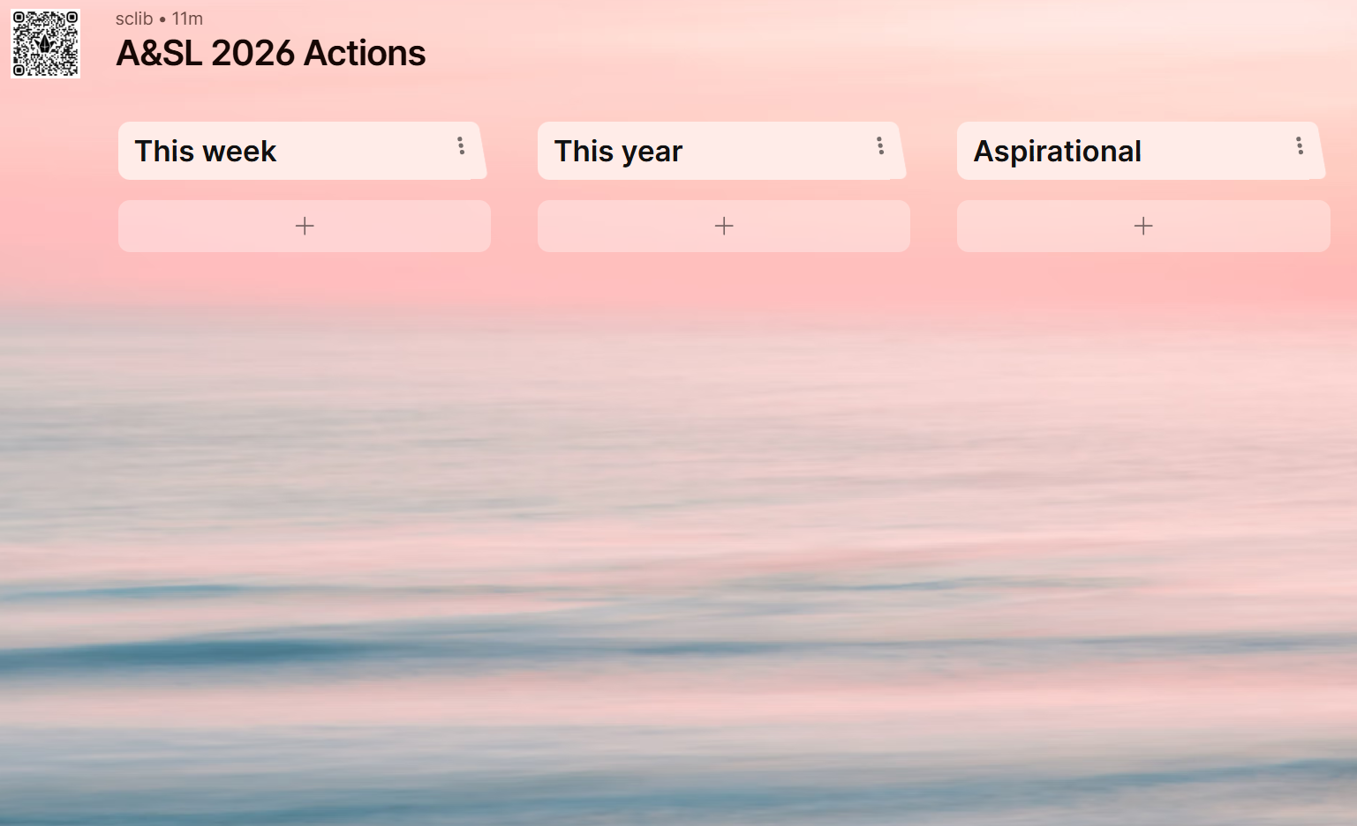
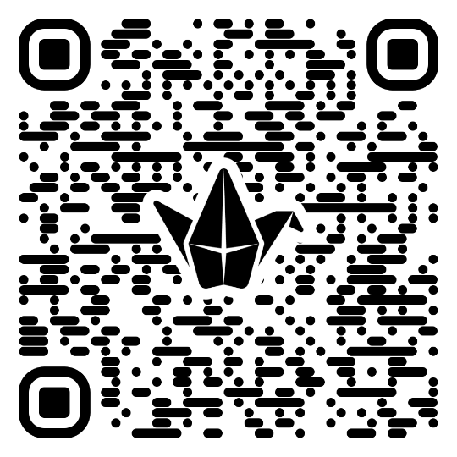
Padlet: actions
tinyurl.com/asl2026actions

Slide 17

Defining Librarianship
A&SL 2026
Reimagining Librarianship: Purpose, Practice, and Possibility
What does it mean to be a librarian today?

Slide 18
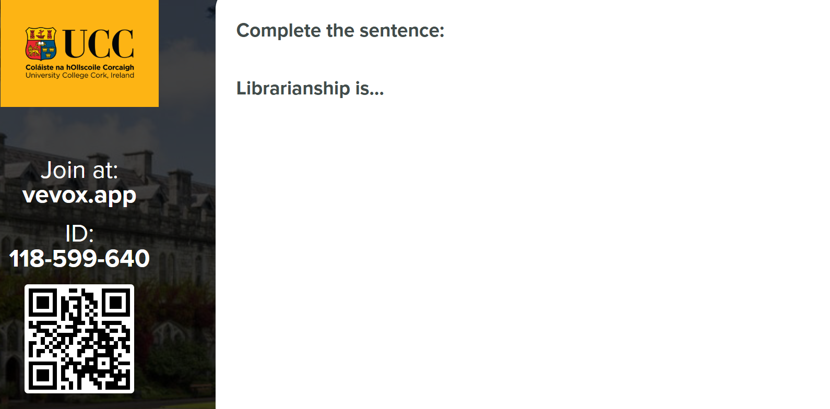
Vevox: complete the sentence

Slide 19
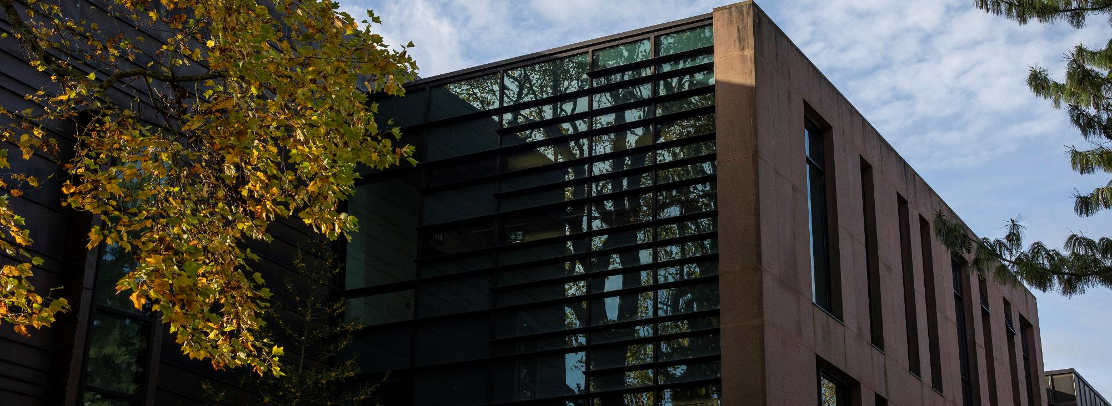
Thank you
Stephanie Chen, Learning & Teaching Librarian, UCC Library
stephanie.chen@ucc.ie / @stephaniechen.bsky.social

