Slide 1
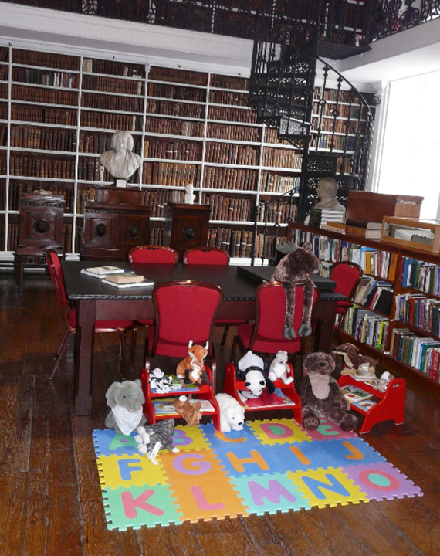
Stewardship, Service and the Space to Imagine: Reframing Librarianship for Today and Tomorrow
Dr Robert Whan
CILIP Ireland Chair and
Head of Service Delivery, National Library of Ireland
Contact Emails: chair.ireland@cilip.org.uk / rwhan@nli.ie

Slide 2
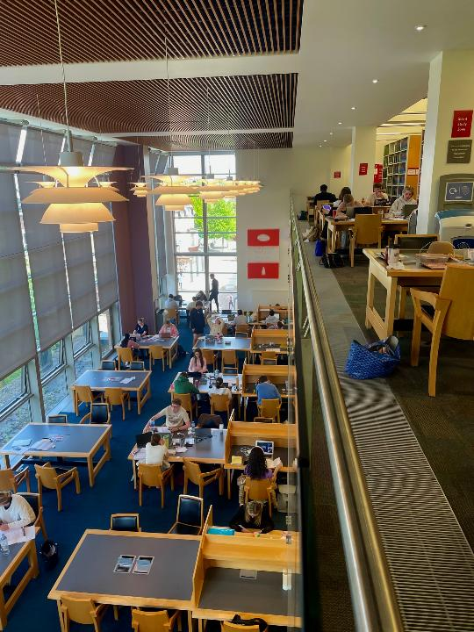
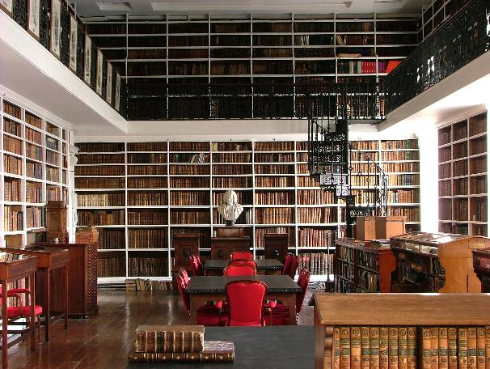
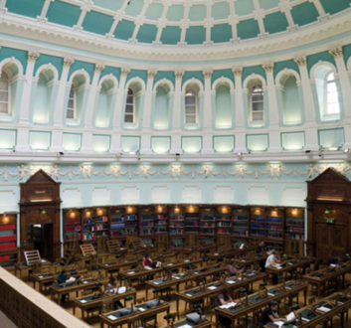
Through the Lens of Three Libraries
Armagh Robinson Library
National Library of Ireland
McClay Library,
Queen’s University Belfast

Slide 3
Three Key Interconnected Concepts
Stewardship: Our ethical responsibility to care for collections, knowledge, memory and trust – in physical and (increasingly) digital formats
Service: The everyday work that libraries undertake: access, equity, learning/research support, user experience and civic/community engagement
Imagination: A professional skill that enables us to anticipate needs, design new models, and shape the future with confidence

Slide 4
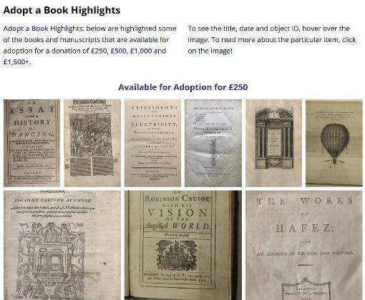
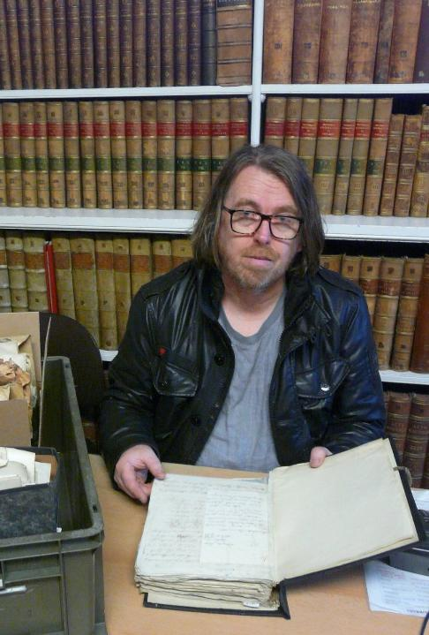
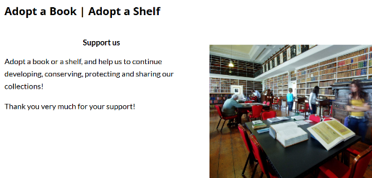

Slide 5

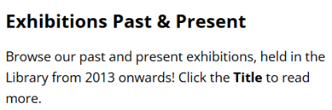
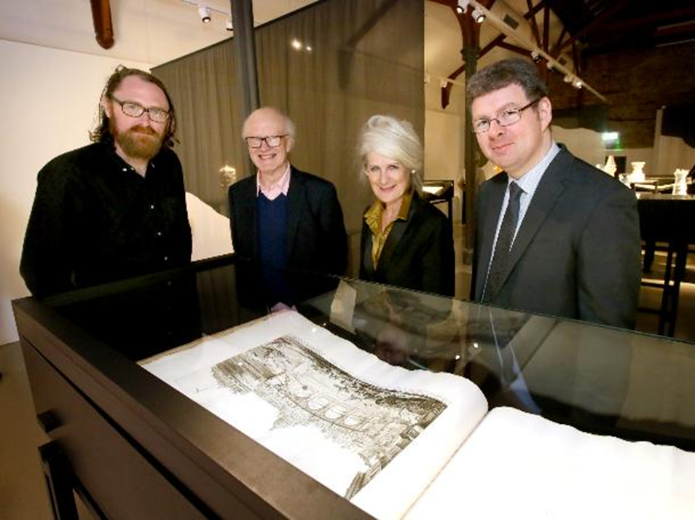
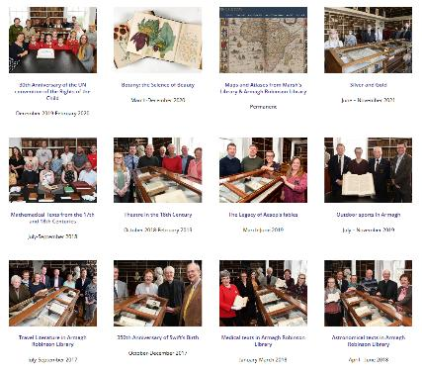
Exhibiting Collections

Slide 6
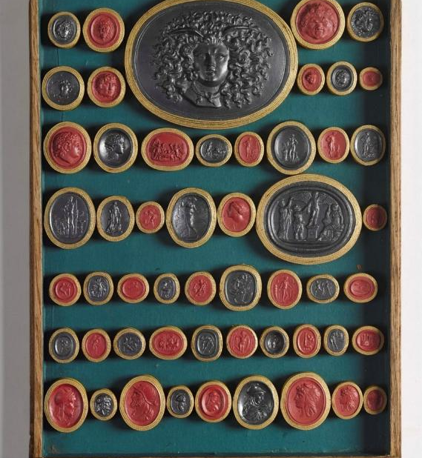
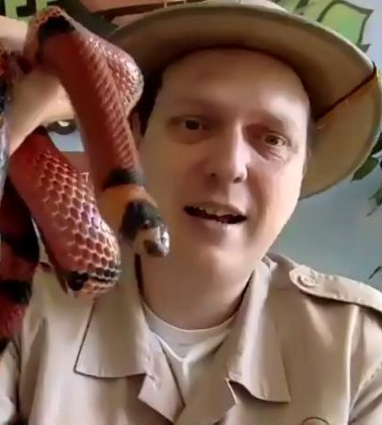
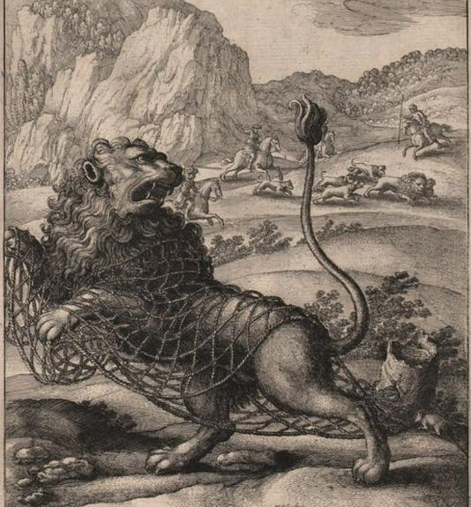
Extending Education & Access

Slide 7
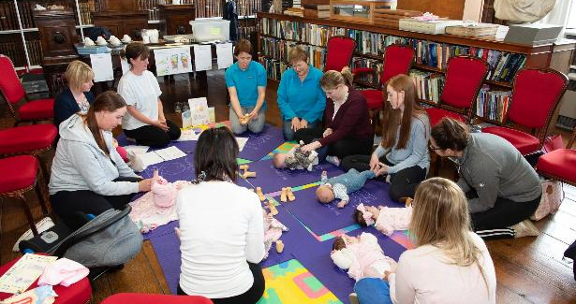
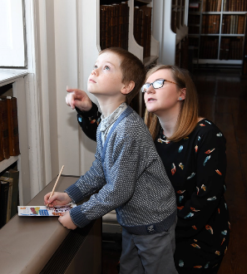
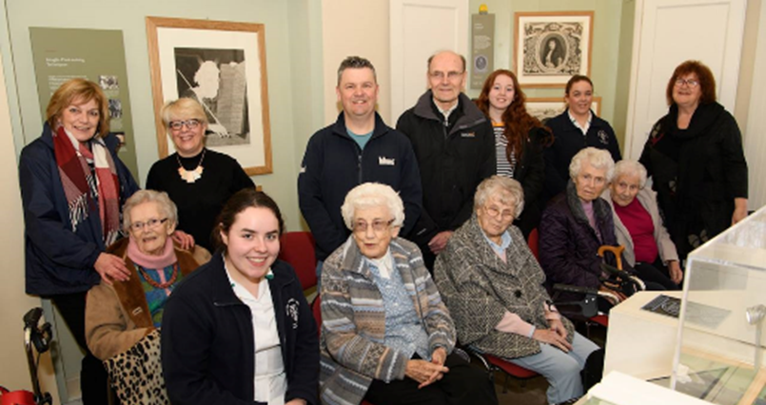
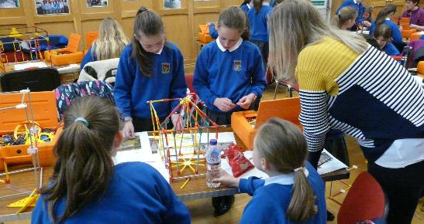
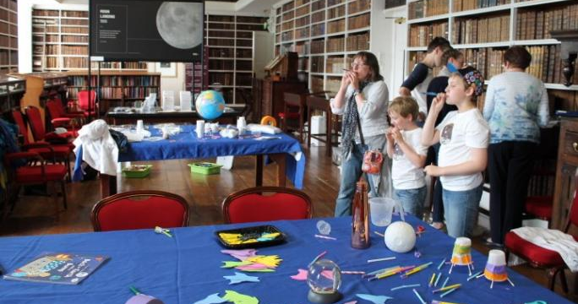
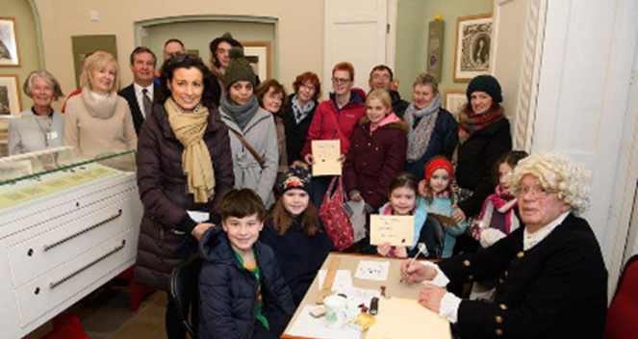
Education for All Ages

Slide 8
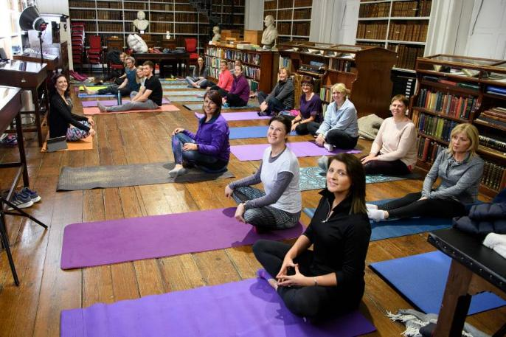

Slide 9


Slide 10
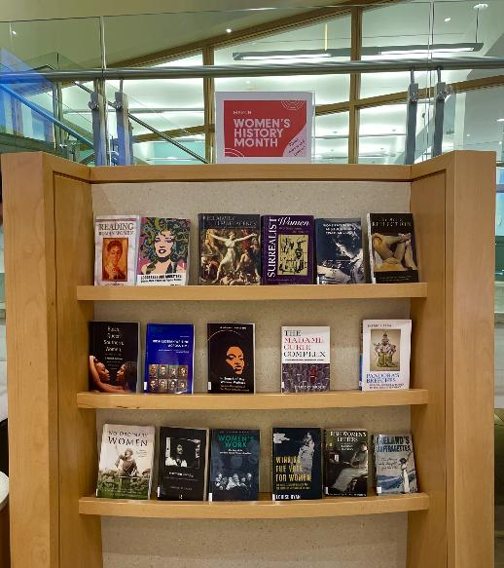
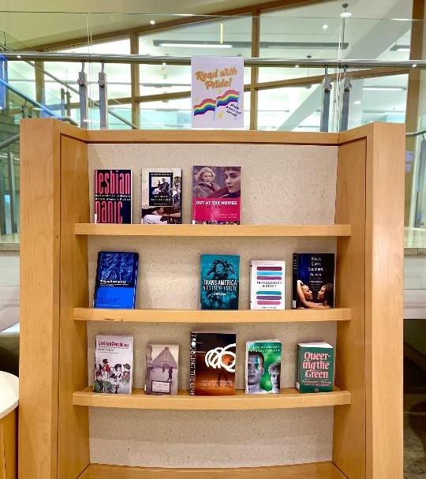
Reader Development

Slide 11

Consulting with Customers

Slide 12
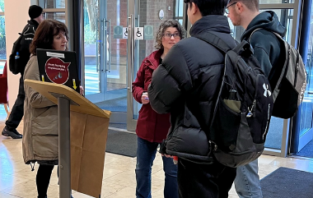
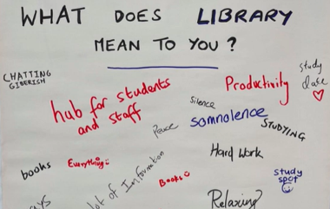
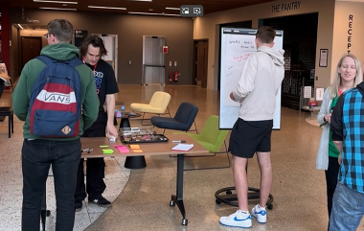
Utilising User Experience (UX) Techniques
Graffiti walls
Interviews
Photo studies
Cognitive mapping
Love & break-up letters
Observation
Behavioural mapping
Customer-led tours
Usability testing

Slide 13
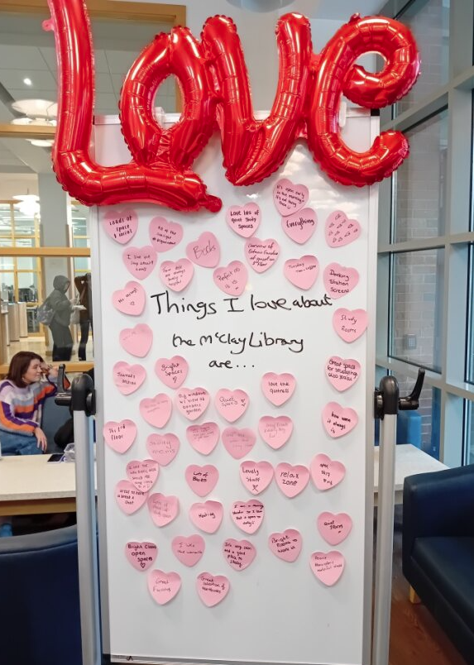
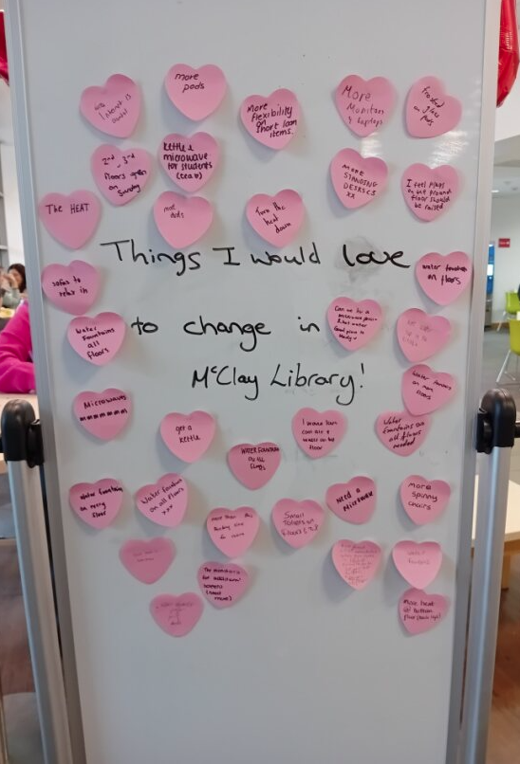

Slide 14
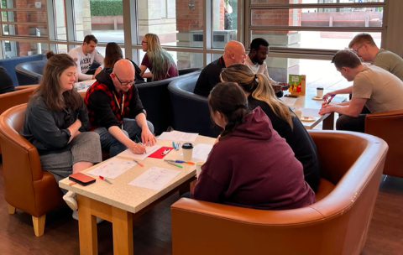
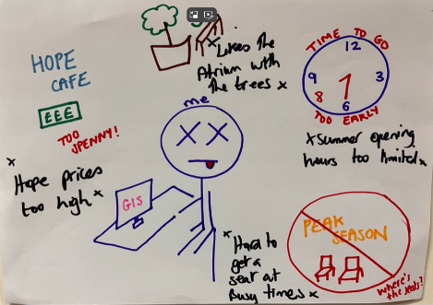
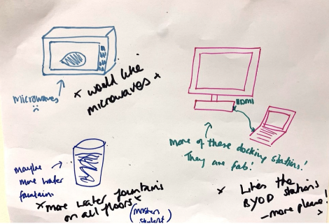
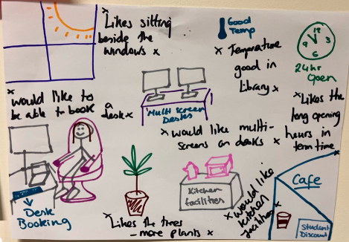
Cognitive Mapping

Slide 15
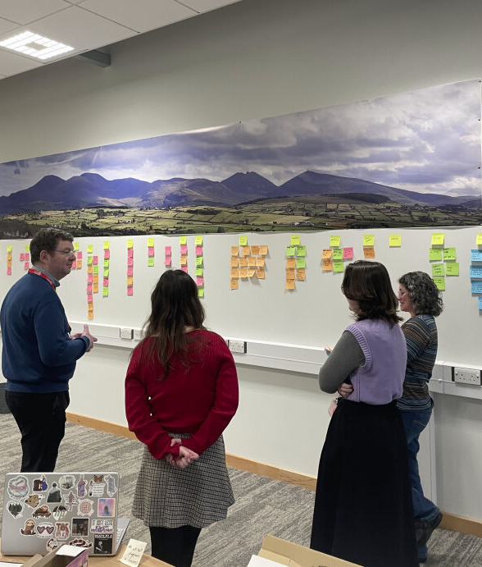
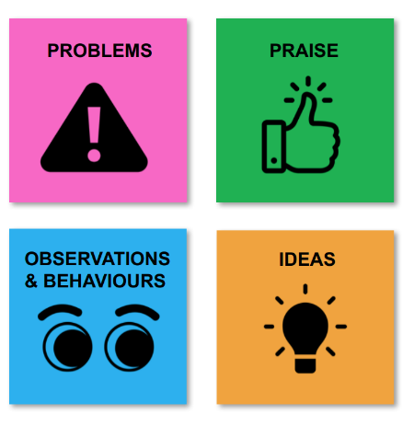
Affinity Mapping &
Idea Generation

Slide 16
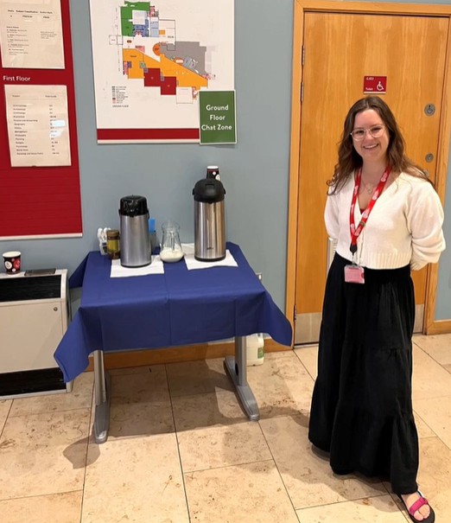
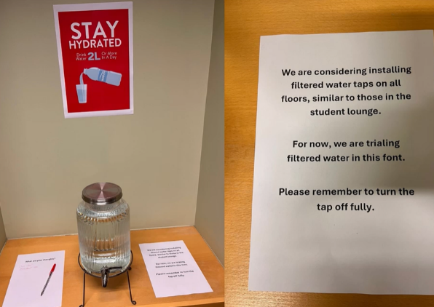
Prototyping

Slide 17
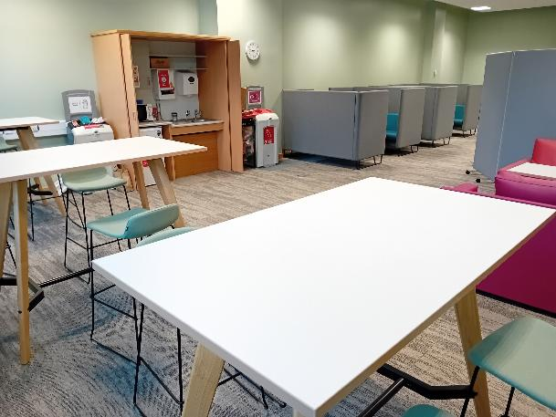
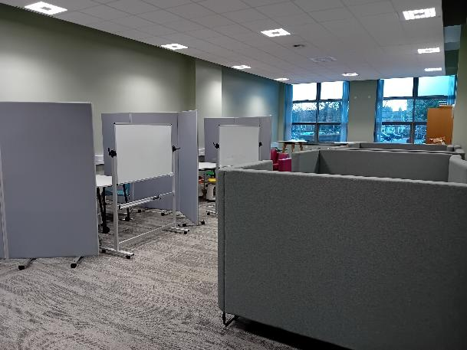
Introduction of Co-Lab Space within McClay Library
(September 2025)

Slide 18
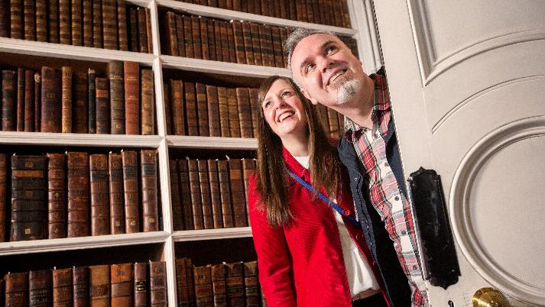
Creating the Space for Imagination

Slide 19
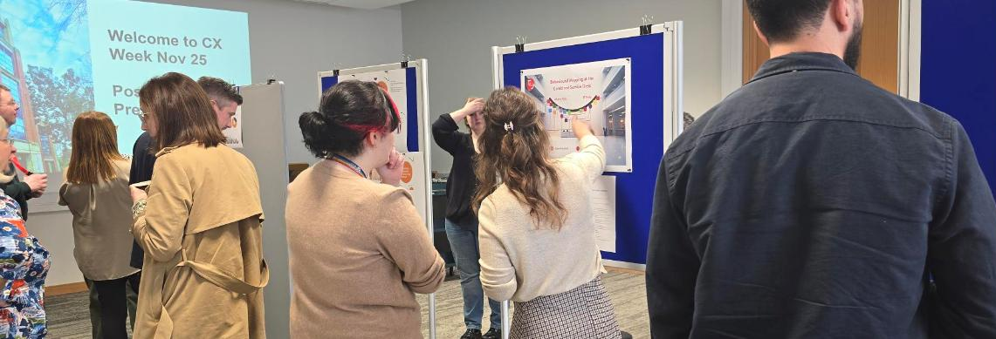
One Method: Biannual CX Weeks

Slide 20
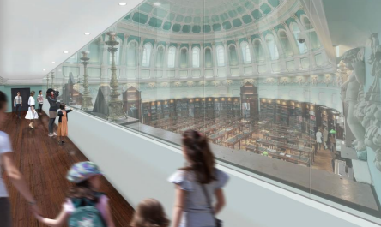
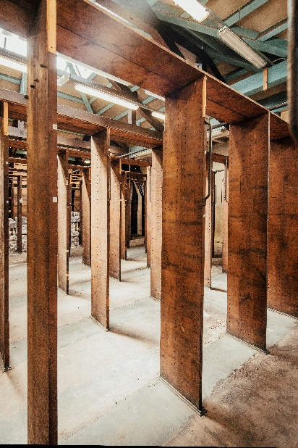
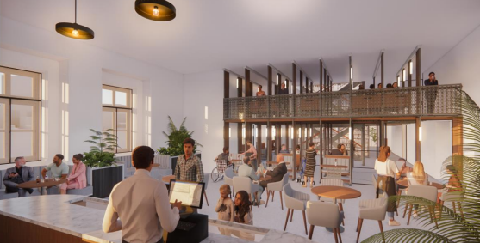
Bringing Tradition and Transformation Together
At The National Library of Ireland

Slide 21
Stewardship, Service and the Space to Imagine: Reframing Librarianship for Today and Tomorrow
Dr Robert Whan
CILIP Ireland Chair and
Head of Service Delivery, National Library of Ireland
Contact Emails: chair.ireland@cilip.org.uk / rwhan@nli.ie

