Slide 1
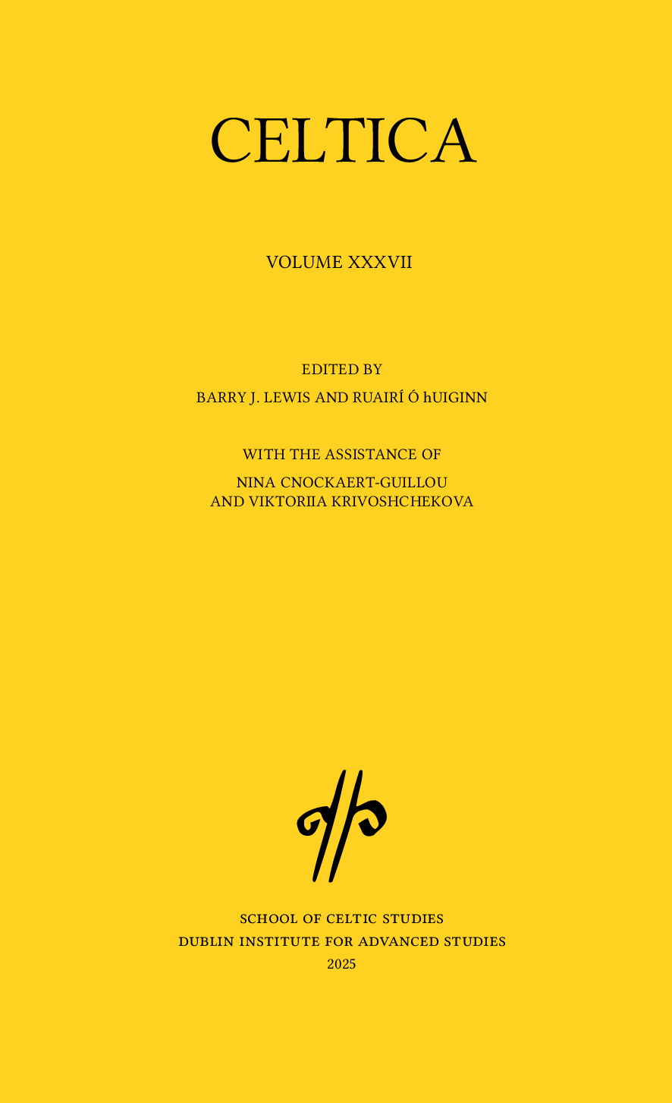
Expanding Legacy Publishing:
CELTICA goes Open –
Librarians leading the way
Margaret Irons
Librarian

Slide 2
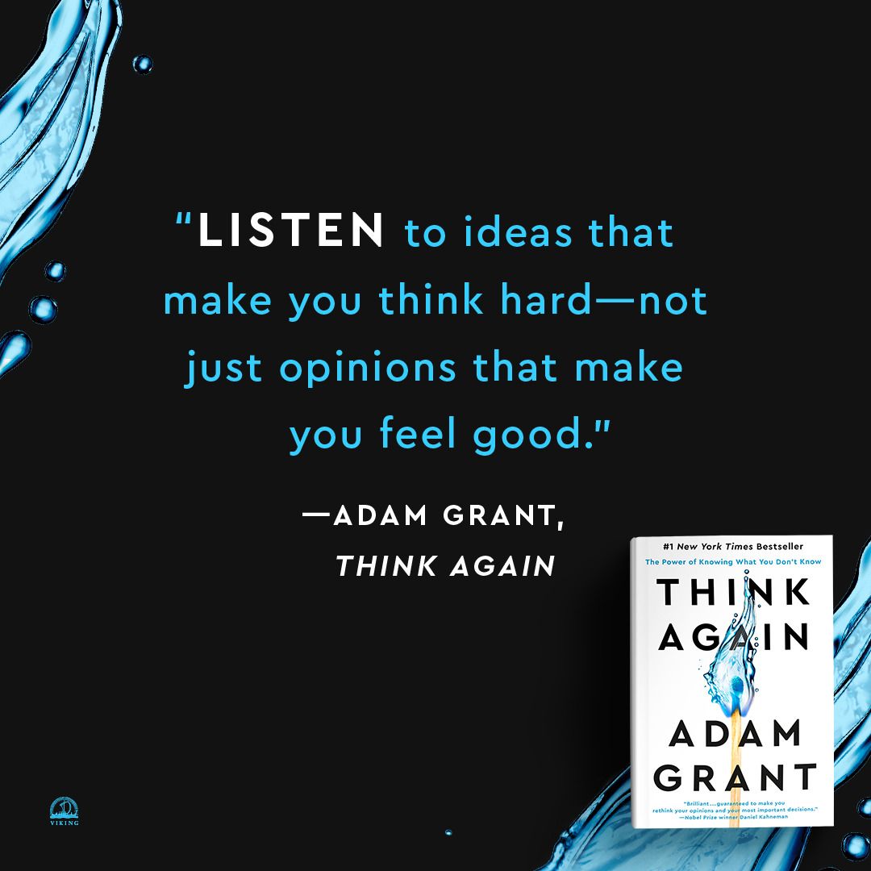
Think Again
How many of you have participated in meetings and heard the following?
That’s not the way we do things
It will never work here
It’s too complicated
We don’t have the staff
We don’t have the money
Making decisions based on past experiences cannot allow for new processes to emerge. There is a difference between what we think and how we think.

Slide 3

Celtic Studies
Subject Repository
OR
Institutional Repository?
Open Research
Open Access
DOIs & PIDs
Data Management
Licensing
Publishing

Slide 4
About CELTICA
Celtica is the peer-reviewed journal of the School of Celtic Studies,
Dublin Institute for Advanced Studies (DIAS)
Since its first appearance in 1946 it has published pioneering work in all aspects of Celtic Studies, including linguistics, literature, manuscript studies, textual criticism, history, law, dialect studies and onomastics.
It covers all of the Celtic languages and all periods from the earliest inscriptions to the spoken languages of the present day.

Slide 5
WHY Open Access?
Broadening reach – removing access barriers
Aligning with open scholarship – enhancing transparency
Meeting funder requirements – ie DOIs
Long-term preservation – LOCKSS and CLOCKSS
Diamond Open Access – no APCs or subscription fees
No subscription fees – less sales admin
Public sector body – labour is institutionally absorbed

Slide 6
Advocacy and Approval
Internal advocacy began in 2016
Institutional buy-in from DIAS Board
Final approval in 2022
Delays and setbacks
Finally live in 2025
Officially announced 19/06/25 mailing list - whoop

Slide 7
Technical Details
Platform: Open Journal Systems (OJS) – also looked at Janeway –
affiliate institute for NORF PublishOA
https://journals.dias.ie/index.php/celtica - why journals.dias.ie?
DOI assignment – Crossref
  Working out suffix and prefix
  https://doi.org/10.58480/SCS-k337u-mtxrb
  https://it.dias.ie/doi
Digitisation and metadata creation
Notes:
Blah blah blah

Slide 8
Key Learnings
Start early and be patient
Technical support is essential
Professional support networks invaluable –
Library Publishing Group
now
Open Scholarship & Library Publishing Group
Metadata matters
Stay flexible and constantly reassess
  The most meaningful way to succeed is to help others succeed
Notes:
Blah blah blah

Slide 9
What Next?
Digitising back issues
Platform enhancements
Community engagement and usage tracking
DOAJ index listing
Utilising OJS to maximum capabilities
Workflow redesign
Educating colleagues and assigning workflows

Slide 10
Thank You!
All our networks – LAI Groups & Sections –
especially the wonderful Aisling Coyne
Advocates for FAIR & Open Access – NORF, SONRAÍ etc
Publications Committee of the School of Celtic Studies
IT team at DIAS
Contact: margaret@celt.dias.ie
journals.dias.ie

Slide 11
