Slide 1
Reimagining Librarianship Beyond the Library
Emerging Competencies for National Research Infrastructure
Jenny O’Neill

Slide 2
“Skills unique to librarianship are also essential for research infrastructure”
Some context
Sonraí Irish Data Stewardship Network
EOSC Ireland
Some closing thoughts

Slide 3
Passionate about Open Research & FAIR Data
Master of Library & Information Science, UCD (2013)
Library Intern, RCPI (2014)
Data Curator, DRI (2014-2016)
Data Manager, UCD Library (2016-2023)
Research Engagement Officer, Asiera (2023-)
Notes:
This case study explores how core library competencies, organising information, teaching and community engagement, are increasingly essential within national‑level research infrastructure initiatives. Drawing on my transition from academic librarian to Research Engagement Officer at Asiera, I reflect on how librarianship continues to shape my professional practice, even outside a traditional library setting.

Slide 4
formerly known as HEAnet and EduCampus
Delivering Information and Communications Technology (ICT) shared services for Ireland’s education and research sector.

Slide 5

Information Literacy
We are educators. We teach students how to find, evaluate, and use information effectively

Slide 6

Research Support & Scholarly Communication
We assist researchers & students throughout the research lifecycle, e.g. advanced information searching, publishing open access, supporting data management

Slide 7

Collection Development & Curation
We curate digital collections and institutional repositories

Slide 8

Digital & Technological Proficiency
We have expertise in databases, discovery tools, reference software and digital scholarship tools, supporting online learning environments and digital archives

Slide 9

User-Centered Service & Outreach
We actively engage our communities, understanding diverse user needs, designing accessible, inclusive services and promoting services through outreach, partnerships and events

Slide 10
sonraí
[noun, mpl4]
datum, pl. data
Website: datastewards.ie
Listserv: irishdatastewards@listserv.heanet.ie
LinkedIn: Irish Data Stewardship Network
https://www.focloir.ie/en/dictionary/ei/data
Notes:
Through EOSC Ireland, librarianship skills inform stakeholder engagement, governance development and planning for a national node that will connect Irish researchers to European Open Science infrastructures.

Slide 11


Sonraí’s mission is to foster, enable and advocate for the development of research data stewardship and data stewards nationally.
Photo by K. Mitch Hodge on Unsplash
Notes:
Established under NORF Open Research Fund (2022)
Built a national community of practice
Now transitioning to a long-term self-sustaining model
“Sonraí began under the NORF 2022 call, with a mandate to help implement the national action plan for open research. We’re now evolving from a funded project to a sustainable network with long-term responsibilities.”

Slide 12
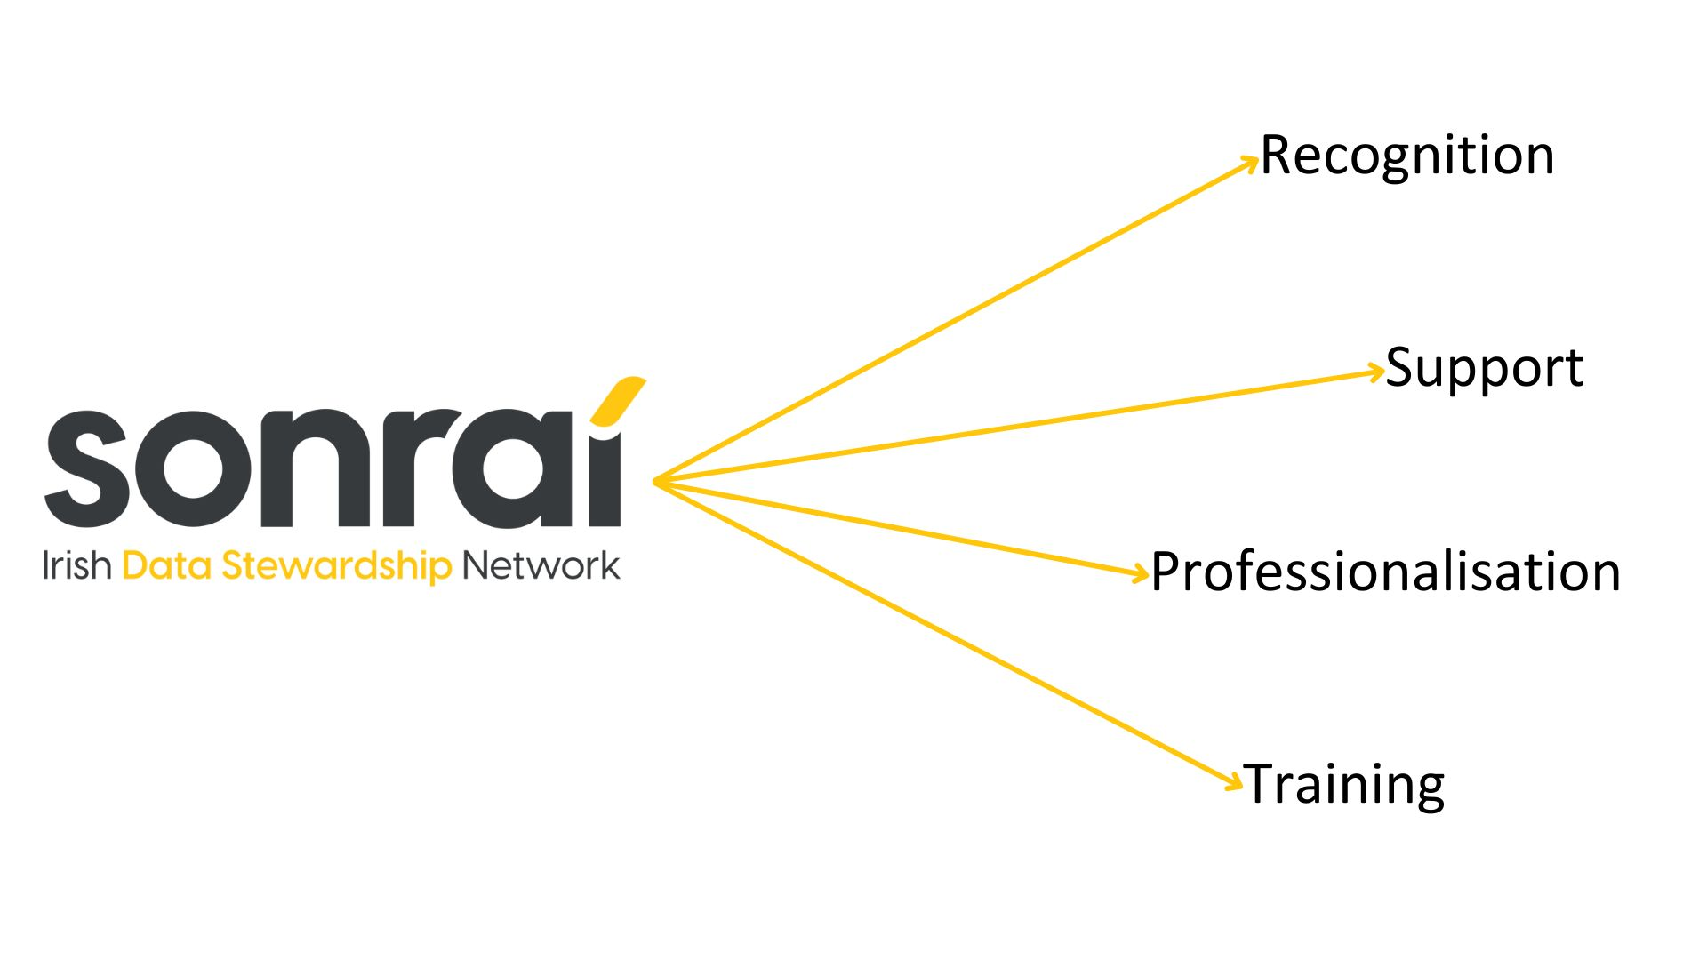

Aims
Establish a national data stewardship network across research performing organisations, funders and related research support services and infrastructures to build national capacity and develop a collective voice and pool of expertise.

Slide 13


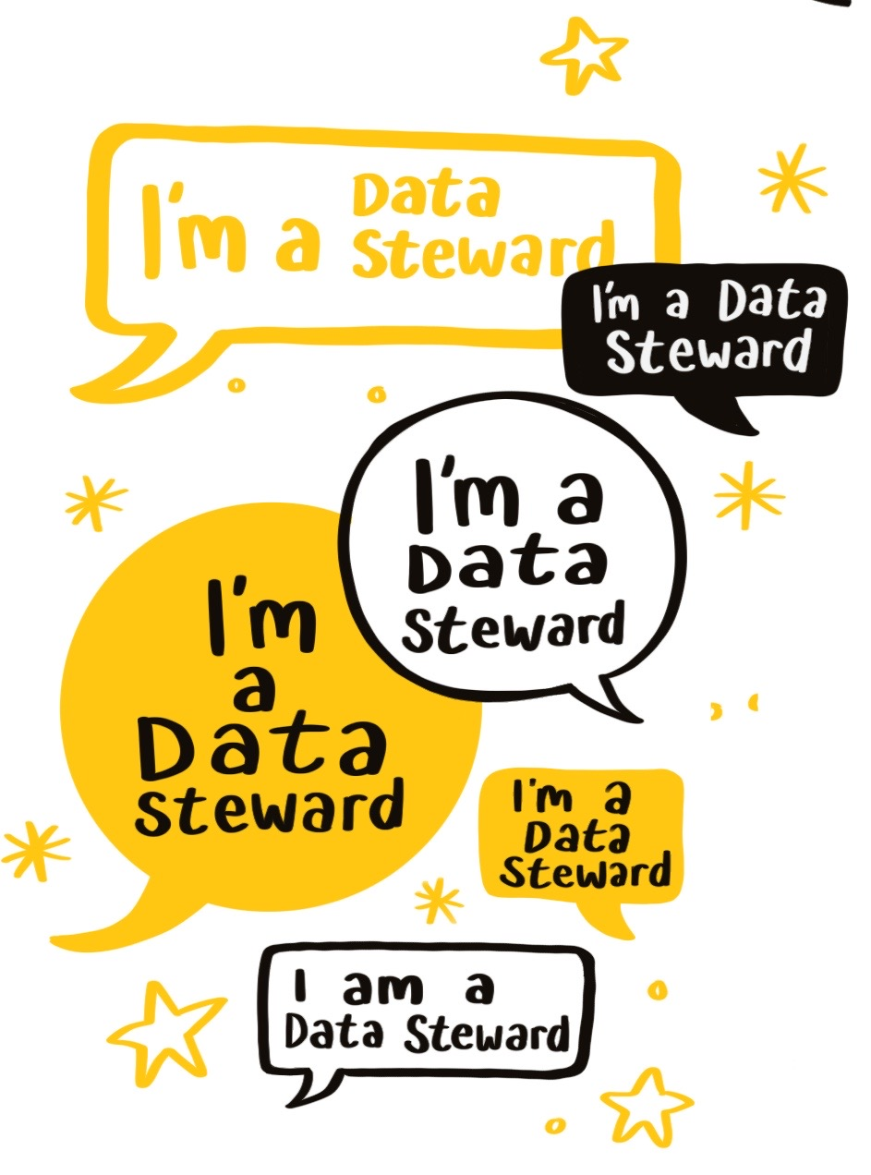
Am I a Data Steward?​
Do you often find yourself minding the data?
Are you the ‘data person’ in your research group, team, department or service?
Are you the person who develops/implements data processes, databases and workflows within your unit?
Do you spend a significant portion of your time on data, metadata handling/wrangling, alignment, quality, cleaning and mining?
Do you administer or provide support for data infrastructure or service?
Have you reviewed, written or implemented a data management plan?
Do you provide research data management support, training or implementation as a central service or to a research group or team?
Are you tasked with data curation, preservation or FAIRification?
Are you working on Research Data Management policy development or implementation?

Slide 14
Committee
Steering group
  Representatives from across research landscape
  Officers positions rotate every 2 years ​
  Coordinates and has oversite of network activities ​
  Maintains website​
  Implements 5 year plan/ strategy ​
  Fosters relationships with relevant groups and networks
  Representative from wider national and international landscape with key stakeholders and expert advisers from relevant groups ​
  Meets 3 time per year ​
  Acts as an advisory body for the committee​
  Provides a review panel for the 5 year plan
Task and Finish Groups
  Time limited groups set up with the aim of delivering a specific task, object or output ​
  Task and finish groups require at least one committee member to lead the group but can include volunteers from the wider membership/stakeholders ​
  Task and finish groups report to the committee​
  There focus should be on activities which further the mission of the network and speak to the actions outlined in the 5 year plan.
Notes:
Governance

Slide 15
DH5001: Introduction to Data Stewardship
On successful completion of this module, students should be able to:
  Analyse the role of data steward and the research data lifecycle and the principles and practices of data management.
  Design and generate data management plans that comply with relevant policies, legislation, and codes of conduct.
  Design, implement, and assess documentation and metadata standards to ensure effective data stewardship, accessibility, and compliance with best practices.
  Evaluate and apply data quality standards and reproducibility principles to ensure accuracy, integrity, and reliability in data management.
  Apply and assess the FAIR and Open Data Principles across various contexts and data types.
  Evaluate and compare data repositories for use across data types and research needs.
https://www.ucc.ie/en/dh5001/
Skills
Reinvestment
Sustainability
Capacity
Notes:
First task

Slide 16






$$✓$$
Information Literacy
Research Support & Scholarly Communication
Collection Development & Curation
Digital & Technological Proficiency
User-Centered Service & Outreach
$$✓$$
$$✓$$
$$✓$$
$$✓$$

Slide 17

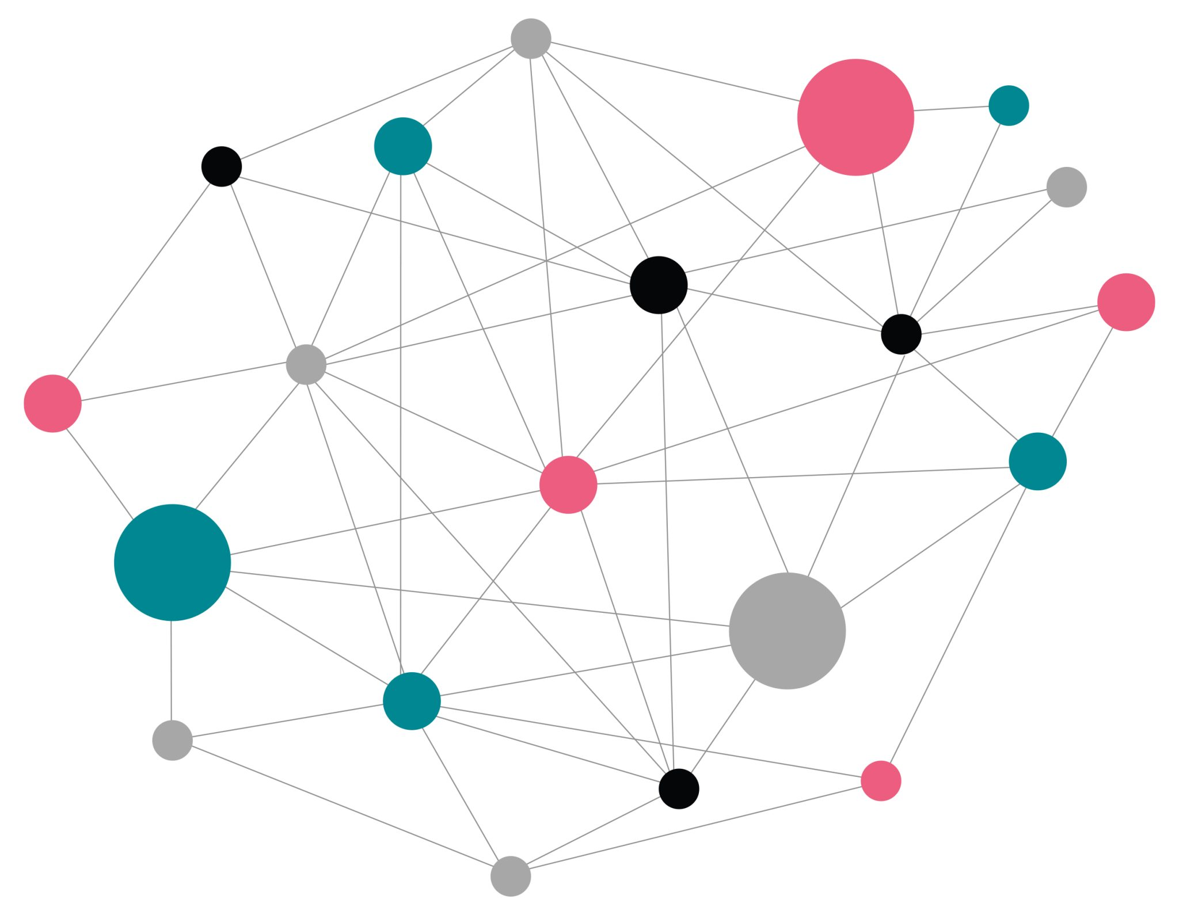
EOSC Federation
Notes:
EOSC stands for European Open Science Cloud. The EOSC Federation aims to provide Europe's researchers with the necessary digital resources to conduct research within and across disciplines and borders according to the principles of FAIR data and open science, in a trustworthy and secure environment. This will be done by putting in place a so-called ‘system of systems’ with an appropriate organisational and operational structure, between institutional, regional, national, and European data repositories, research infrastructures, e-infrastructures and other scientific service providers federated into a network of nodes.
An EOSC Node will be typically formed by multiple research institutes, universities and other stakeholders with a common geographical or thematic scope. The goals of the EOSC Federation include enhanced access to and use of digital resources, improved efficiency and higher impact of investment in research, improved research integrity, increased robustness and trustworthiness and increased data sovereignty.

Slide 18
File Sync & Share
Enable automatic file syncing and secure sharing across locations and teams.
Interactive Notebooks
Create and share documents with real-time code execution.
Large File Transfer
Streamline large file transfers online with added security and integrity.
Virtual Machines
Design and conduct experiments with flexibility while ensuring reproducibility.
Cloud Container Platform
Deploy cloud-native containerised applications that can easily scale.
Bulk Data Transfer
Move data effortlessly to data-intensive execution environments.
EOSC EU Node
Notes:
The EOSC EU node is the first node of the EOSC Federation, made available to researchers by the European Commission. This gives researchers across Europe access to a range of tools & services including file sync and share, interactive lab notebooks, large file and bulk data transfer, virtual machines and cloud container platforms. There are 13 additional candidate nodes which hope to be connected by the end of 2025. Examples of these candidate nodes include national nodes from Finland, Poland, Germany and the Netherlands and thematic nodes from biobanking and biomolecular studies from BBML ERIC, the life sciences including Elixir, EMBL, Instruct, Bioimanging and CERN.

Slide 19
And Ireland?
2023
DFHERIS asked HEAnet to prepare a position paper
2024
Paper submitted to DFHERIS
2024
Webinar: Planning Ireland’s contribution to the EOSC Federation
2025
Developed a first iteration of national paper
2025
Broader engagement towards final version, [In-person] EOSC Ireland workshop
Recommends the development of a national position paper
2025
Final version submitted to DFHERIS & CSA funded.
2026
EOSC.ie project
Notes:
Nominated by DFHERIS, Asiera is the EOSC Association Mandated Organisation for Ireland. The overall recommendation coming from the final paper included detailed planning for an EOSC-Ireland node to occur via a CSA (Co-ordination and Support Action) followed by full implementation. The project includes partners from the across the Irish research and academia community, including ICHEC, TU Dublin, DRI and others and will recommend architectural and technical solutions, propose governance, business, and funding models and drive stakeholder engagement. And I’m delighted to say that DFHERIS have agreed to fund this initial 12 month project which we will kick off in early 2026.

Slide 20





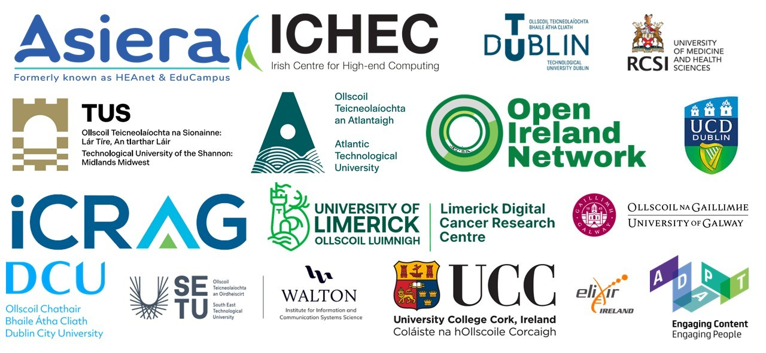




Ireland’s Research Infrastructure Ecosystem
High-Performance & Emerging Computing
Ireland’s HPC capacity
EuroHPC
Artificial Intelligence
Quantum computing
Digital Research Infrastructure
EOSC Integration
EOSC EU Node
National EOSC Nodes
Thematic EOSC Nodes
HEAnet Research Cloud DRE
Data Sovereignty & FAIR Principles
Open Science
Federated Ecosystem
IRL-DataSpace
IRL-DSSC
Data Infrastructure & Stewardship
IRLDAT shared storage
HEAnet Research Cloud DRE
Sonraí Irish Data Stewardship Network
Research Data Management Dynamic Purchasing System
Cross-sector
Collaboration
Notes:
Establishing the EOSC Ireland node is a strategic step toward achieving key national policy objectives in research, innovation, and digital transformation, including Impact 2030, European Research Area Priority Actions on Open Science, NORF National Action Plan for Open Research and Open Data Strategy 2023–2027. It will also enable researchers to conduct high-quality, reproducible research and drive new scientific discoveries. In the second half of 2026, Ireland will host the European Union presidency, offering a key chance to showcase its leadership in Open Science through this CSA.

Slide 21

WP 0: Project Management
WP 1: Technical Architecture
WP 2: Technical Trials
WP3: Organisational Structure, Governance and Funding
WP 4: Connecting to EOSC Federation
WP 5: Sensitive Data Services
WP 6: Community Engagement

Slide 22





$$✓$$
Information Literacy
Research Support & Scholarly Communication
Collection Development & Curation
Digital & Technological Proficiency
User-Centered Service & Outreach
$$✓$$
$$✓$$
$$✓$$
$$✓$$
WP 0: Project Management
WP 1: Technical Architecture
WP 2: Technical Trials
WP3: Organisational Structure, Governance and Funding
WP 4: Connecting to EOSC Federation
WP 5: Sensitive Data Services
WP 6: Community Engagement
Notes:
Through EOSC Ireland, librarianship skills inform stakeholder engagement, governance development and planning for a national node that will connect Irish researchers to European Open Science infrastructures.

Slide 23

“librarianship continues to shape my professional practice”

Slide 24
Jenny O’Neill
Research Engagement Officer jenny.oneill@heanet.ie

