Slide 1

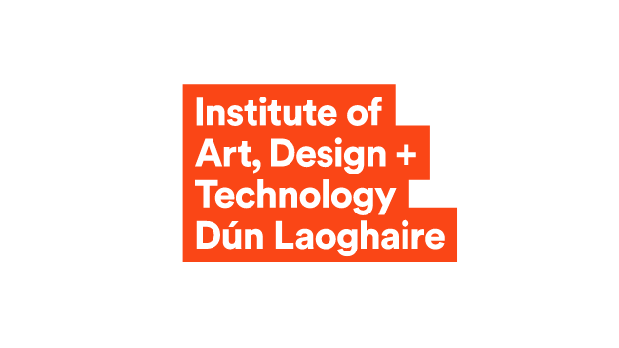
Diamond Ireland
Jane Buggle
Institute Librarian
Co-Lead WP2
Diamond Ireland
Advancing Diamond Open Access Scholarly Publishing in Ireland

Slide 2
Diamond Ireland Overview
NORF-funded initiative ensuring the future sustainability of Diamond Open Access publishing in Ireland
Repositions scholarly publishing as a shared public good
National platform for Diamond journal and monograph publishing
Support beyond campus to small and culturally significant publishers

Slide 3
Project Evolution
Phase 1: 2022 – 2025
PublishOA - Co-led by the Royal Irish Academy and Trinity Long Room Hub with national affiliates
Feasibility study and pilot platform development
Phase 2: 2025 – 2026
Diamond Ireland
Development of the Diamond Ireland Press and the Diamond Ireland Hub

Slide 4
Leadership and Partnerships
Co-led by the Technological University of the Shannon (TUS) and the Atlantic Technological University (ATU)
Team: Dr Frank Houghton (TUS), Dr Johanna Archbold (ATU), Niamh Brennan (TCD), Jane Buggle (IADT)

Slide 5












National Network Affiliates

Slide 6










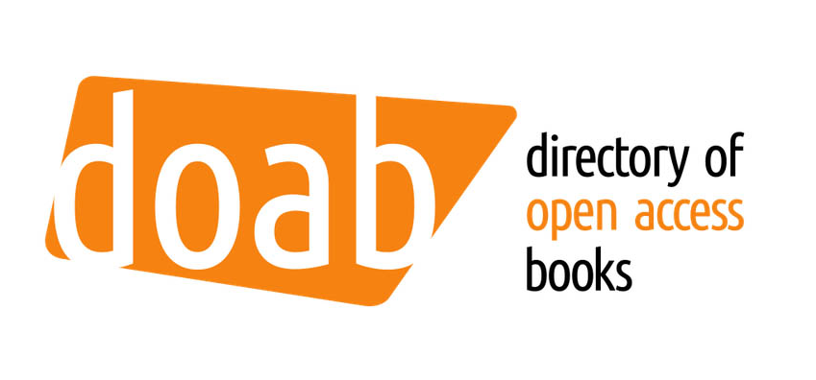

International Advisory Board

Slide 7
Diamond Ireland Components
Sustainable network supporting bibliodiversity
Best practice Diamond OA journal and monograph publishing
Tiered partnership model
OA publishing platform (Diamond Ireland Press)

Slide 8
Diamond Ireland Hub – Support Services
Advice on governance and editorial policies
Supports for standards, preservation, copyright, and licensing
Discoverability and impact enhancement
International policy alignment

Slide 9
Diamond Ireland Work Packages
WP 1: Project Management and Coordination
WP 2: Network Bibliodiversity and Inclusion, Community Engagement and Capacity Building
WP 3: Network Governance and Sustainability

Slide 10
WP 2 Key Deliverables
Bibliodiversity and Publishing Ethics Consultation Report
Bibliodiversity Toolkit
Diamond Ireland Summit (June 2026)
OA Book Publishing Microgrant Scheme

Slide 11
WP 3 Key Deliverables
Governance Framework Structure and Terms of Reference
Diamond Ireland Business Plan
Tiered Partnership Model

Slide 12
Diamond Ireland Press - Platform
National Diamond OA Publishing Platform launching March 2026
PKP-hosted OJS for journals
PKP-hosted ONP for books
National, inclusive, platform-agnostic discoverability layer

Slide 13
Platform Migration
5 established OA journals migrated to Diamond Ireland Press
Migration review underway by individual journal editorial boards
Next: new IADT Journal of Research & Creativity (IJRC)
More journals in the pipeline (new, established, student)

Slide 14
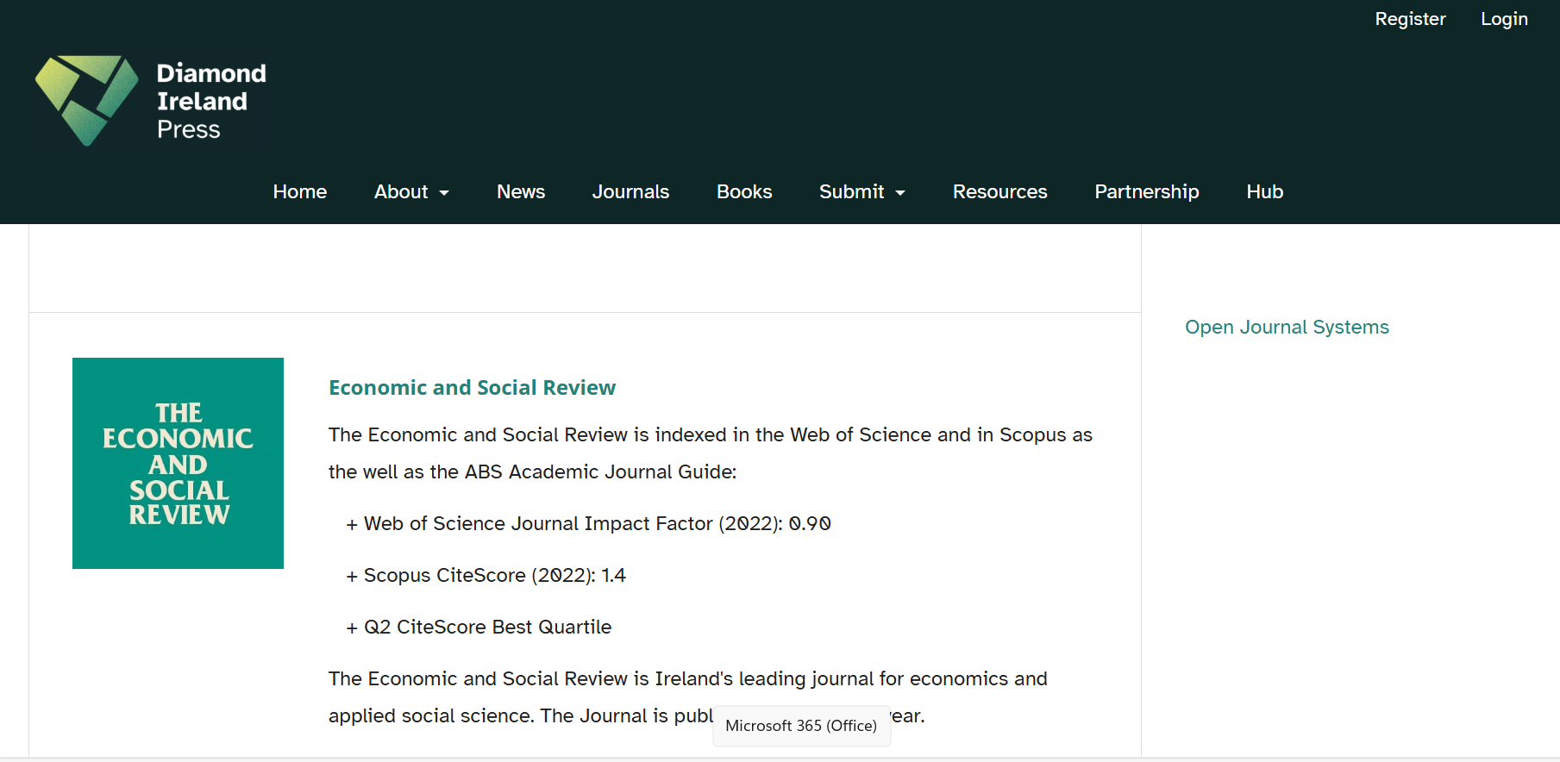

Slide 15
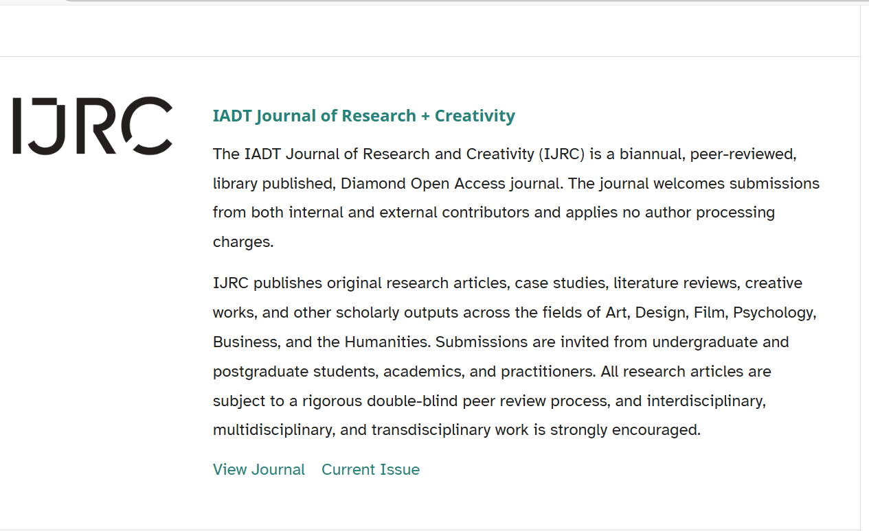
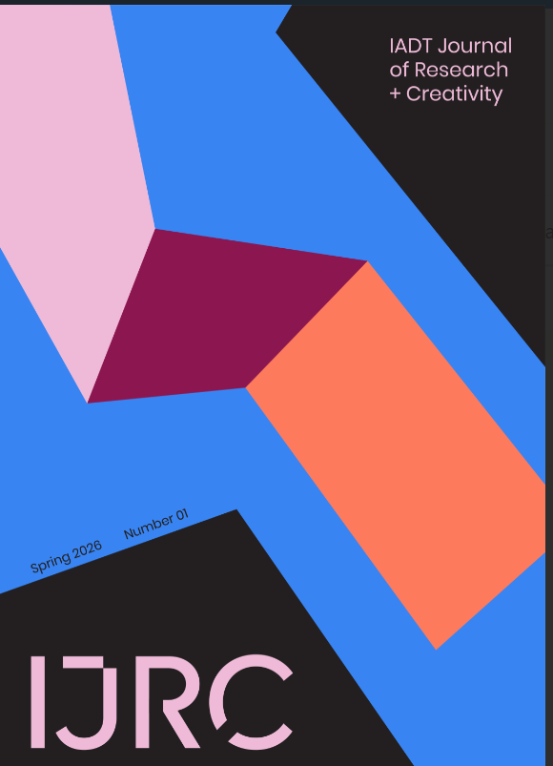

Slide 16
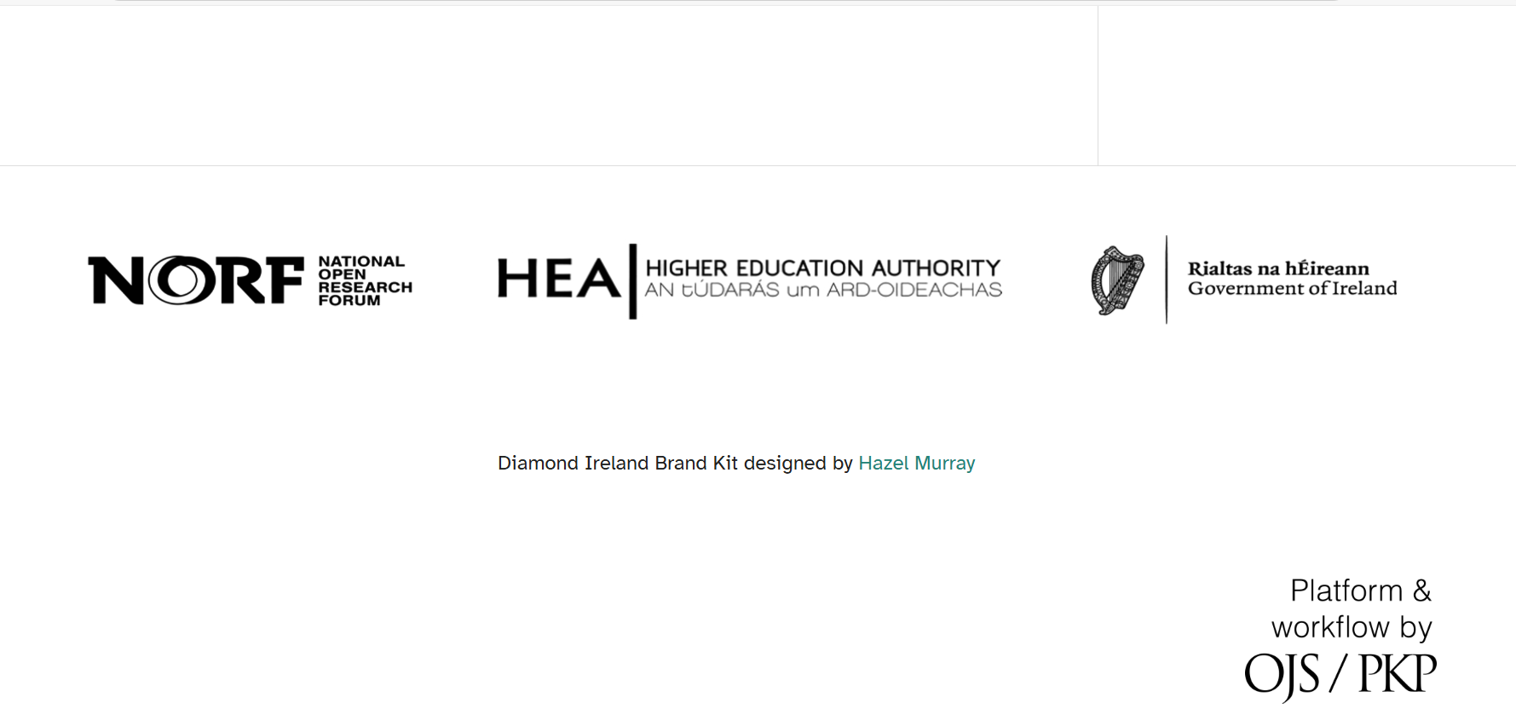

Slide 17
Shared Stewardship Model
Libraries and academics as co-stewards of scholarly communications
Collaboration, capacity-building, and mutual responsibility
Recognising distinct partnership each partner brings
Partnership[-based governance ensuring long-term visibility

Slide 18
Core Principles
Bibliodiversity and cultural diversity preservation
Publishing ethics and equitable access to knowledge
Editorial independence maintained
Community-governed publishing at scale

Slide 19
Beyond Infrastructure
Sustaining diverse scholarly record requires more than removing author charges
Infrastructural frameworks
Educational support and capacity building

Slide 20
Impact and Vision
Viable, practical route to achieving OA through the Diamond model
Extending options for authors and funders for OA compliance
Ethical, sustainable, high-quality Irish OA publishing
Contributing to inclusive, resilient, diverse OA landscape
Connecting with the European Diamond Capacity Hub

Slide 21
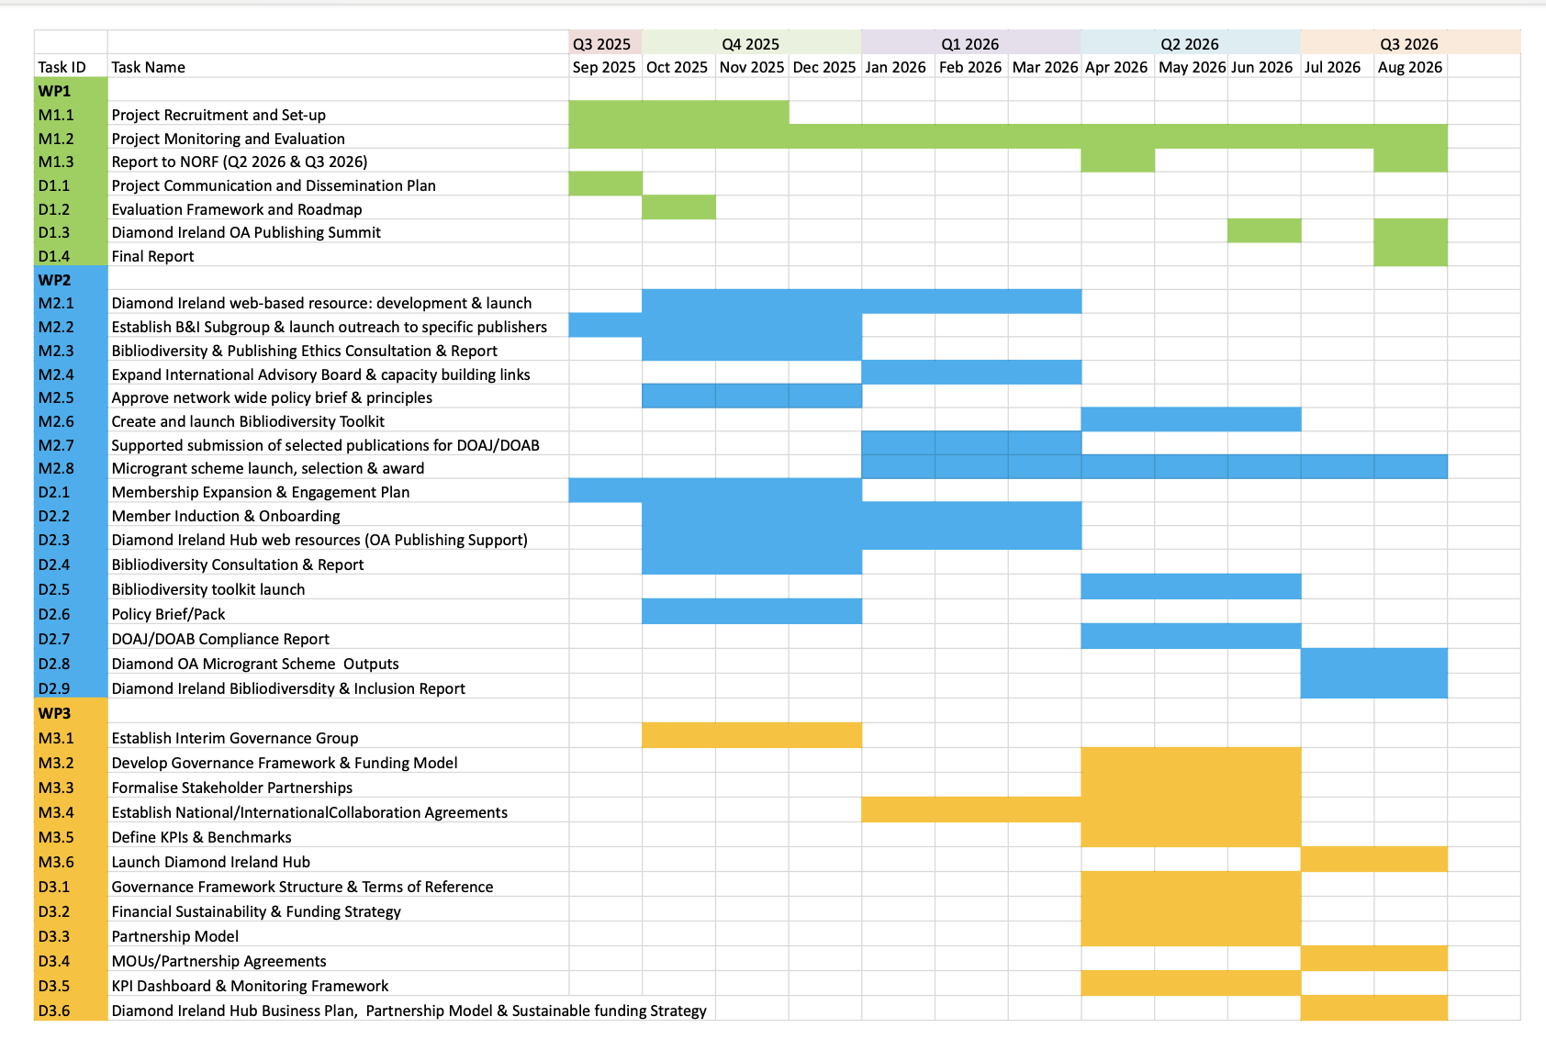
Gant Chart

Slide 22
Key Resources - PublishOA
Diamond OA platform pilot and feasibility report (Zenodo: 15311004)
Landscape report on scholarly publishing in Ireland (Zenodo: 15721574)
Directory of Irish Diamond OA Journals (Zenodo: 15607985)

Slide 23
Thank You
Contact: jane.buggle@iadt.ie
Convenor: IFLA Library Publishing Section
Manager/Co-founder: Irish Open Access Publishers (IOAP)
IADT Pure Profile: Jane Buggle - Institute of Art, Design + Technology

