Slide 1


A&SL 2026
Choosing What Matters
Enacting Library Values Through Strategy in a Small HE Library
Genevieve Larkin
Head of Library Services, Marino Institute of Education Library
Notes:
This presentation reflects on a question that many of us are facing in our libraries: what does it mean to practise librarianship when expectations continue to grow, but capacity does not?
For many libraries, the challenge is not a lack of ideas or ambition. In fact, quite the opposite. We’re a profession that loves to learn, experiment, and improve what we do. The difficulty is that we simply can’t do everything we might want to do. So the question becomes one of judgement: what do we prioritise, what do we defer, and what do we choose not to pursue?
This talk isn’t really about a specific set of services. Instead, it looks at how one small library approached strategic decision-making over several years and how professional values helped guide those choices. The key argument is quite simple: reimagining librarianship today may be less about expanding what we do, and more about making deliberate, values-informed decisions about what matters most and where we need to set limits.

Slide 2

Context
Small Institution
Rapid Technological Change
College of Education
Adapting to evolving digital tools and
information landscapes.
Lean Staffing
Constraints
Operating with a limited team, emphasizing efficiency and multi-skilling.
Acknowledging and working within inherent
limitations.
Broad Service Expectations
Meeting diverse needs across the academic community.
Notes:
By way of context, the library I’m describing is a small HE library within a specialist institution.
Like many libraries of this size, we operate with a lean staffing model while supporting a wide range of teaching, learning, and research activities.
At the same time, the environment around us has been changing rapidly, particularly in relation to digital infrastructure, user expectations, and the expanding role of libraries in areas such as research support and open publishing.
So the challenge was how to respond to those changes in a way that was realistic and sustainable for a very small team. And that is really where the question of strategic choice begins to emerge.

Slide 3
Choosing What Matters
Making choices when capacity is limited
What do we prioritise?
What do we defer?
What do we stop doing?
Notes:
In practice, librarianship increasingly involves deciding where to direct our effort.
Identifying essential services and tasks that must be maintained.
Determining which initiatives or tasks can be postponed without significant impact.
Deciding on services or activities that are no longer feasible or critical.
So the question becomes: what do we prioritise, what do we defer, and what do we choose not to pursue? I personally would love to hear more about how other librarians make these decisions.

Slide 4




Core Values
Guiding Principles for Strategy and Practice
Equitable Access
User-informed Development
Care and Responsiveness
Professional Integrity
Prioritising inclusive and reliable access to resources and services.
Shaping services in response to user needs and feedback.
Supporting students and staff in a way that recognises their context and wellbeing.
Making transparent, evidence-informed decisions within available resources.
Notes:
For us, the starting point is our core professional values. Values such as equity of access, user participation, care for our users and community and professional integrity helped guide the way we think about priorities.
But values on their own are quite abstract. The real challenge is translating them into concrete decisions about services and resources.
In practice, that meant using strategy and operational planning as a way of turning those values into clear priorities.

Slide 5
Strategy in Practice
A 5-year operational plan guided the transformation, developed incrementally across multiple, overlapping areas.
Digital Infrastructure
Collections Strategy
Teaching & Research Support
Space & Student
Experience
Enhancing the
technological foundation.
Refining and optimising resource acquisition and
management.
Improving resources and support for staff and students.
Optimising physical and experiential aspects for students.
Notes:
To translate values into action, we worked through a five-year operational plan.
Rather than attempting large-scale change all at once, the plan helped us structure development across several areas of the library.
These weren’t sequential phases - many developments ran in parallel and evolved over time.
For example, work on digital infrastructure - including a new library services platform, authentication, and reading list software - continued throughout the period.
At the same time, we reshaped our collections approach through a new policy, alongside demand-led purchasing and more targeted acquisitions.
Teaching and learning support, and improvements to library space, also developed incrementally as needs emerged - with physical changes informed by UX studies, LibQUAL, and ongoing feedback.
The plan helped us pace this work and make decisions about where to focus effort within the capacity of a very small team. But even with a plan in place, decision-making was rarely straightforward, and often involved difficult trade-offs.

Slide 6



Strategic Tensions
Balancing competing priorities
Access vs. Affordability
Ambition vs. Sustainability
Collections vs. Student Space
Notes:
On reflection, most of our strategic choices were shaped by a small number of recurring tensions.
One was the tension between access and affordability- particularly in a context where we operate outside of national consortia, and where resource costs continue to rise.
Our goal was not only to expand collections but to make sure they were targeted and relevant. We worked with staff and students via new RLS to make sure what we were buying was relevant. We also conducted a huge weed of existing resources and reduced the books on the shelf by a third, making room for both newer acquisitions and enhanced student space.
Another was the tension between ambition and sustainability. There are always new services, technologies, and initiatives that libraries can develop, but not all of them can be supported within the capacity of a small team.
And finally there was the tension between the library as a collection space and the library as a student space, particularly as student expectations around study and wellbeing spaces have evolved.
In practice, strategy meant navigating these tensions and deciding where to place our effort.

Slide 7
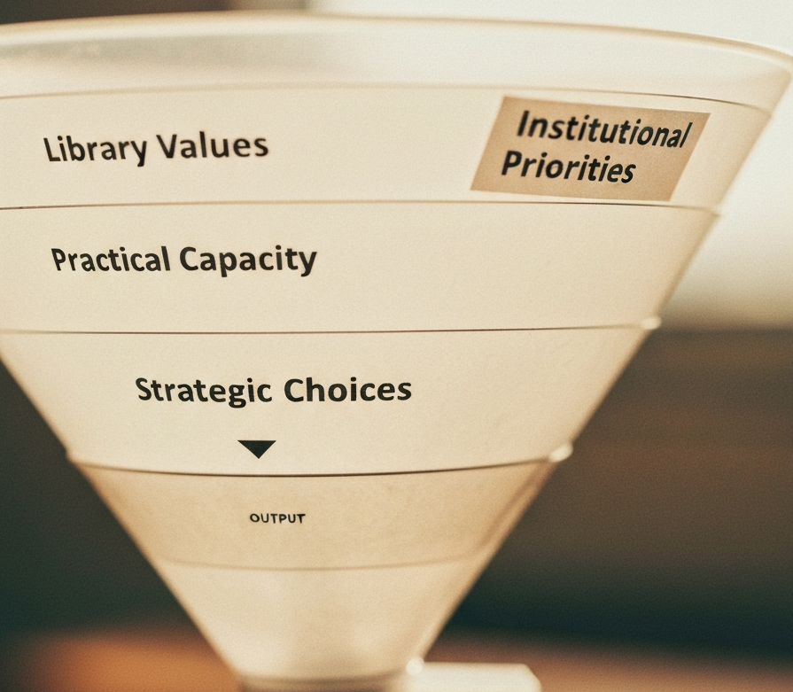
Decision Filter
Ideas become priorities through a filtering process
Library Values
Equity • Participation • Care • Integrity
Institutional Priorities
Teaching • Research • Access • Sustainability • Technology
Practical Capacity
Staffing • Budget • Time • Space
Notes:
In practice, decisions tended to pass through a fairly simple filter.
First, we asked whether a project or initiative responded to a clear user need and aligned with our core library values.
Second, we considered institutional priorities; ensuring that what we were developing supported teaching, research, and the wider student experience.
And finally, we had to look honestly at practical capacity: staffing, time, budget, and space.
Only when something aligned across those three areas did it become a strategic priority.
In that sense, choosing what mattered wasn’t about doing everything; it was about focusing effort where those factors aligned.

Slide 8
Strategic Choices
Digital Infrastructure
  Reliability and access first
  More unified interface
Collections
  Demand-led purchasing
  Access over ownership
Teaching Support
  Clear, sustainable provision
Student spaces & experience
Focused, flexible study environments
Notes:
A priority for us was digital infrastructure. Ensuring reliable access to library systems and authentication became a foundational priority, because without that, many other services simply don’t function effectively for users.
A second area was collections strategy. We moved toward a more targeted approach, including demand-led purchasing, so that resources reflected actual T&L needs rather than attempting to expand collections broadly.
And a third area was teaching and learning support. Instead of offering highly bespoke sessions on request, we consolidated our information literacy provision into a small number of clearly defined and sustainable models.
In each case, the aim wasn’t expansion, but a focus on directing effort where it would have the greatest impact for our users.

Slide 9
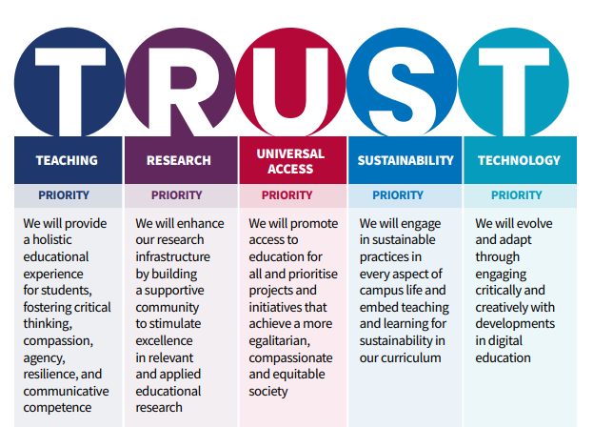
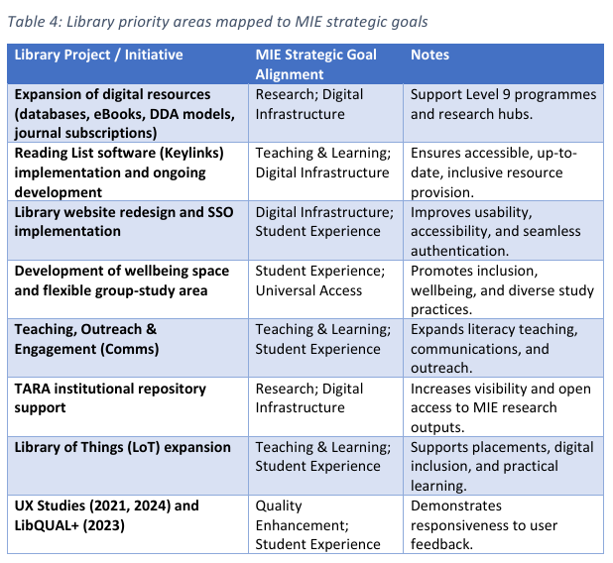
MIE strategic pillars
Notes:
One practical step that helped us was mapping library initiatives over 5 years directly to institutional strategic priorities.

Slide 10
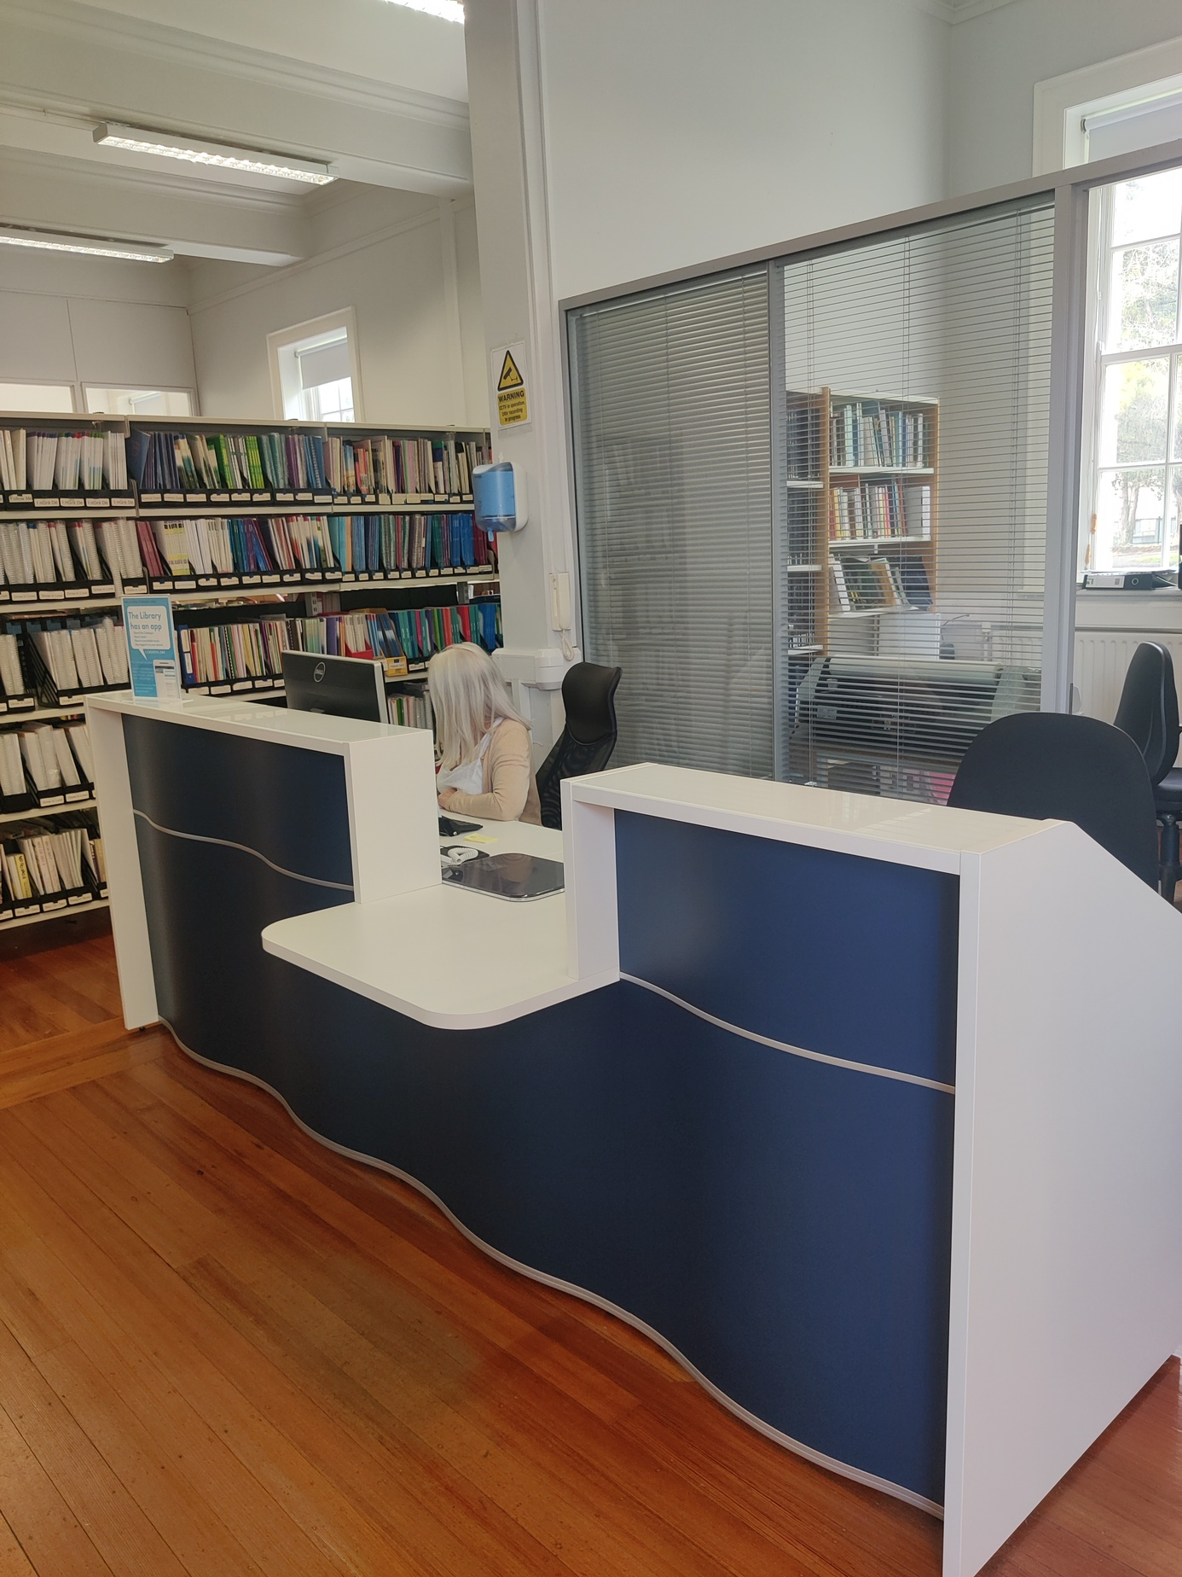
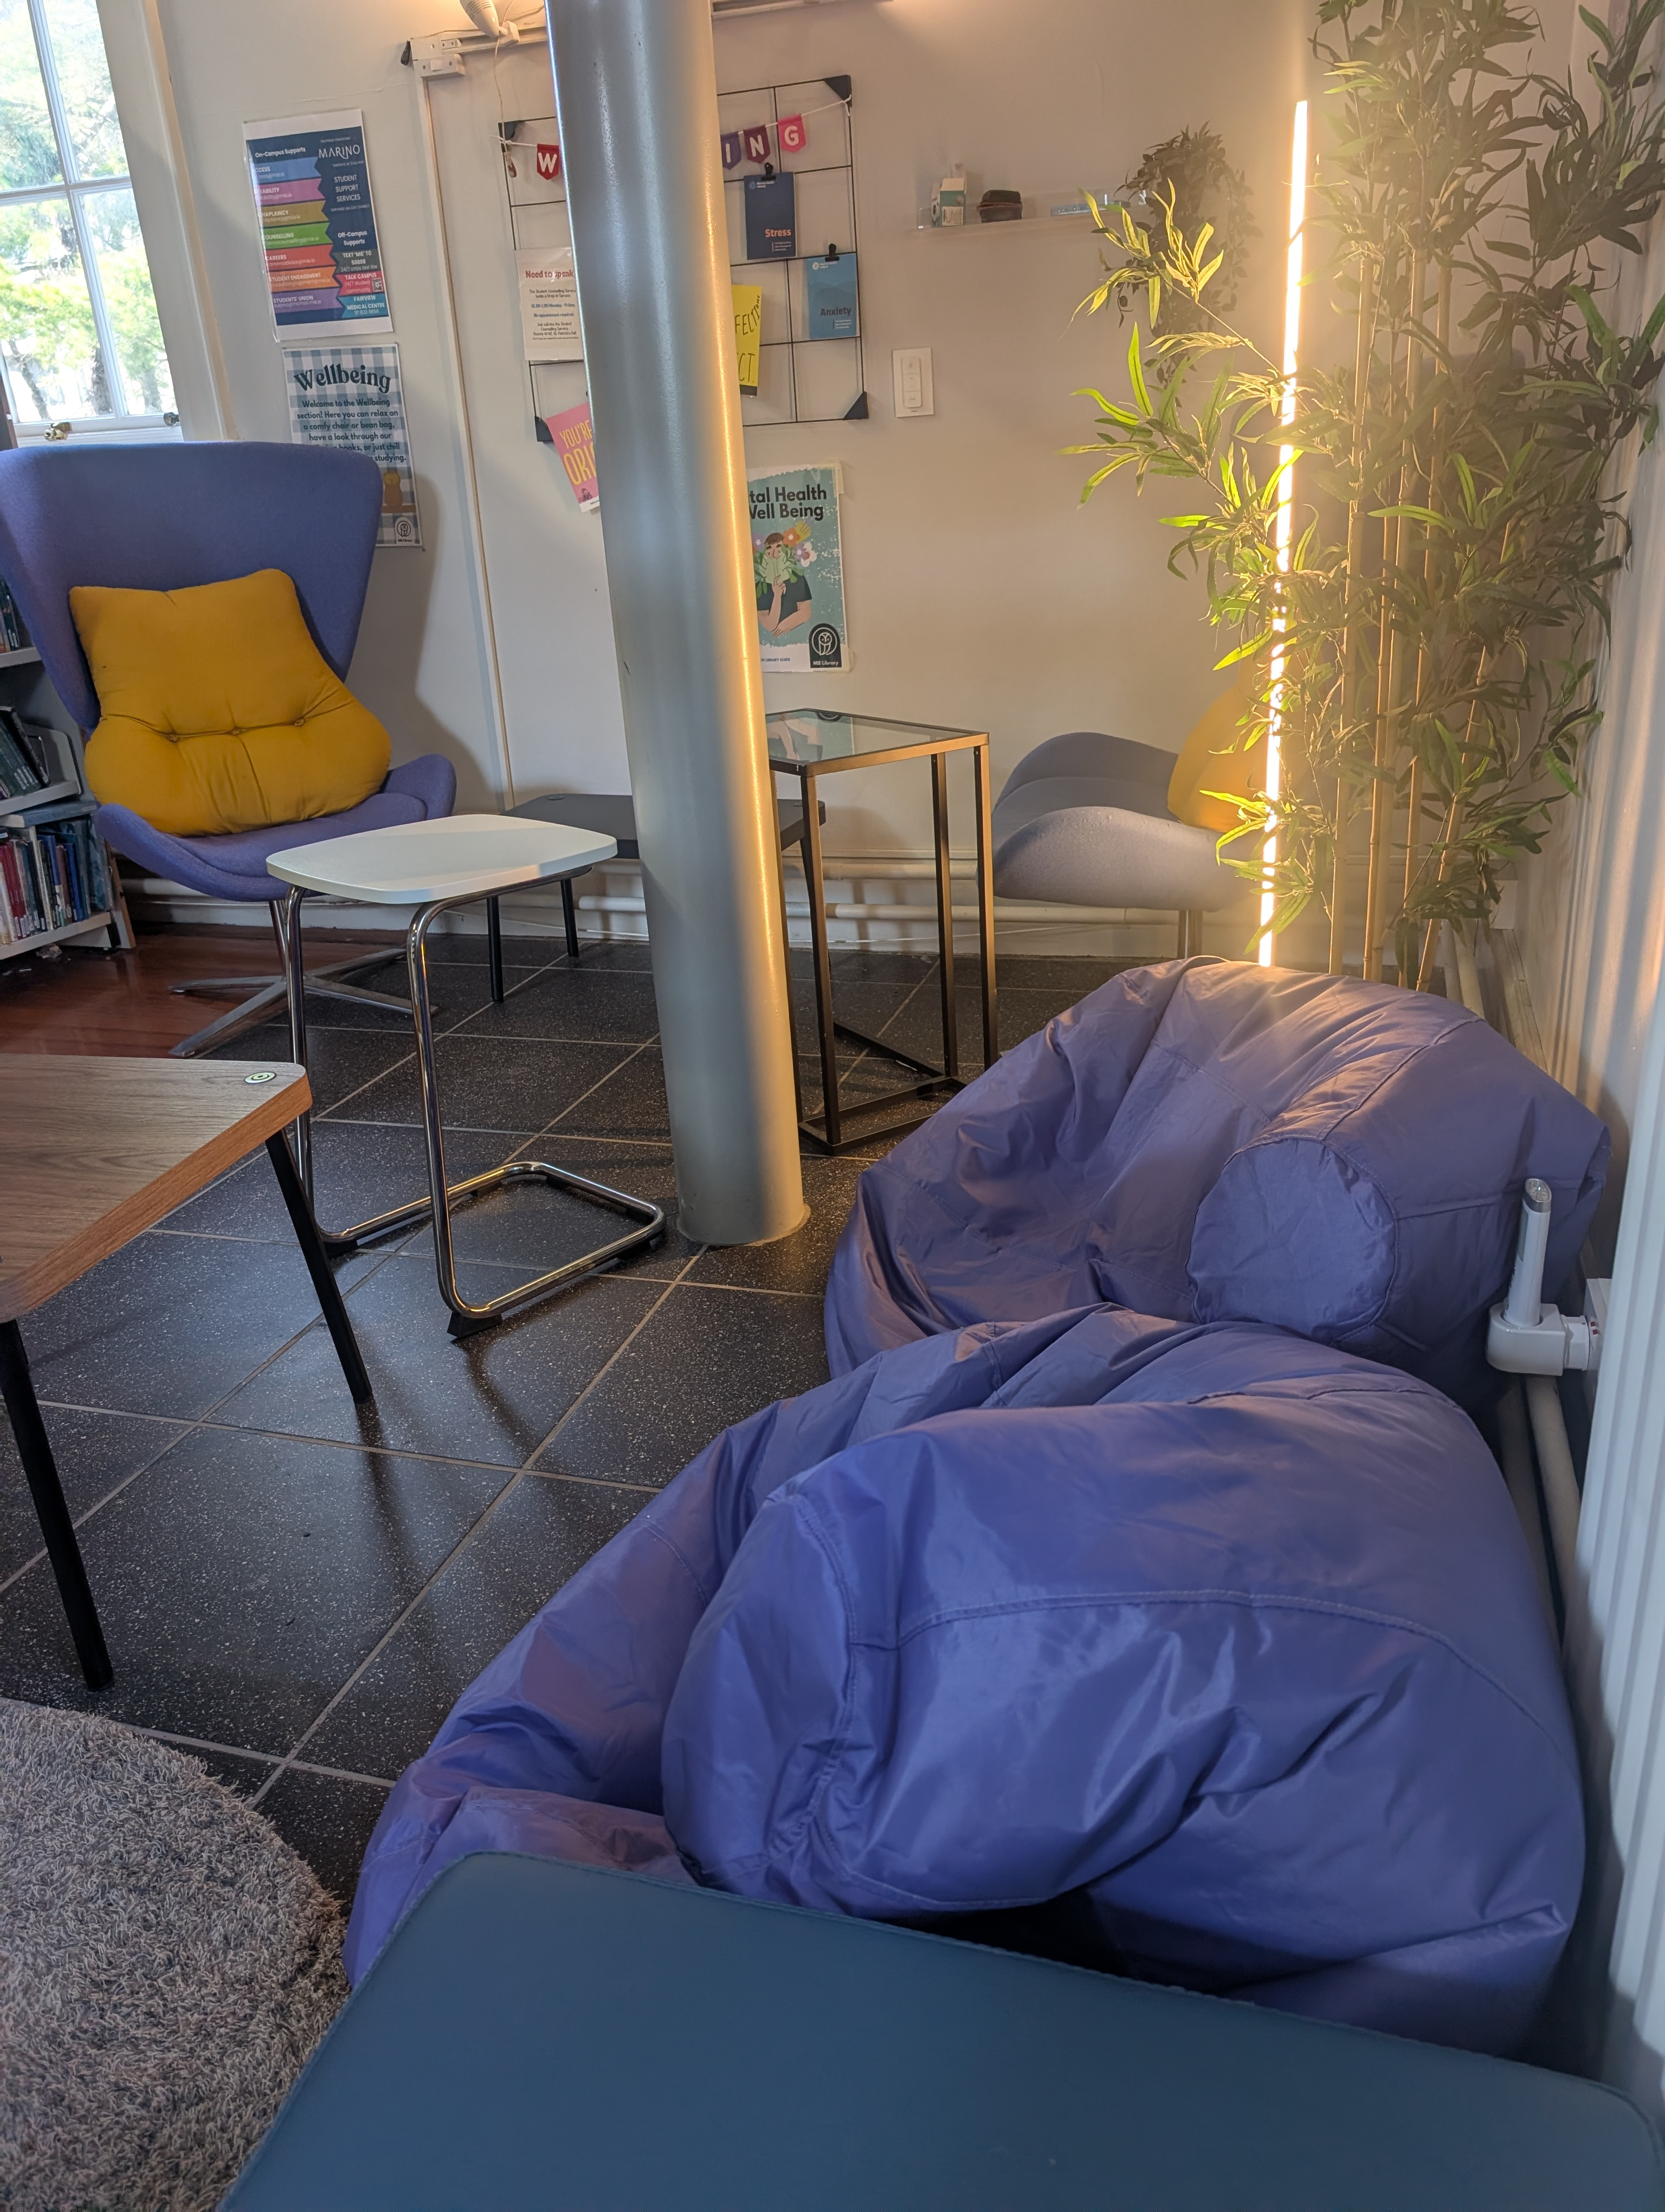
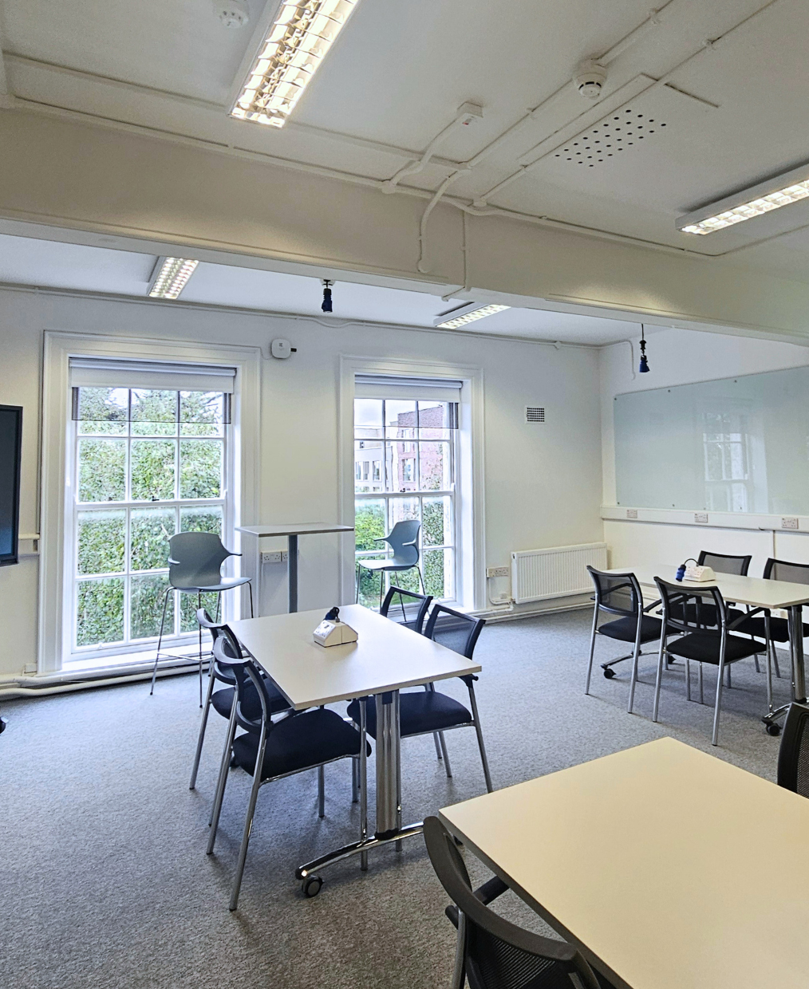
Physical changes
New Library reception
Wellbeing space/reading nook
New group study room
Notes:
We made a number of physical changes to the library space.
These were relatively small in scale, but focused on improving how students use the space day-to-day.
For example, we introduced a wellbeing area, redesigned group study space, and developed a new service point.
These changes were informed by UX work, LibQUAL, and ongoing feedback, and reflect a focus on the library as a flexible student space.
Again, the emphasis was on targeted, achievable improvements rather than large-scale redevelopment.

Slide 11
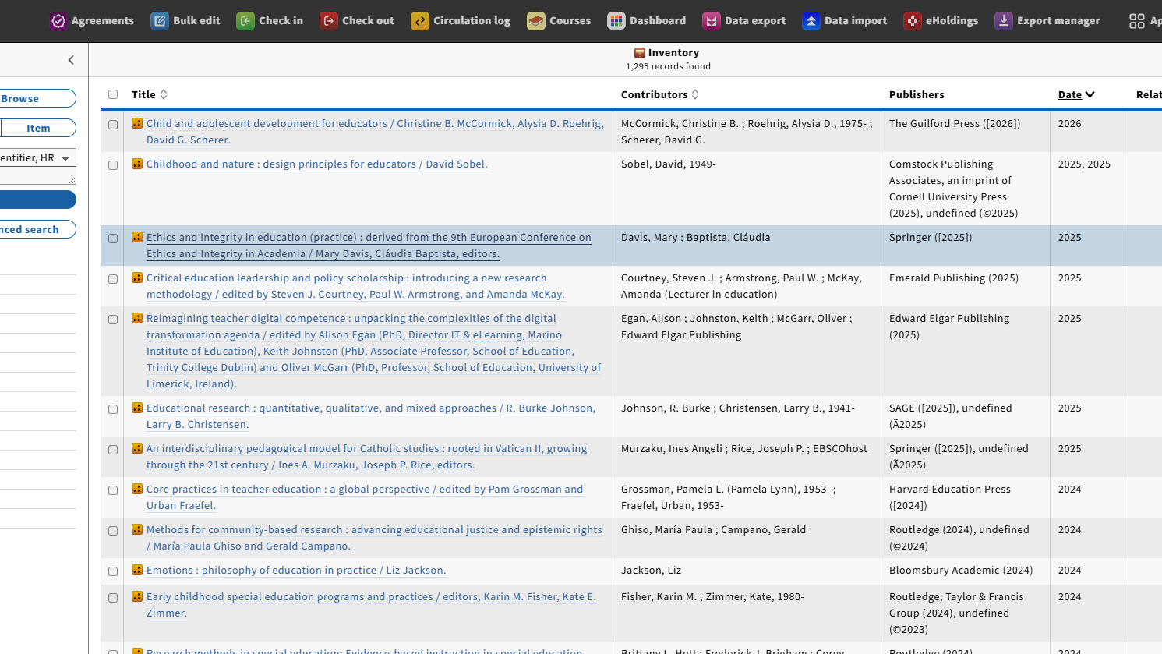
New LSP - FOLIO
Notes:
We migrated to a new library services platform just under three years ago, which was a major project for a small team.

Slide 12
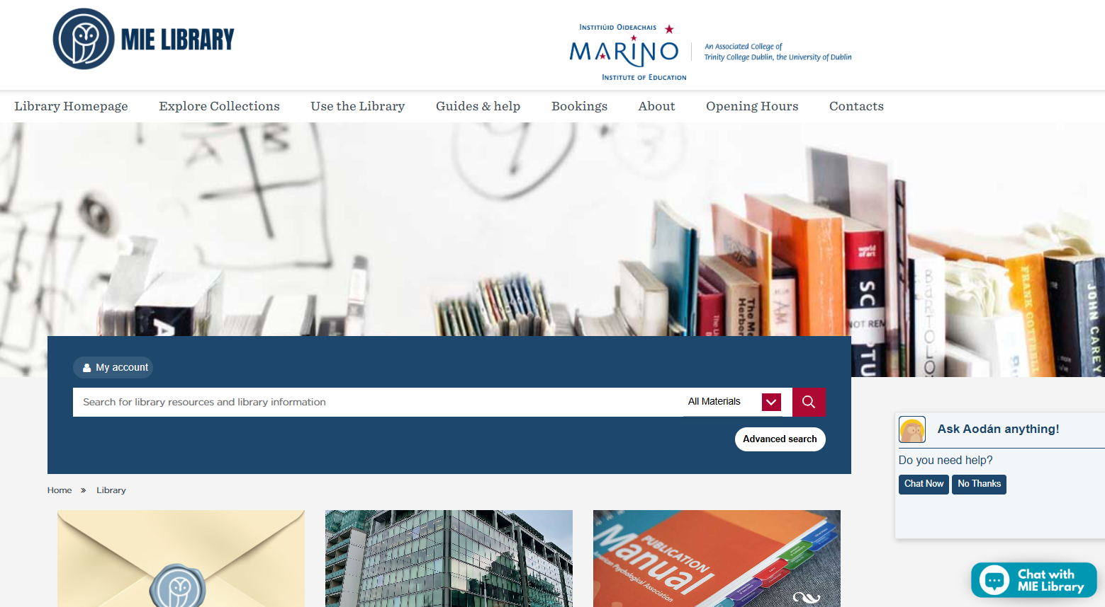
Library website
Notes:
We also made significant changes to the library website following a web UX study in 2024, focusing on improving usability, navigation, and access to key resources.

Slide 13
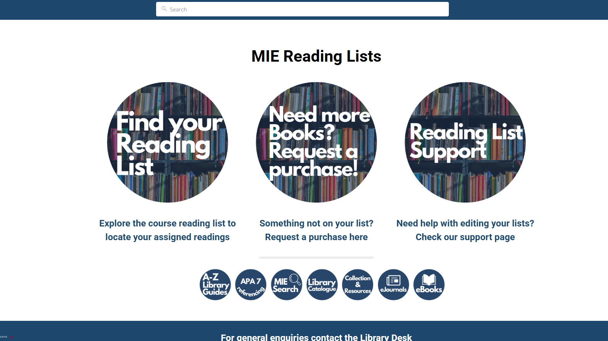
Reading lists
Notes:
We introduced a new reading list system, allowing us to prioritise access to essential course materials and align collections more closely with teaching.

Slide 14
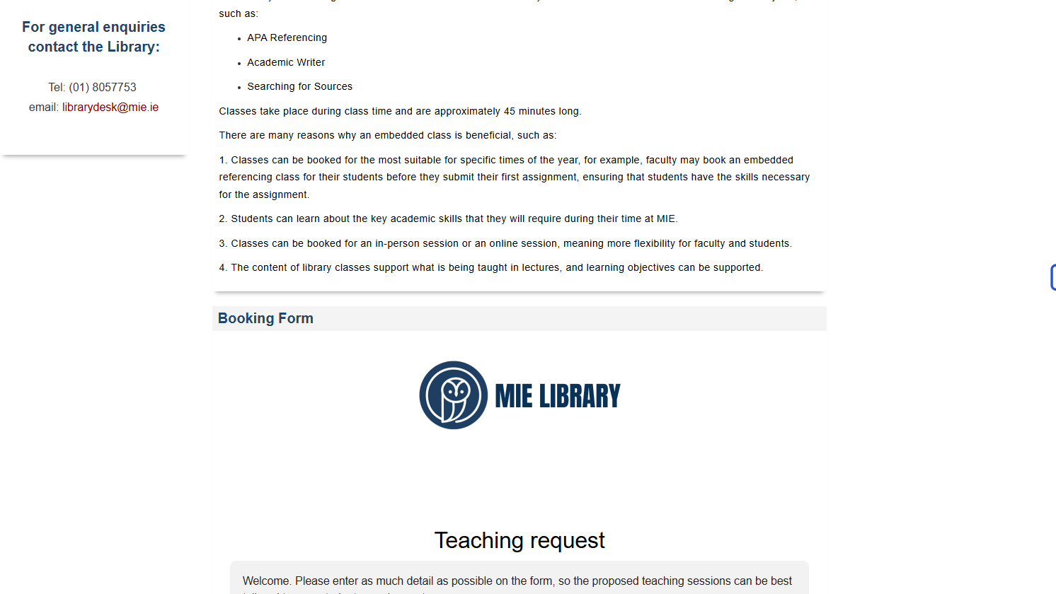
Embedded teaching requests
Notes:
We streamlined our teaching offer, focusing on a small number of clear and consistent models for students and staff.
This helped ensure that what we offered was both sustainable and clearly understood.
We also improved communication around what was available.

Slide 15

Strategic Choices
What we chose not to do - yet
Setting limits:
We chose not to:
  Expand specialist research services before we have dedicated capacity
  Introduce additional platforms until systems are embedded
  Offer fully bespoke teaching provision
Not doing something is also a strategic decision.
Notes:
Services such as research data management, bibliometrics, and digital scholarship are important, but developing them properly requires dedicated capacity.
We made a decision not to expand into those areas until we could sustain them.
That can be challenging, particularly when there is so much innovation happening in those spaces across the sector.
Similarly, there are always new platforms and technologies promising to transform library services and the UX. We adopted a simple principle: if something didn’t significantly improve access for our users, we didn’t introduce it (though we do keep these under review).
Many of us receive requests for new types of library teaching. Instead of responding ad hoc, we consolidated our teaching into a limited set of embedded classes.
And that brings us back to the central idea of this presentation.

Slide 16




The Power of Prioritisation
Strategic "No"
Prioritisation
Intentional Focus
Values-informed decision-making
In a resource-constrained
environment, saying "No" is as important as saying "Yes."
Prioritise what truly matters and allocate resources effectively.
Direct your energy and resources towards key objectives.
Ensure decisions and actions align with core values.
Notes:
Looking back, the most important lesson from this period of development was the power of prioritisation.
In a small library, strategy is not really about doing more. It’s about making deliberate decisions about where to focus effort, and being clear about what cannot be pursued at the same time.
What helped in our case was grounding those decisions in professional values, institutional priorities, and a realistic understanding of capacity.
We are now developing a formal library strategy following a recent QR, building on this work and making that approach more explicit.
Practising librarianship today is not about doing more. It’s about exercising professional judgement: choosing what matters, and having the confidence to set limits.
Thank you.

Slide 17

Thank
you
Genevieve.larkin@mie.ie
www.linkedin.com/in/genevieve-larkin

