Slide 1




BEYOND THE TECHNICAL:
Redefining Librarianship Through A Website Redesign Project
Francisca Silva
franciscaisabel.botelhosilva@dbs.ie
1

Slide 2

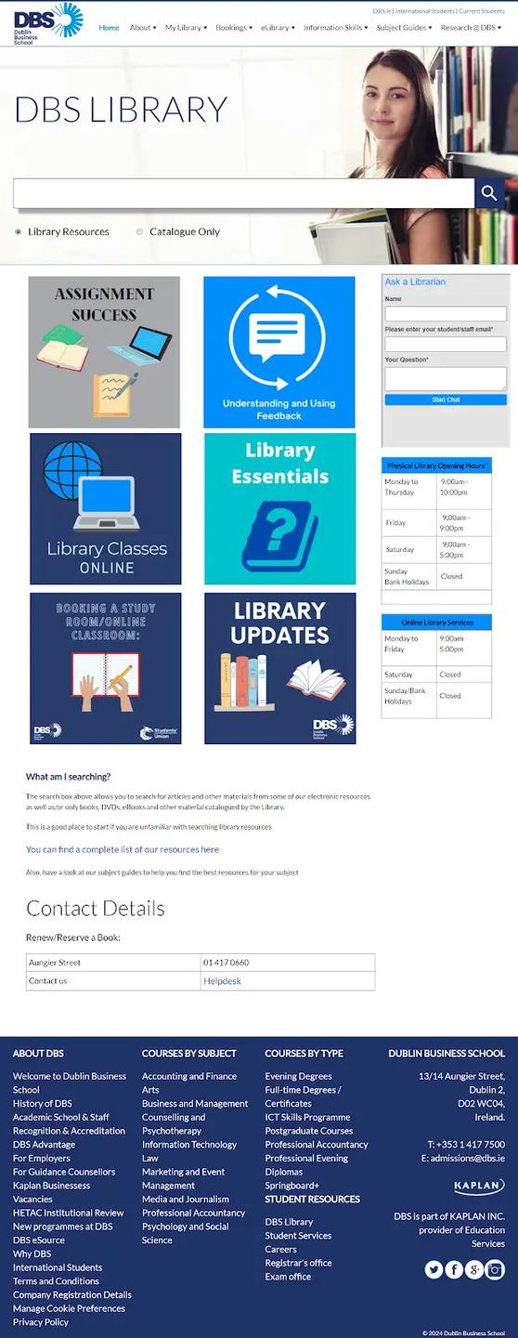
The Need for Change
01.
02.
Two CMSs
Maintenance
The website was hosted in two different CMSs, creating challenges for librarians.
Ownership of the homepage, Issues with institutional CMS and updating the website.
03.
04.
Look and Feel
User Experience
Outdated look and inconsistency of fonts and imagery.
Difficulty in finding information due to website structure and navigation.
2

Slide 3


The Website Redesign Project
2022
2023
2024
2025
START OF THE PROJECT
PROGRESS WITH GUIDES AND UPDATES
NEW SYSTEMS LIBRARIAN
THE FINAL STAGES
3

Slide 4

What do I do?
  Support the patron in finding the information they need.
  User Experience and Information Architecture principles.
  Collaboration as the cornerstone of the project.
4

Slide 5
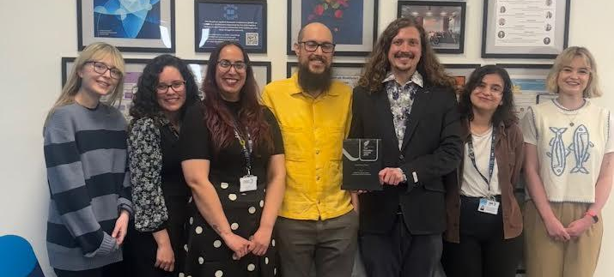
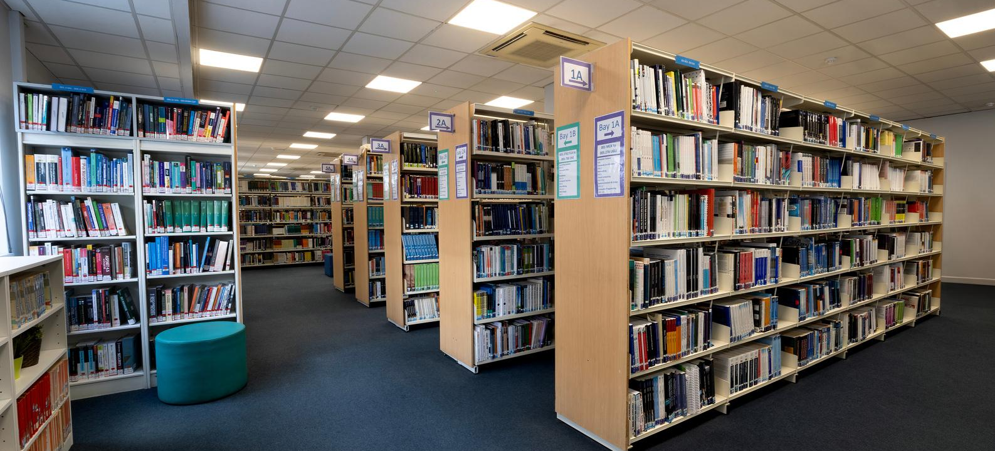
Establishing Procedures & Teamwork
Meet the Team Where They Are
Collaborative Design
Designing procedures and guidelines for the team to address needs and establish long lasting protocols.
Regular meetings and feedback for major elements such as wireframes and navigation (card-sorting exercise).
5

Slide 6

Collaborating with students and making them apart of the decisions was what made this project successful.
User Testing
  Student feedback from different channels.
  Student focus groups (before and after launching the website)
Both contributed to the validation of the website design, and addressed issues found with the organisation of the website.
6

Slide 7





Negotiating Skills
Two CMSs and Partial Ownership
Institutional Stakeholders
UX Data as an Asset
7

Slide 8

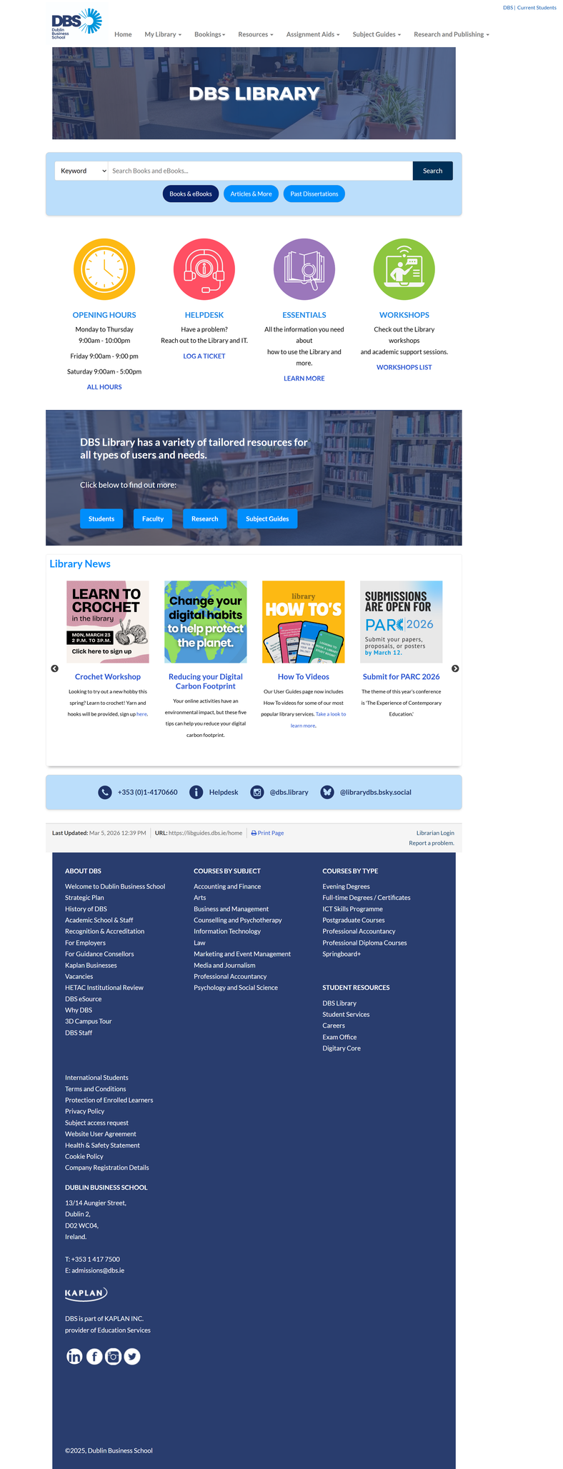

The Homepage Redesign
BEFORE
AFTER
8

Slide 9

What did I learn about Librarianship?
  Beyond the technical and the hard skills.
  User Experience and Information Architecture principles as framework and to rethink the core mission of librarians.
  More than providing resources, librarians need to listen to patrons needs and use that knowledge to design intuitive pathways to resources.
9

Slide 10
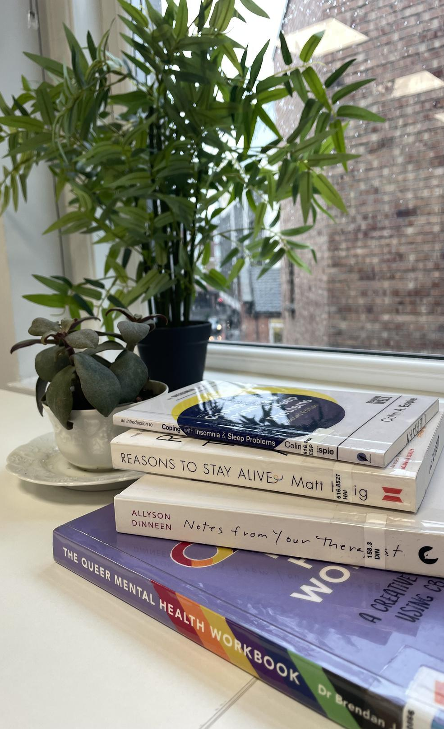


Thank you!
Francisca Silva
franciscaisabel.botelhosilva@dbs.ie
10

