Slide 1
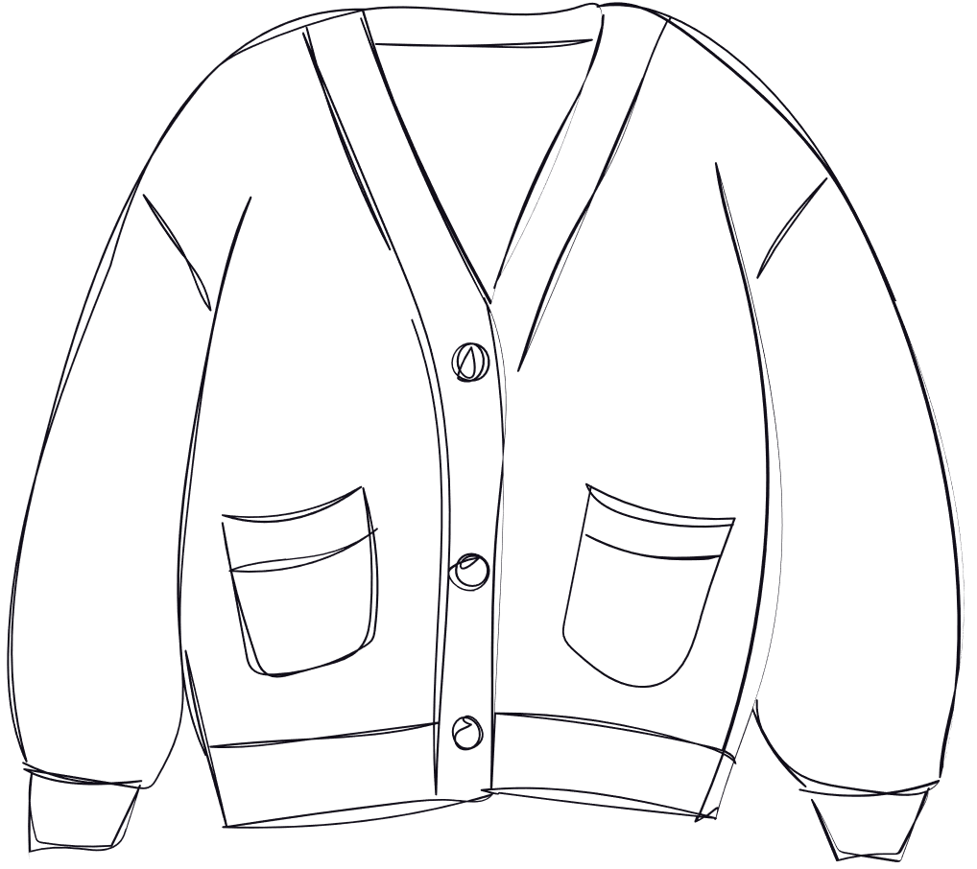


Cardigans and Communications:
balancing traditional curation with outreach demands in 2026

Slide 2
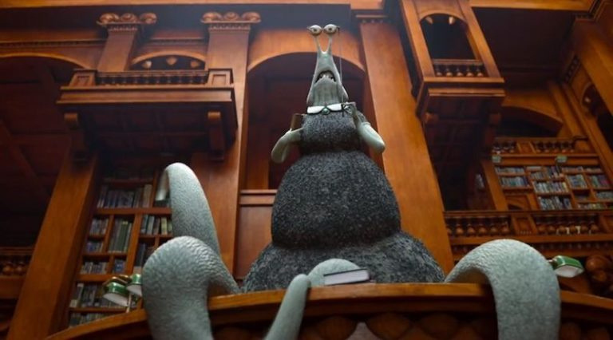
Monsters University (Disney Pixar, 2013)

Slide 3
  Data collection and analysis
  Workflows
  Key partnerships
  Letting the stats speak

Slide 4








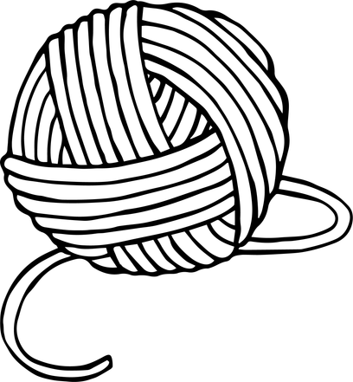
Data collection
  What we already measure
  How we measure it
  What we need to measure
  How to best measure it

Slide 5
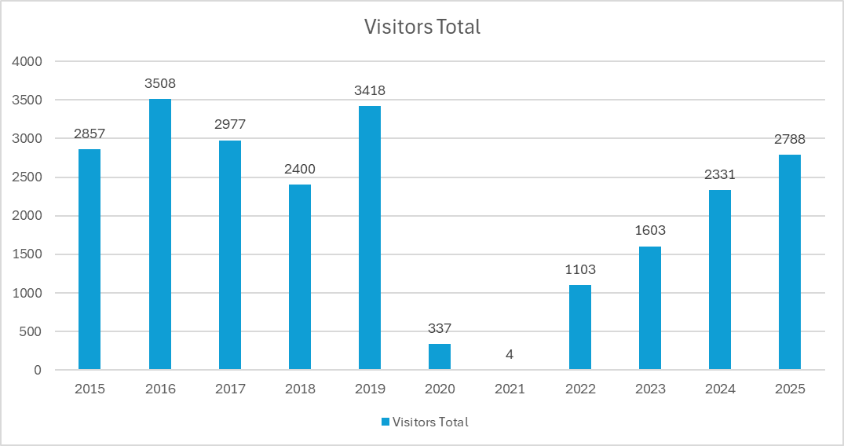

Slide 6
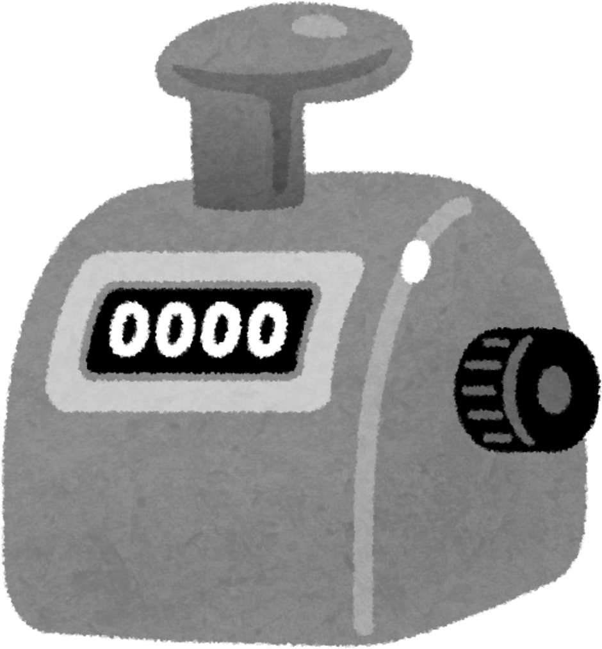
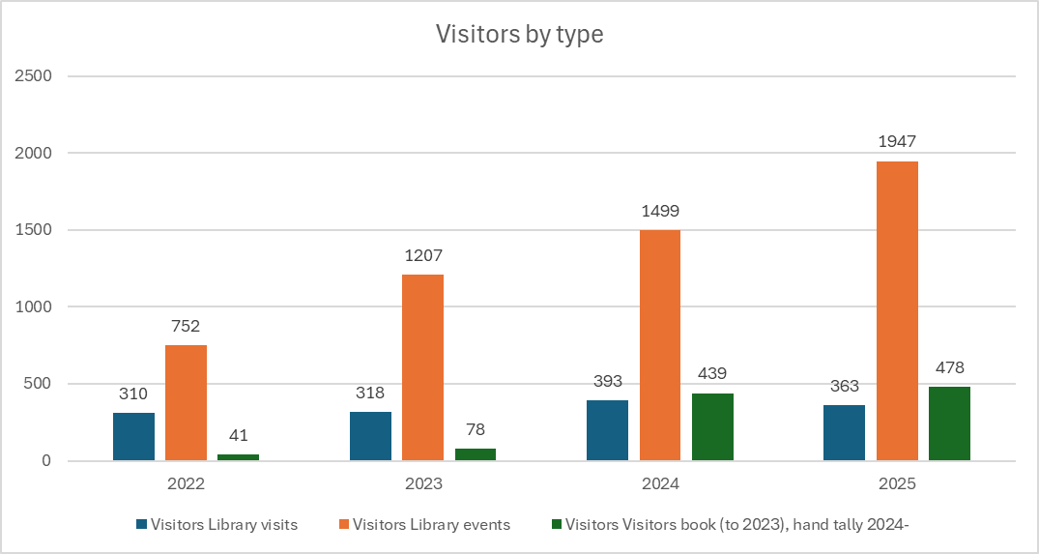
Private groups Public events Drop in visitors

Slide 7
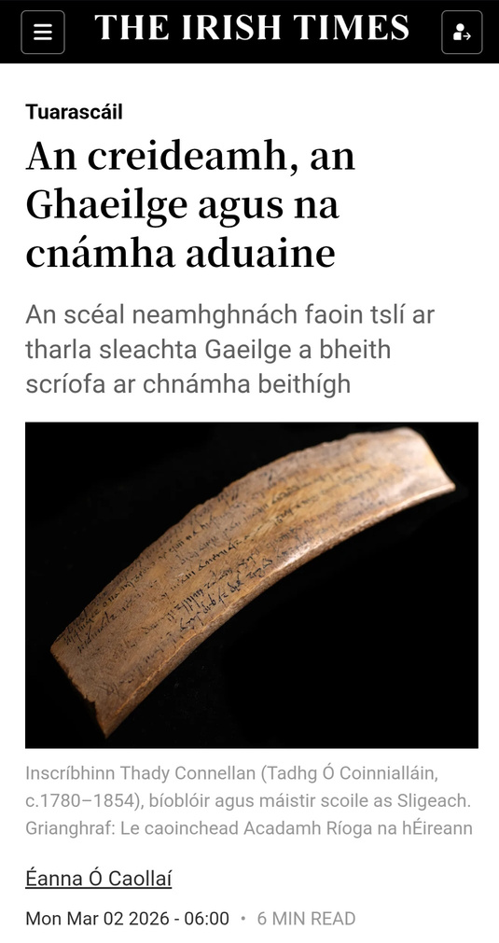
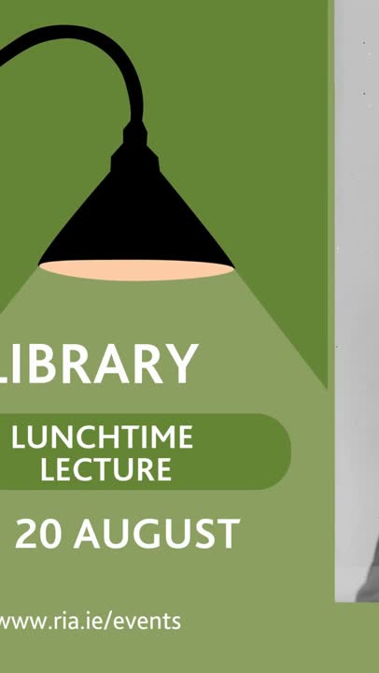
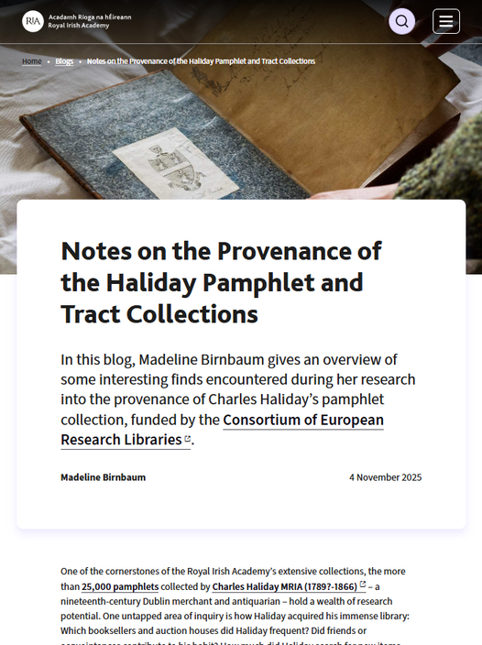
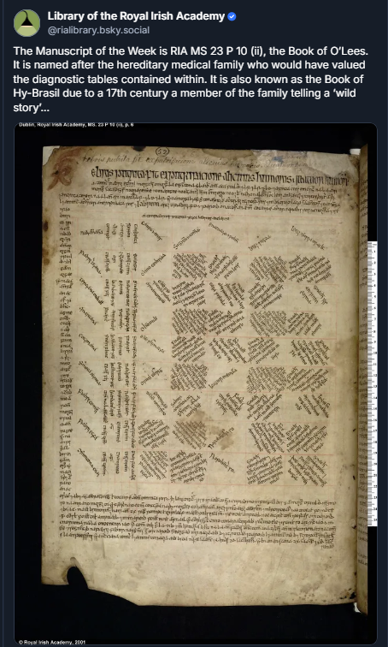

Slide 8
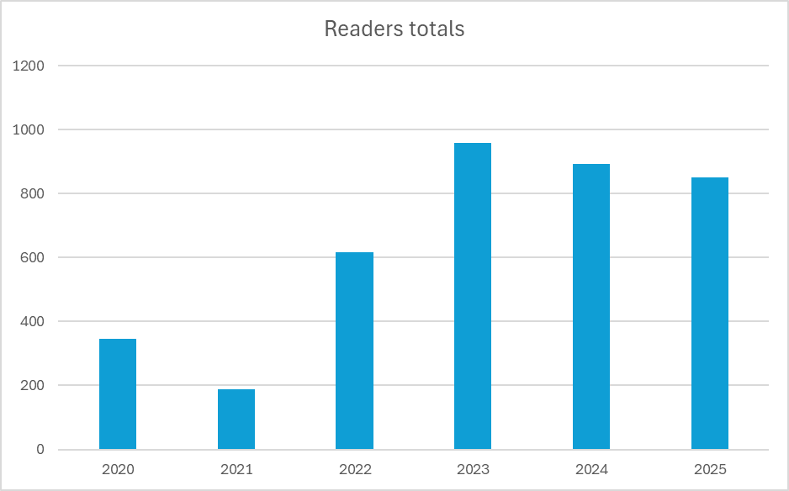

Slide 9
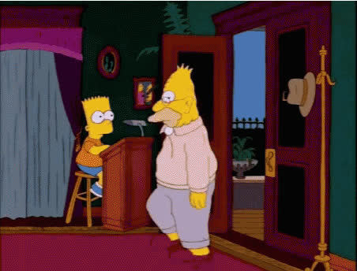
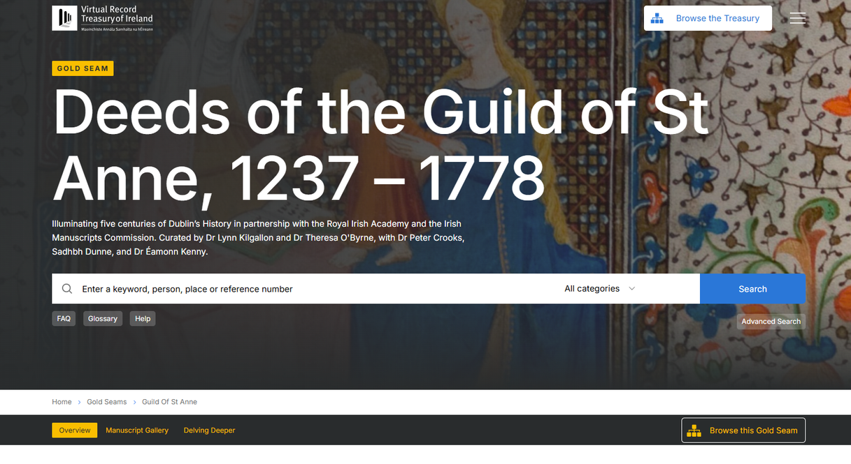

The Simpsons, S08 E05 (Twentieth Century Fox, 2006)
Virtual Record Treasury of Ireland

Slide 10


Workflow
  Nothing is ephemeral
  Year planner

Slide 11
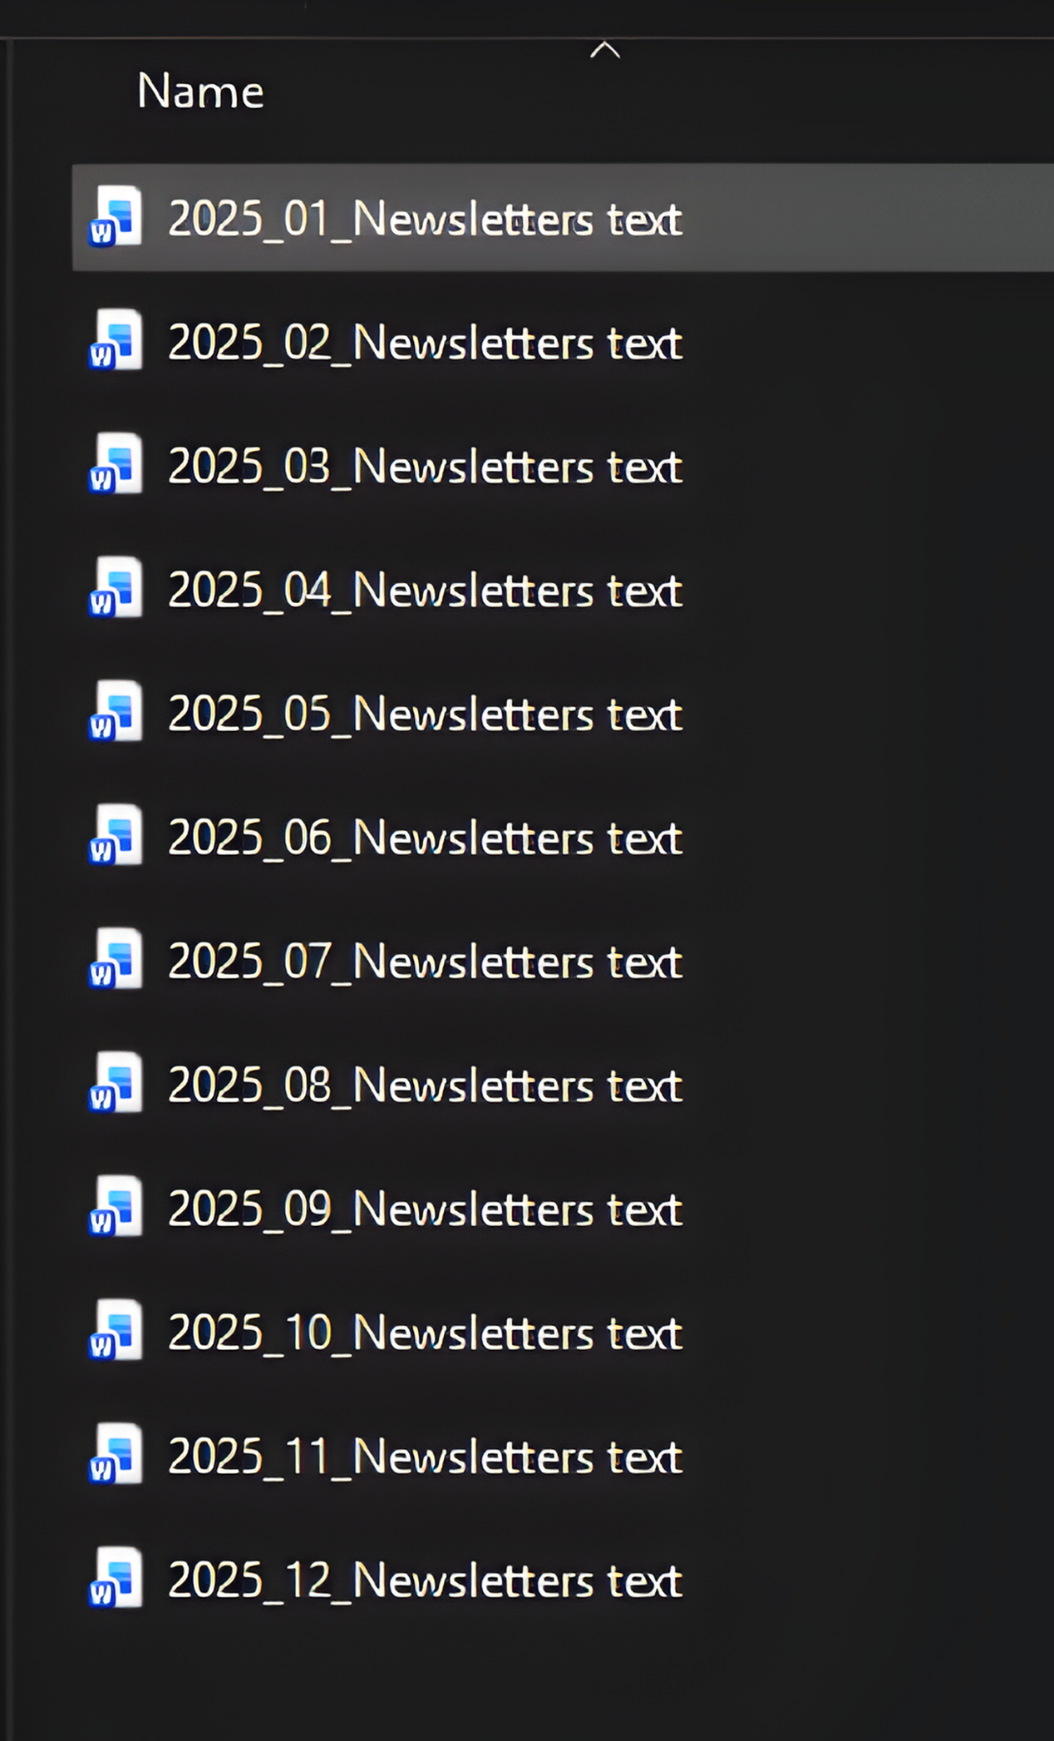
Dec notices for Jan 2025 – Members and Public notices (unless marked for MRIA only)
•
•
•
Christmas closure
Collecting Ireland’s history recording
Exhibition/lecture – Casimir Markievicz
Next notice potential content – i.e. Jan notices for Feb
•
•
Lecture recording?
SnaG lecture
Heading
Library closure: 24 December – 4 January
Content
For the Christmas period, the Library will be closed to readers from 12pm, Wednesday, 24 December 2025. We will re-open 10am, Monday, 5 January 2026. For enquiries please email: library@ria.ie. For appointments please visit our booking page.
Webpage link
https://outlook.office365.com/book/RoyalIrishAcademy@ria.ie/?ismsaljsauthenabled=trues/calendar
Caption
RIA Library reading room clock
ALT
Antique clock mounted on a gallery balcony, with roman numerals and the maker’s name on the face, J. Booth & Son. There are stacks of archival boxes on shelves in the background.
Heading
Listen back: Collecting Ireland’s History lecture
Content
This Library Lunchtime Lecture, in collaboration with the Virtual Record Treasury of Ireland (VRTI), explored the diverse approaches to collecting Irish manuscripts of the last 700 years; and the role of libraries in preserving and recovering lost materials. Focusing on collections from the Bodleian Libraries, Cambridge University Library, British Library, National Library Ireland, Trinity College Dublin and the Royal Irish Academy, the talk also addressed the themes presented in the accompanying exhibition.
Webpage link
https://www.ria.ie/audio/collecting-irelands-history-lecture/
Caption
Collecting Ireland’s History exhibition case at RIA Library
ALT
Bird’s eye view into an exhibition case filled with flat paper documents and caption labels.

Slide 12
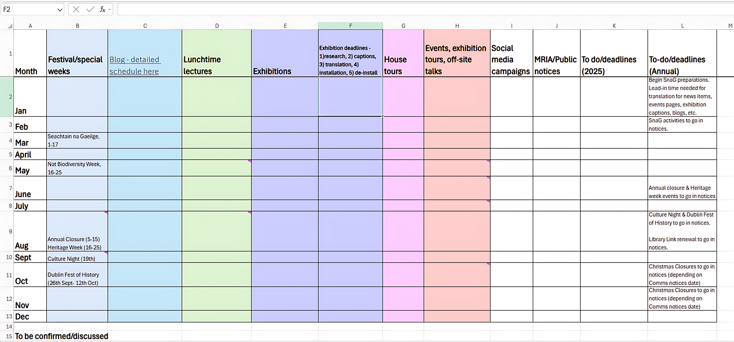

Slide 13


Key partnerships
  Central Comms teams
  Local/national festivals

Slide 14

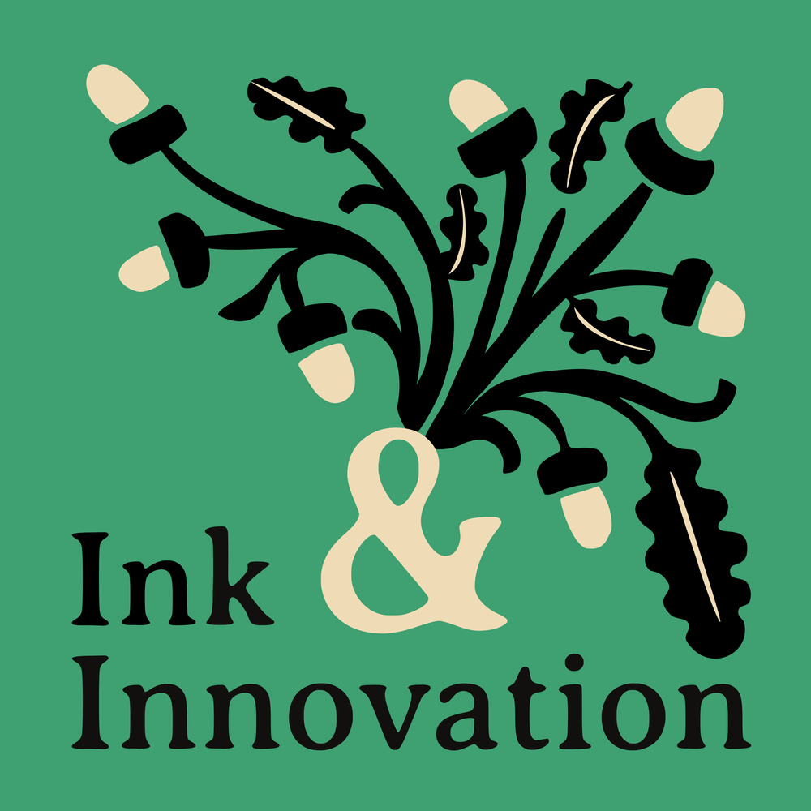



Slide 15
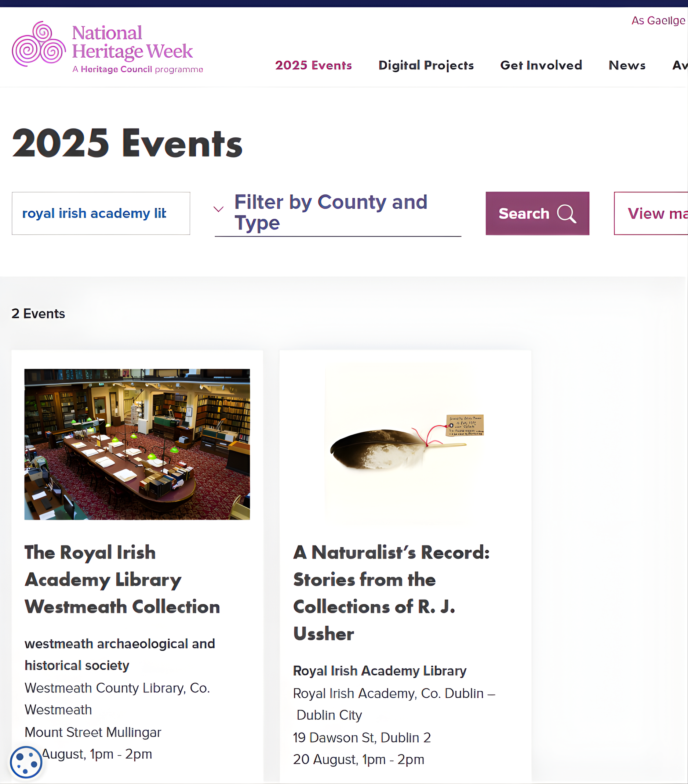
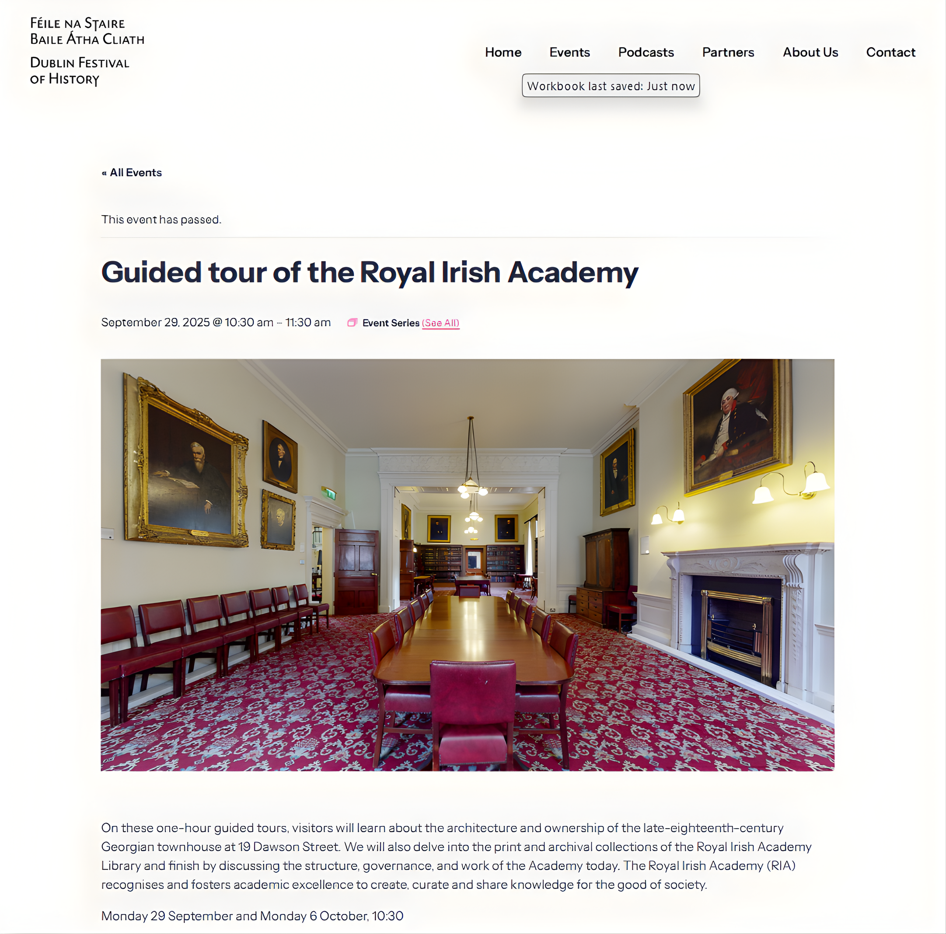

Slide 16


Let the stats speak
  What did we change?
  What did it achieve?

Slide 17
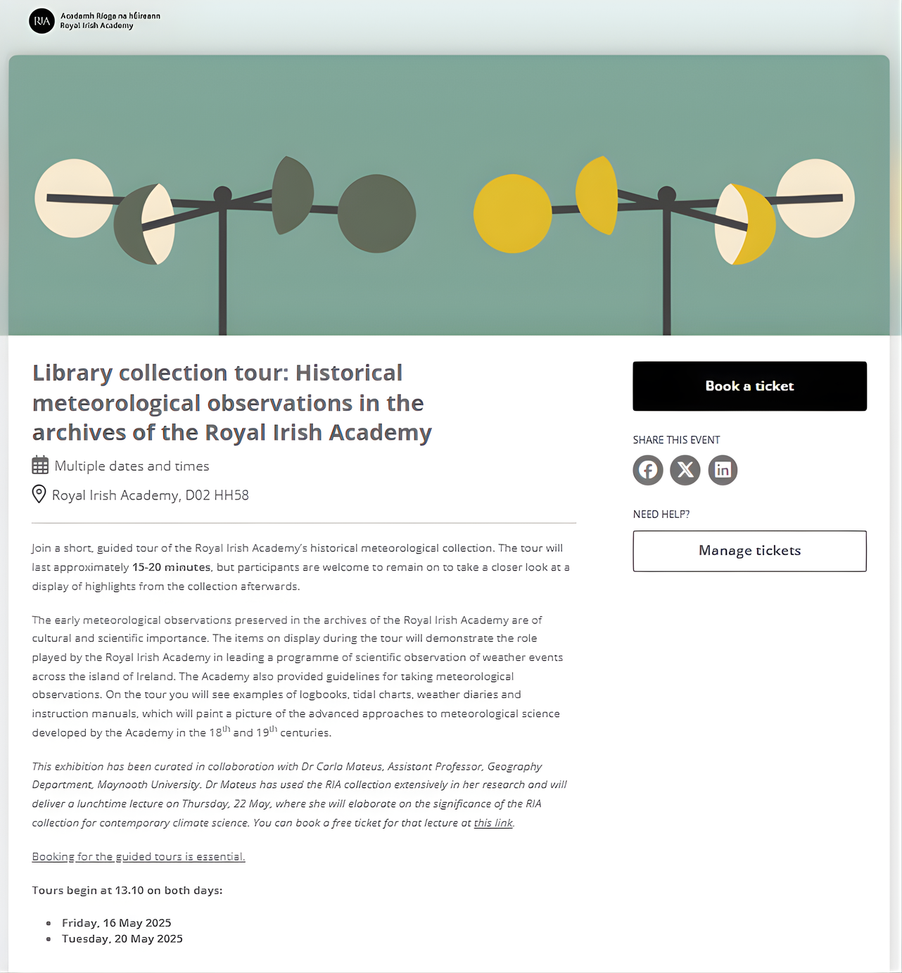
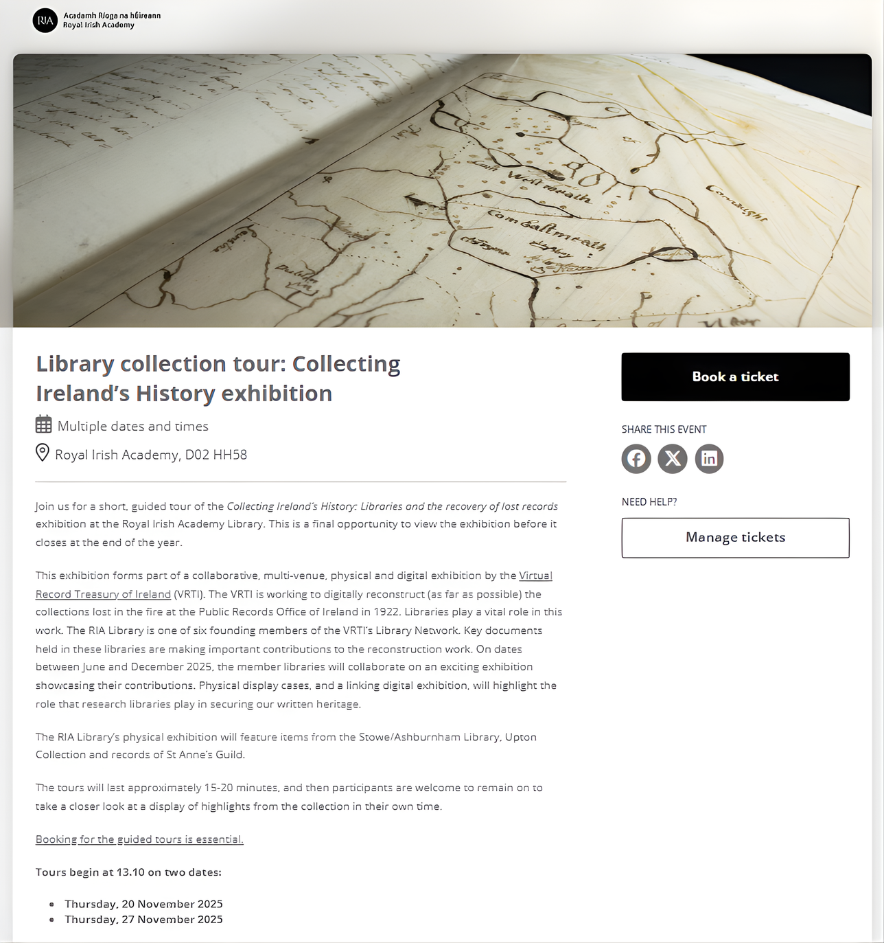
The short, guided tour

Slide 19
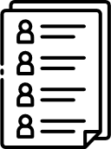

The mailing lists
Libraries/archives
Local history
Nature/biodiversity
Irish language

Slide 20
Cardigans and Communications
e.rothwell@ria.ie

