Slide 1

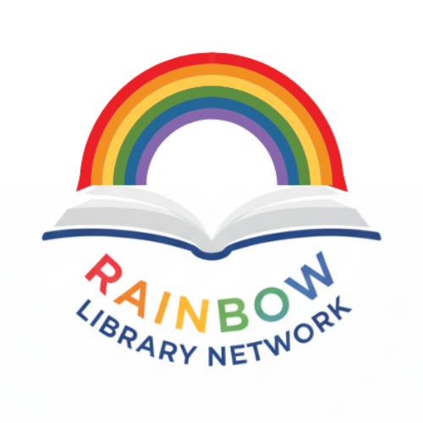
Building Ethical Futures: The Rainbow Library Network and the Evolving Mission of Libraries in a Diverse World
Empowering inclusive knowledge sharing across communities
Notes:
---

Slide 2
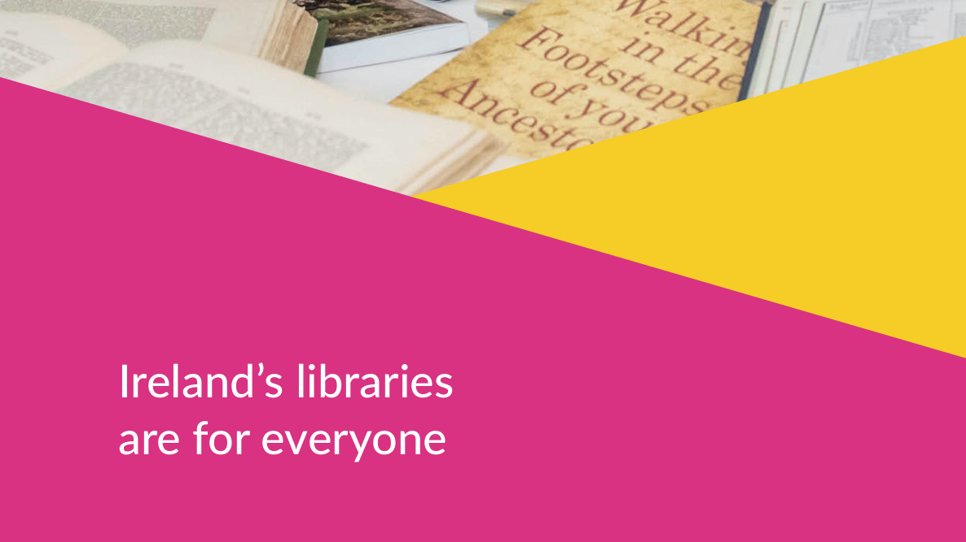
https://lgma.ie/en/news/the-library-is-the-place.pdf

Slide 3

Ethical Principles Underpinning Librarianship
Equity of Access
  Libraries ensure everyone can access information regardless of background, identity, or socioeconomic status.
Intellectual Freedom
  Libraries protect the right to read and think freely without censorship, supporting democratic engagement.
Inclusivity and Respect
  Libraries create welcoming spaces that affirm differences related to gender, race, and ability.
Community Care and Responsibility
  Libraries nurture wellbeing and dignity, balancing ethical challenges amid social and political tensions.
Notes:
At the heart of modern librarianship lie ethical principles that have shaped the profession for decades and continue to influence how libraries serve increasingly diverse communities. These foundational values—equity of access, intellectual freedom, inclusivity, and community care—form the moral architecture guiding daily decision-making in library environments. Equity of access ensures that all individuals, regardless of identity, socioeconomic status, or background, can freely engage with information and cultural resources. Intellectual freedom protects the right to read, think, and explore ideas without fear of suppression or censorship, reinforcing the library as a bastion of democratic engagement. Inclusivity expands this commitment further by emphasising the creation of welcoming environments that respect and affirm differences, particularly those related to gender identity, sexual orientation, race, and ability. Community care encapsulates the responsibility libraries hold not only to provide materials but also to nurture the wellbeing, safety, and dignity of all who enter their spaces. In an era where social polarisation has heightened tensions around public cultural institutions, these ethical pillars face new strains. Debates around contested narratives, identity politics, and shifting public expectations have thrust libraries into the centre of civic discourse. Staff must often navigate ethical dilemmas involving collection development, program curation, and balancing community needs with rising external pressures. The growing prevalence of organised campaigns aimed at restricting access to LGBTQ+ materials—particularly those featuring queer stories or addressing gender diversity—illustrates how ethics are not abstract ideals but lived imperatives affecting real patrons and professionals. Case studies from public libraries in Ireland and abroad reveal that when these principles are upheld, libraries act as transformative spaces of belonging, empowerment, and dialogue. However, when they are compromised, communities—especially marginalised ones—lose critical avenues for representation and engagement. As ethical challenges intensify, the profession must reaffirm and reinterpret its core values to suit evolving social landscapes, ensuring that libraries remain resilient, responsive, and ethically grounded institutions committed to justice and equity.

Slide 4

Rising Social Polarisation and Its Impact on Libraries
Ideological Conflicts in Libraries
  Libraries face ideological clashes over gender identity, sexuality, and multicultural content, becoming battlegrounds for social polarisation.
Challenges to Neutrality
  Social polarisation challenges libraries' traditional neutrality, creating tension between community needs and vocal opposition.
Staff Wellbeing Impact
  Library staff experience increased anxiety and burnout due to confrontations and misinformation campaigns targeting inclusive programs.
Defending Pluralism and Ethics
  Libraries uphold intellectual freedom by maintaining diverse collections and fostering community dialogue despite opposition.
Notes:
Social polarisation is reshaping public discourse, influencing how cultural institutions like libraries function and are perceived. In recent years, libraries have increasingly become focal points for ideological conflicts, particularly around issues of gender identity, sexuality, and multicultural representation. Far-right activism in Ireland and other countries has fuelled an atmosphere of hostility toward certain library materials, events, and displays, with queer literature and LGBTQ+-themed programs drawing disproportionate scrutiny. This agitation often manifests in protests, organised misinformation campaigns, or direct confrontations with library staff, creating an environment in which professionals must simultaneously perform their roles and safeguard their own emotional and physical wellbeing. The intensification of these pressures undermines the long-standing position of libraries as politically neutral spaces and challenges the assumption that information access is a universally accepted good. Instead, libraries find themselves navigating contested territory where community needs and ethical mandates may conflict with vocal opposition groups. These dynamics have a chilling effect on programming decisions, particularly when staff fear backlash for hosting inclusive events or maintaining diverse collections. Furthermore, the emotional toll on staff cannot be understated; reports have cited increased anxiety, burnout, and feelings of professional vulnerability. Yet these challenges also highlight the essential role libraries play as defenders of pluralism and intellectual freedom. By continuing to offer materials representing a full spectrum of identities and experiences, libraries counteract the exclusionary narratives promoted by extremist groups. Social polarisation thus becomes not only a barrier but an impetus for reaffirming professional ethics. Libraries must adopt proactive strategies—such as staff training, policy reinforcement, and community dialogue facilitation—to remain resilient. These efforts ultimately underscore the importance of creating structures of support, such as professional networks, to help staff navigate polarised climates while upholding the core values of librarianship.

Slide 5
Formation and Purpose of the Rainbow Library Network
Notes:
Origins and Significance of the RLN, Mission and Core Activities of the RLN

Slide 6
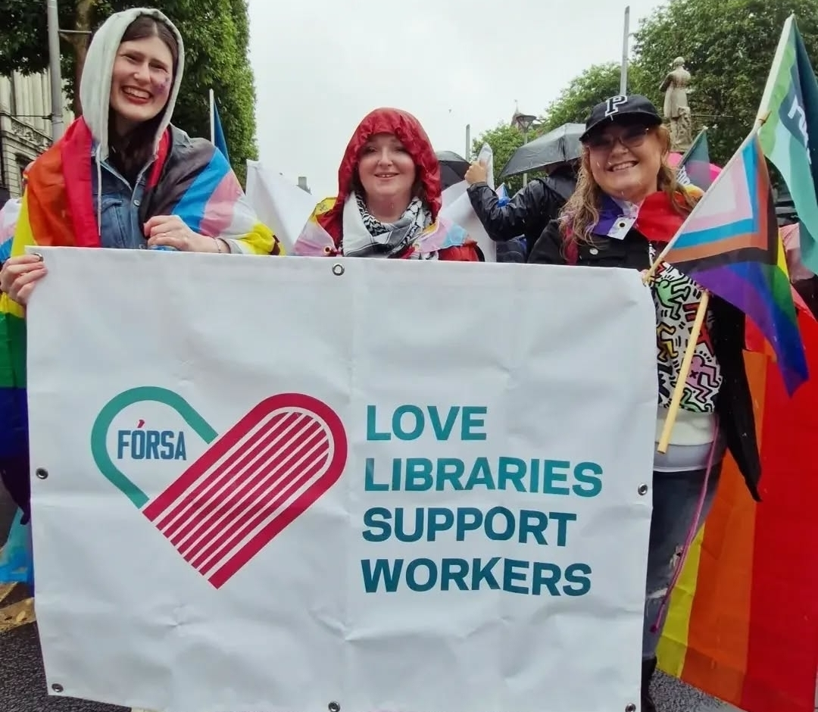
Origins and Significance of the RLN
Historic Formation
  RLN is the first LGBTQ+ network in the Library Association of Ireland, marking a historic milestone.
Addressing Challenges
  The network responds to hostility toward queer materials and supports LGBTQ+ library staff wellbeing.
Commitment to Inclusivity
  RLN promotes equity across collections, programming, and staffing aligned with ethical principles.
Fostering Belonging and Solidarity
  The network builds belonging, empowering marginalised voices and enhancing cultural competence.
Notes:
The establishment of the Rainbow Library Network (RLN) within the Library Association of Ireland marks a historic moment in the progression of Irish librarianship. As the first LGBTQ+ network within the Association, the RLN represents a deliberate and ethically grounded intervention shaped by both professional values and broader societal needs. Its formation was catalysed by mounting concerns among library professionals regarding rising hostility toward queer materials, the wellbeing of LGBTQ+ staff, and the wider climate of cultural contestation. By creating a formal space where LGBTQ+ library workers and allies can connect, the RLN acknowledges the unique experiences and challenges faced by queer professionals—experiences that were long underrepresented or overlooked within the broader professional landscape. The significance of the RLN extends beyond symbolic representation; it embodies a commitment to embedding inclusivity into the structural fabric of the profession. This includes advocating for equitable representation across library collections, programming, and staffing. The network’s founding aligns closely with ethical principles such as intellectual freedom, equity, and community care, translating them into actionable strategies and supports. The RLN also serves to counteract the isolation many LGBTQ+ professionals may experience in their workplaces, particularly in regions where social attitudes toward queer identities remain conservative or where institutional support is inconsistent. As a professional body, the RLN fosters belonging, solidarity, and shared purpose. Its formation creates a ripple effect that strengthens not only individual practitioners but the sector as a whole by promoting diversity, empowering marginalised voices, and enhancing the cultural competence of library services. Ultimately, the RLN’s origins reflect a turning point: a recognition that professional ethics must be lived collectively and intentionally, especially in a social climate where diversity and inclusion efforts face intensified scrutiny. In creating this network, the LAI has taken a concrete step toward building more equitable and supportive futures within librarianship.

Slide 7
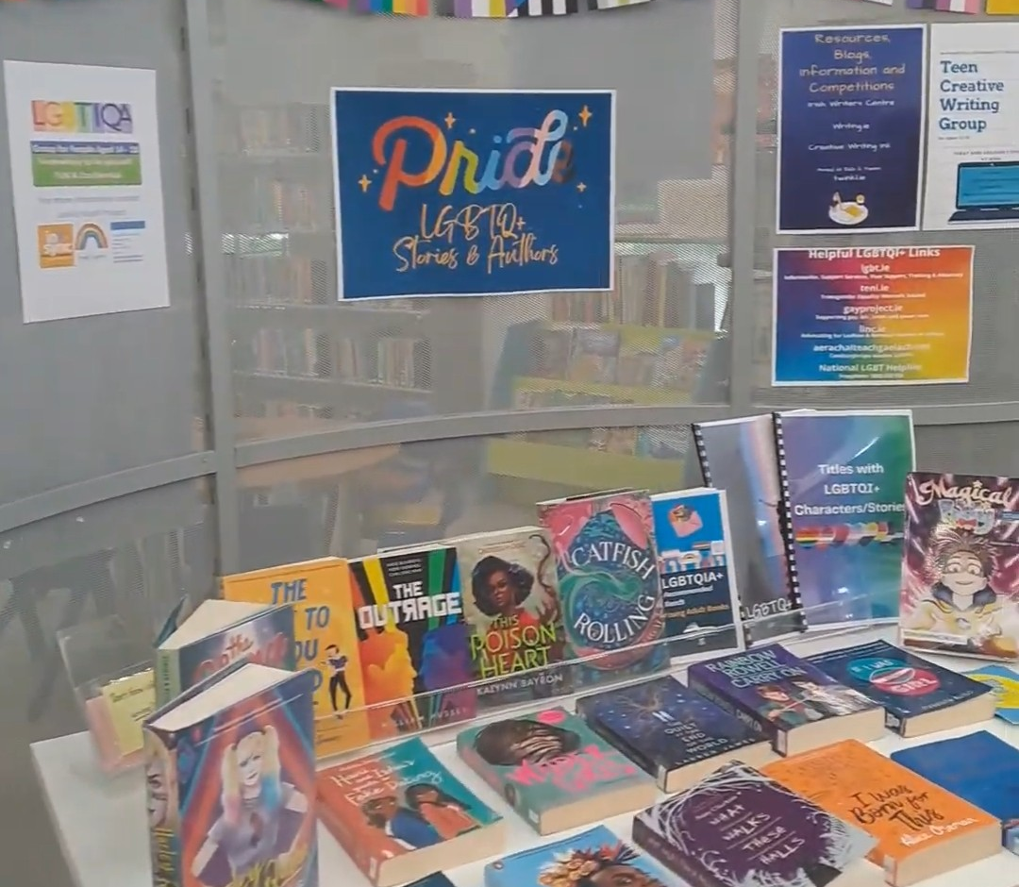
Mission and Core Activities of the RLN
Professional Development
  RLN offers workshops and webinars to improve staff knowledge on LGBTQ+ issues and inclusive service design.
Advocacy and Intellectual Freedom
  The network advocates for queer literature, fights book challenges, and promotes diverse policy frameworks.
Community Building
  RLN creates safe spaces for LGBTQ+ library workers and allies to share, collaborate, and build resilience.
Sharing Best Practices
  RLN shares inclusive programming and outreach strategies to help libraries implement sustainable changes.
Notes:
The Rainbow Library Network’s mission is rooted in advancing inclusivity, representation, and support within Irish libraries through a combination of professional development, advocacy, community building, and resource sharing. One of its core activities involves providing professional development opportunities that enhance staff understanding of LGBTQ+ issues, inclusive service design, and best practices in collection development. These opportunities often take the form of workshops, webinars, or collaborative learning sessions where practitioners share practical strategies for improving library environments. Another central pillar of the RLN’s work is advocacy—both within library institutions and in the broader public sphere. The network actively works to protect intellectual freedom, particularly regarding queer literature and educational resources. This includes advocating against book challenges, promoting policy frameworks that uphold collection diversity, and amplifying the voices of LGBTQ+ staff and patrons. Community building is equally vital to the RLN’s mission. By creating a supportive professional community, the network provides a safe space where LGBTQ+ library workers and allies can seek guidance, share experiences, and collaborate on initiatives. This strengthens professional resilience and helps mitigate the impacts of discrimination or harassment. The RLN also curates and circulates best practices related to inclusive programming, outreach, and staff training, enabling libraries across Ireland to implement meaningful and sustainable changes. Through these efforts, the RLN demonstrates how professional networks can help libraries enact their ethical commitments beyond their collections, rooting inclusion within their organisational cultures. By fostering solidarity, advancing knowledge, and reinforcing professional values, the RLN acts as both a resource and a catalyst for institutional transformation. Its mission positions libraries not only as providers of information but as proactive agents of social equity committed to cultivating environments where all individuals feel represented, respected, and valued.

Slide 8
RLN as a Model for Resilience and Ethical Leadership
Notes:
Supporting Staff Wellbeing and Professional Resilience, Strengthening Intellectual Freedom and Protecting Collections

Slide 9

Supporting Staff Wellbeing and Professional Resilience
Peer Support and Community
  RLN offers peer support networks that reduce isolation and foster resilience among LGBTQ+ staff and allies.
Professional Development
  RLN provides training that enhances staff skills for managing social challenges and workplace conflicts effectively.
Institutional Policies and Safety
  RLN promotes policies ensuring staff safety including crisis protocols, reporting systems, and anti-discrimination measures.
Ethical Commitment and Care
  Supporting staff wellbeing strengthens libraries’ ethical commitment to community care and social responsibility.
Notes:
Staff wellbeing has become a critical concern within contemporary librarianship, particularly as rising social tensions have intensified workplace pressures. The Rainbow Library Network (RLN) plays an important role in supporting the mental, emotional, and professional resilience of LGBTQ+ staff and allies who may face heightened risks of harassment or discrimination. By offering peer support structures, the RLN helps mitigate feelings of isolation and vulnerability that commonly arise in politically charged environments. Through formal and informal networks, members can share experiences, coping strategies, and practical tools for addressing conflict or safeguarding their wellbeing. This type of communal support is especially vital in contexts where staff confront external hostility linked to the presence of queer literature or inclusive programming. Research across professional sectors indicates that identity-based networks contribute significantly to employee retention, job satisfaction, and overall psychological safety. Within the library setting, these benefits translate into a more stable and confident workforce better equipped to maintain high-quality services. The RLN also facilitates professional development that boosts staff competence in navigating complex social dynamics, empowering individuals to respond constructively to challenges such as censorship attempts or confrontational patrons. Additionally, the network encourages the development of institutional policies that prioritise staff safety, including crisis-response protocols, reporting mechanisms, and anti-discrimination frameworks. These structural supports amplify the wellbeing benefits offered by the network. By championing both interpersonal and organisational approaches to resilience, the RLN models how library institutions can uphold their duty of care. In doing so, it strengthens the profession’s ethical commitment to community care—extending these values not only to patrons, but to the people working tirelessly to serve them. Ultimately, the RLN demonstrates that safeguarding staff wellbeing is integral to sustaining the library as a socially responsive and ethically grounded public institution.

Slide 10

Strengthening Intellectual Freedom and Protecting Collections
Advocacy for Intellectual Freedom
  RLN leads proactive advocacy to defend intellectual freedom in libraries amid censorship challenges.
Ethical Collection Development
  RLN supports policies that ensure collections reflect cultural and educational values over political pressure.
Transparency in Decision-Making
  RLN promotes clear, respectful procedures for handling book challenges and public complaints.
Visibility of Queer Voices
  RLN advocates for LGBTQ+ representation, fostering community empathy and cultural literacy.
Notes:
The protection of intellectual freedom has long been a cornerstone of librarianship, but contemporary challenges have placed renewed emphasis on the need for strong, proactive advocacy. The Rainbow Library Network (RLN) plays a pivotal role in defending the integrity of library collections-particularly those featuring LGBTQ+ authors, themes, and perspectives. As far-right groups increasingly target queer literature for removal or censorship, the RLN provides essential support to professionals tasked with maintaining balanced and inclusive collections. Its members contribute to the development of policies and practices that reinforce ethical collection development standards, ensuring that materials are selected based on their informational, cultural, and educational value rather than political pressure. By offering resources, guidance, and community consultation, the RLN strengthens the capacity of individual librarians and institutions to resist censorship attempts and uphold intellectual freedom. The network also promotes transparency and accountability in decision-making processes, encouraging libraries to adopt clear procedures for addressing book challenges and responding to public complaints. This helps shield staff from undue influence while ensuring that all concerns are addressed respectfully and ethically. Furthermore, the RLN advocates for the visibility and representation of queer voices within collections—not merely as a defensive measure, but as an affirming gesture that acknowledges the vital contributions of LGBTQ+ communities to literature, history, and culture. Case studies demonstrate that libraries that actively highlight diverse materials foster greater community engagement, empathy, and understanding. By supporting these initiatives, the RLN positions libraries as champions of pluralism and cultural literacy. Ultimately, the network’s efforts to protect collections underscore its broader ethical mandate: to ensure that libraries remain spaces where all individuals can explore ideas freely, without fear of suppression or erasure.

Slide 11
The Broader Impact of the RLN and Future Directions
Notes:
RLN as a Model for Inclusive Professional Communities, Future Possibilities for Ethical and Inclusive Librarianship

Slide 12

RLN as a Model for Inclusive Professional Communities
Inclusivity as Foundation
  RLN centers inclusivity as a core practice to empower marginalised voices in professional communities.
Cultural Competence Impact
  Strengthening cultural competence improves library services and fosters welcoming environments for all patrons.
Adaptable and Scalable Model
  RLN’s approach offers a scalable model for other sectors emphasising ethical leadership and equity dialogue.
Libraries as Social Leaders
  Libraries act as community anchors committed to justice, care, and democratic access to information.
Notes:
The Rainbow Library Network (RLN) is more than an internal support structure; it is a model for how professional organisations can respond to societal challenges with integrity, creativity, and care. By centring inclusivity as a foundational practice rather than an aspirational goal, the RLN demonstrates how professional communities can be intentionally designed to empower marginalised voices. Its work illustrates that inclusivity is not achieved through symbolic gestures alone but through sustained, collaborative action involving education, advocacy, and shared responsibility. The RLN’s emphasis on strengthening cultural competence within the profession has ripple effects across library services, influencing how staff interact with patrons, develop programs, and curate collections. These efforts help cultivate libraries as spaces where all individuals feel seen and valued. Importantly, the RLN’s model is adaptable and scalable: other professional sectors can learn from its approach to building resilient networks grounded in ethical principles. This includes prioritising representation within leadership, developing structured support systems, and fostering ongoing dialogue about equity. Through its initiatives, the RLN also reaffirms the library’s role as a community anchor committed to justice, care, and democratic access to information. In a world marked by cultural fragmentation, such models of constructive engagement are essential for rebuilding trust and cohesion. By showcasing the power of collective action, the RLN positions libraries as leaders in shaping ethical futures—institutions willing to evolve, reflect, and advocate for human dignity. This example can inspire similar networks globally, reinforcing the idea that libraries are not only repositories of knowledge but active agents of social transformation.

Slide 13

Future Possibilities for Ethical and Inclusive Librarianship
Collaborative Partnerships
  Expanding partnerships with community groups and institutions enhances inclusive library programs and services.
Intersectional Inclusivity
  Integrating intersectional perspectives in policies ensures libraries address complex identities and foster equity.
Technology and Virtual Access
  Digital platforms extend library reach through virtual support networks and online resource hubs.
Ethical Leadership Development
  Cultivating leaders who advocate for diversity and ethics strengthens the future of librarianship.
Notes:
Looking forward, the Rainbow Library Network (RLN) offers a vision for how libraries can continue to evolve as ethically grounded, culturally responsive institutions. One significant opportunity lies in expanding collaborative partnerships—with community organisations, academic researchers, educational institutions, and advocacy groups—to deepen the impact of inclusive library practices. Such partnerships can facilitate new programs, diversify resource offerings, and broaden the reach of library services to communities that have historically faced exclusion or marginalisation. Another future direction involves integrating intersectional perspectives into library policies and training, ensuring that inclusivity efforts address the complexities of identity, including race, ability, migration status, and socioeconomic background. Technology also presents opportunities: digital platforms can host virtual support networks, resource hubs, and training modules, extending the RLN’s influence beyond geographic boundaries. Additionally, libraries can innovate by developing community-led programming models that invite patrons to shape services in meaningful ways, reinforcing shared ownership of library spaces. Sustaining ethical librarianship will also require ongoing reflection and adaptation. The RLN can play a role in evaluating emerging challenges, such as online harassment, misinformation, and increasing political polarisation. By continuing to foreground ethics as a living practice rather than a static framework, the network helps ensure that libraries remain agile and principled in the face of change. Finally, the RLN’s success underscores the importance of leadership development that prepares future librarians to advocate confidently for diversity, equity, and inclusion. By cultivating leaders who understand the ethical, cultural, and social dimensions of the profession, the RLN contributes to a more just and vibrant future for libraries. In this way, the network not only addresses present challenges but actively shapes the evolution of librarianship for generations to come.

Slide 14
Thank you! rainbowLN@libraryassociation.ie https://www.libraryassociation.ie/rainbow-library-network/
Notes:
RLN as a Model for Inclusive Professional Communities, Future Possibilities for Ethical and Inclusive Librarianship

