Slide 1

Demystifying Publishing: A Librarian-Led Model for Research Dissemination at Innopharma Education
Colm O’Connor
Innopharma Education College Librarian & Research Specialist
Editor-in-Chief of Innopharma Insights
oconnorc@innopharmalabs.com
https://www.linkedin.com/in/colm-oconnor/

Slide 2




Who we are
Innopharma Education is the award-winning, premier education, research and technology institute for industry-led accredited education and training programmes in the Life-Science Industries​.
Medtech
Pharmaceutical
WE
RE-SKILL
WE
UP-SKILL
WE
LIFE-SKILL
Food Science
Empowering people’s pathways to success
Digital Transformation
Notes:
Innopharma Education gives individuals and businesses the skills advantage they need for career and commercial success in the life sciences.
Our accredited courses combine industry context and practical applications with rich insights into high-tech developments.

Slide 3
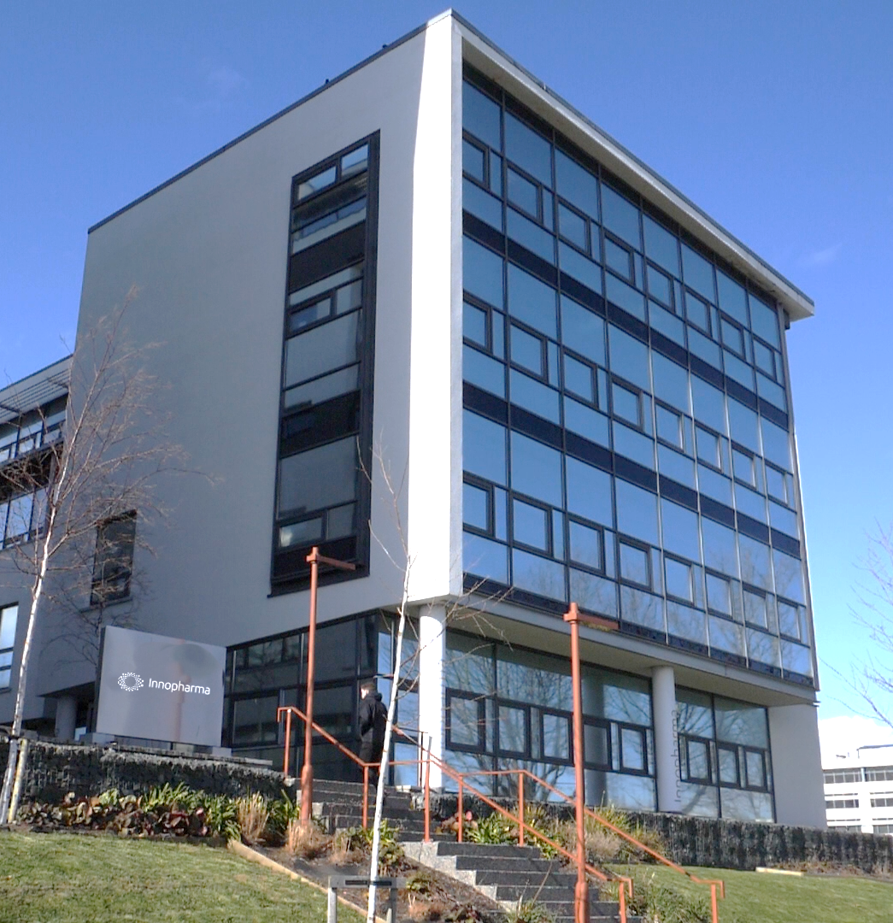



What we offer
ACCREDITED PROGRAMMES
CAREER DEVELOPMENT
Comprehensive qualification framework
QQI accreditation Level 5 – 9
Certificate, Degree, PostGraduate & Masters
70-85% of students have advanced their careers in the 6 months post course completion.
INDUSTRY LED CONTENT
25,000+ Alumni
Industry based lecturers and relevant content based on real world experience
Across Short Courses, Micro-Credentials, Full Programmes & Bespoke Industry Training

Slide 4
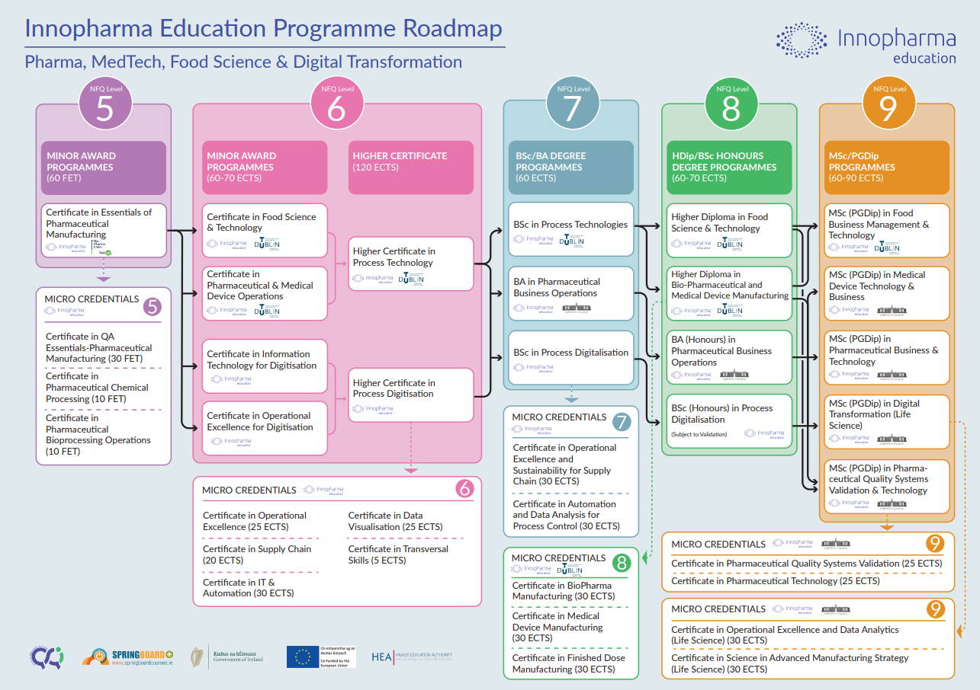


Slide 5
The Problems
The invisible researcher: Our learners (typically mature, part-time professionals) were producing high-quality, practice-based scholarship (through assignments, dissertations, capstones, work experience etc.) but this remained hidden.
Ivory Tower: From conversations, many of our learners viewed academic publishing as ‘exclusive’ and ‘not for them’ .
The challenge: To build a a supportive bridge to move work from ‘Assessment’ to ‘Impact’.

Slide 6
The Solution
The development of an institutional journal to highlight the diverse and exciting range of research activities taking place at Innopharma Education.
With a focus on innovation and current trends, the journal emphasises research and discussion within the domains of Digital Transformation, Pharmaceutical Business and Technology, Medical Device Technology, Food Business and Technology, Education and Sustainability.
The journal welcomes submissions (Research articles, opinion pieces, book reviews, conference reviews etc.) from staff, students & recent graduates on all the above subject areas and encourages accessible content, to engage a broad audience.

Slide 7
The Librarian-Led Model
An editorial team was brought together with librarian as the editor-in-chief and staff from across the College including the Head of Academic programmes, Head of Teaching & Learning, Lecturers & Programme Managers.
Promotion, Support & Mentorship: The call for submissions for Issue 1 was announced through the library with an announcement sent to all students and lecturers encouraging submissions from their students.
Research articles based on dissertations were particularly encouraged as the research had already been done and this offered a new avenue for dissemination.
All students who expressed an interest were contacted and given step-by-step support throughout the process.
A number of resources were created and made available on the online library including a guide on academic writing and a guide on converting a dissertation to an academic article.

Slide 8

Innopharma Insights Editorial Team
Colm O’Connor (College Librarian & Research Specialist)
Aine Behan (Programme Director)
Jennifer Manning (Head of Academic Programmes)
Victoria Buckley (Head of Teaching & Learning and Learner Support)
Jennifer Campbell (Programme Lead)
Catriona Horgan (Admissions & Programme Manager)
Michelle Ryan (Programme Lead)
Editorial Team

Slide 9




Volume 1 PDF
Volume 2 PDF
Launched January 2025
Launched January 2026
Notes:
Facts & Figures
20 articles across the first 2 issues
13 Student articles (ranging from learners at QQI level 6 to Master’s).
Published and made available on our institutional repository

Slide 10
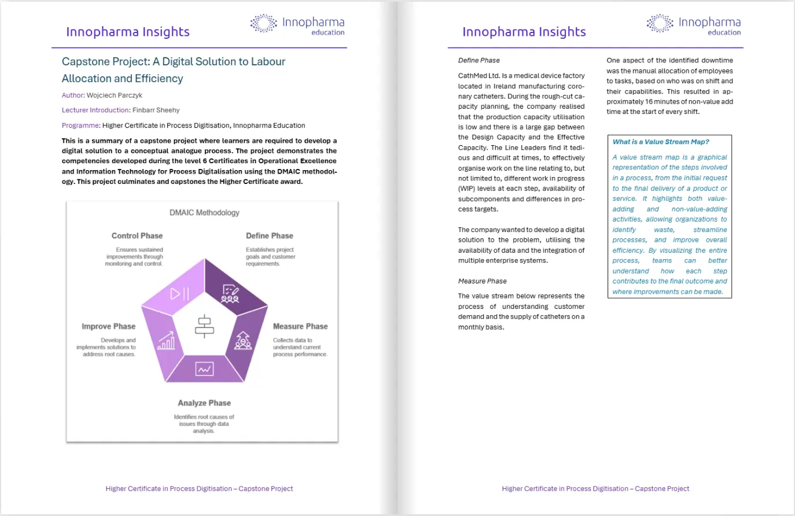

Slide 11
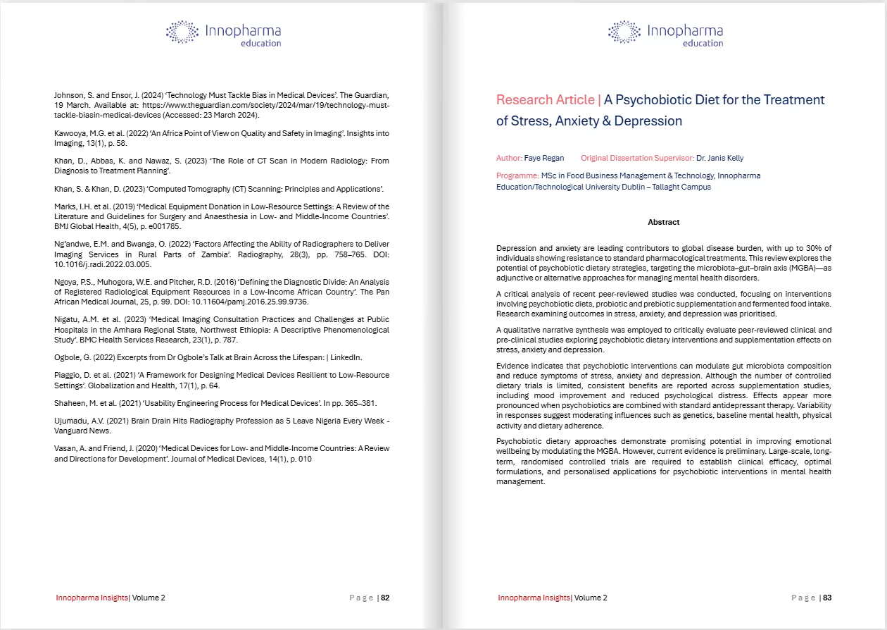

Slide 12




Student Feedback
“I am so happy about this publication”
“I am honoured that you recognise the merit of my work and would be delighted to be a part of this inaugural issue”
A wonderful Christmas Present
“A wonderful Christmas Present”
“I am grateful and excited about this opportunity”
I am grateful and excited about this
opportunity
“Thanks again for your kind words and for including my work in your journal”
“I would be honoured to have my work
contribute towards something bigger”

Slide 13

Future Directions
DOIs and Indexing: Moving toward assigning DOIs (Digital Object Identifiers) to articles to increase discoverability.
Embedded Information Literacy: Integrating a "Writing for Publication" module directly into the curricula in relevant programmes.
Alumni Engagement: Keeping the door open for graduates to publish their industry insights post-qualification, fostering a lifelong learning community.
Measuring Impact: Through Altmetric & Analytics
Increased Student Engagement: Include a student on Editorial Board

Slide 14

Acknowledgement & Inspiration

Slide 15
?
Thanks for listening
Colm O’Connor
College Librarian & Research Specialist
oconnorc@innopharmalabs.com
linked.com/in/colm-oconnor
Questions?

