Slide 1
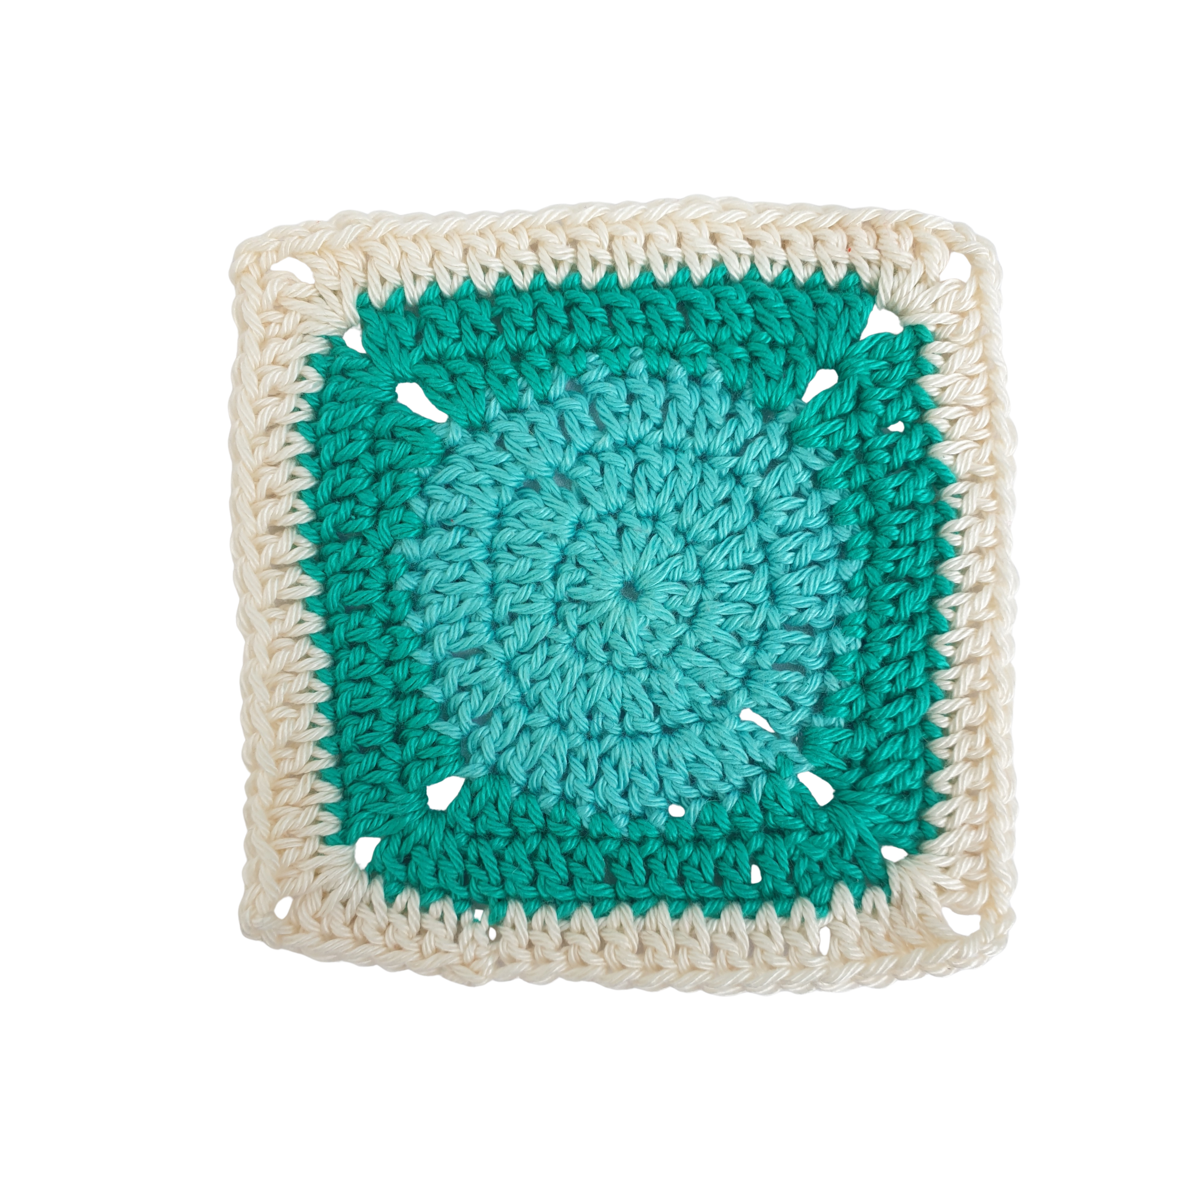
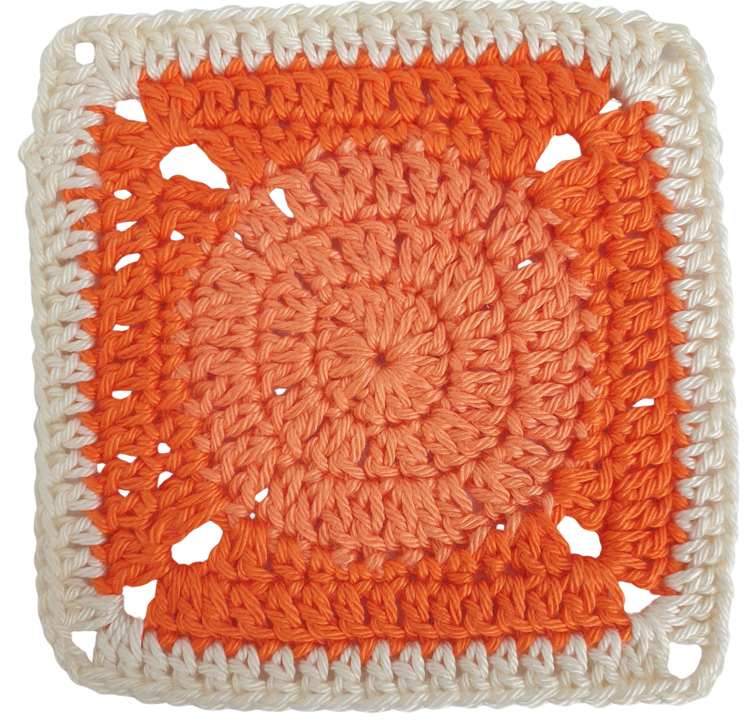
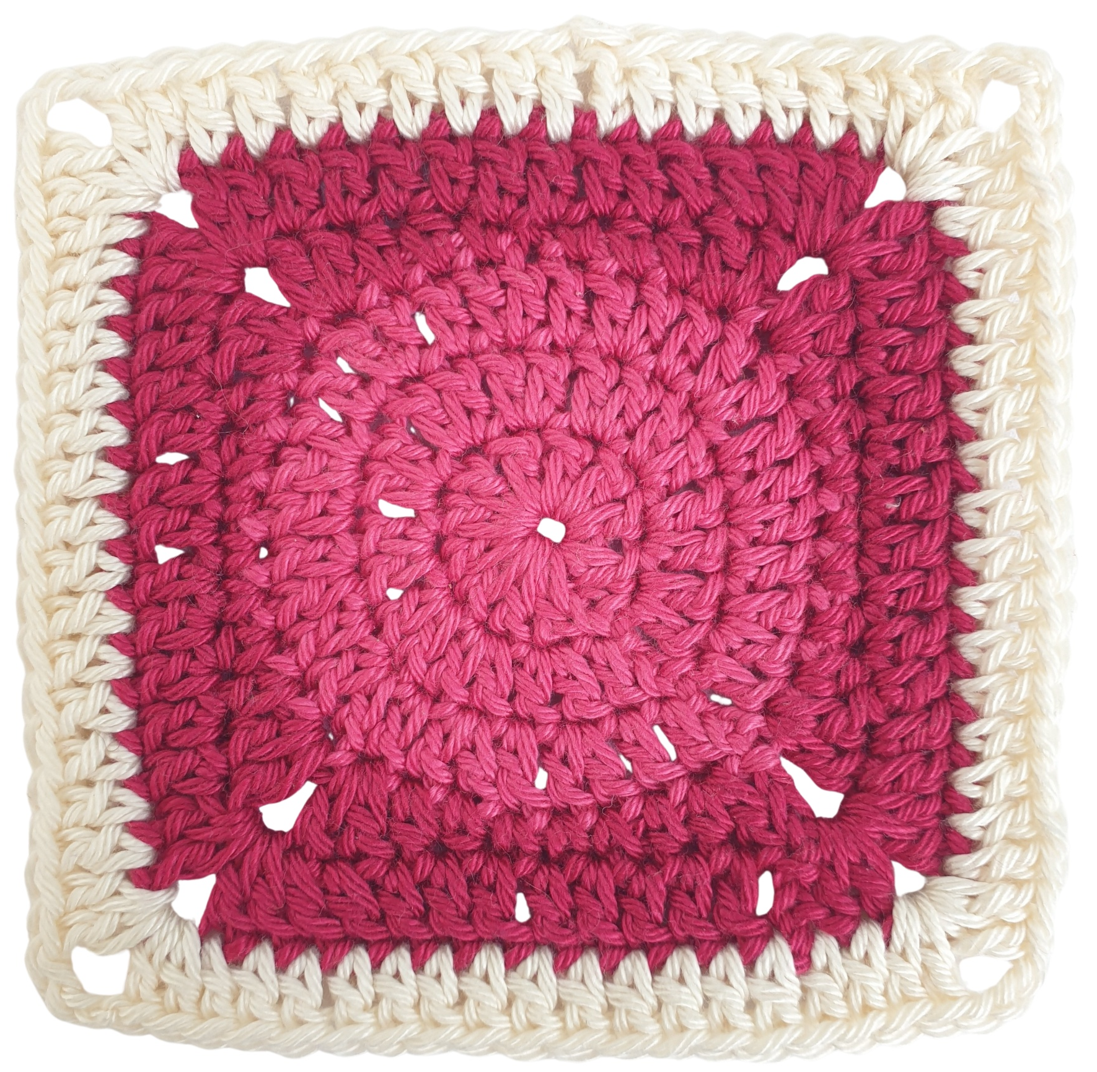
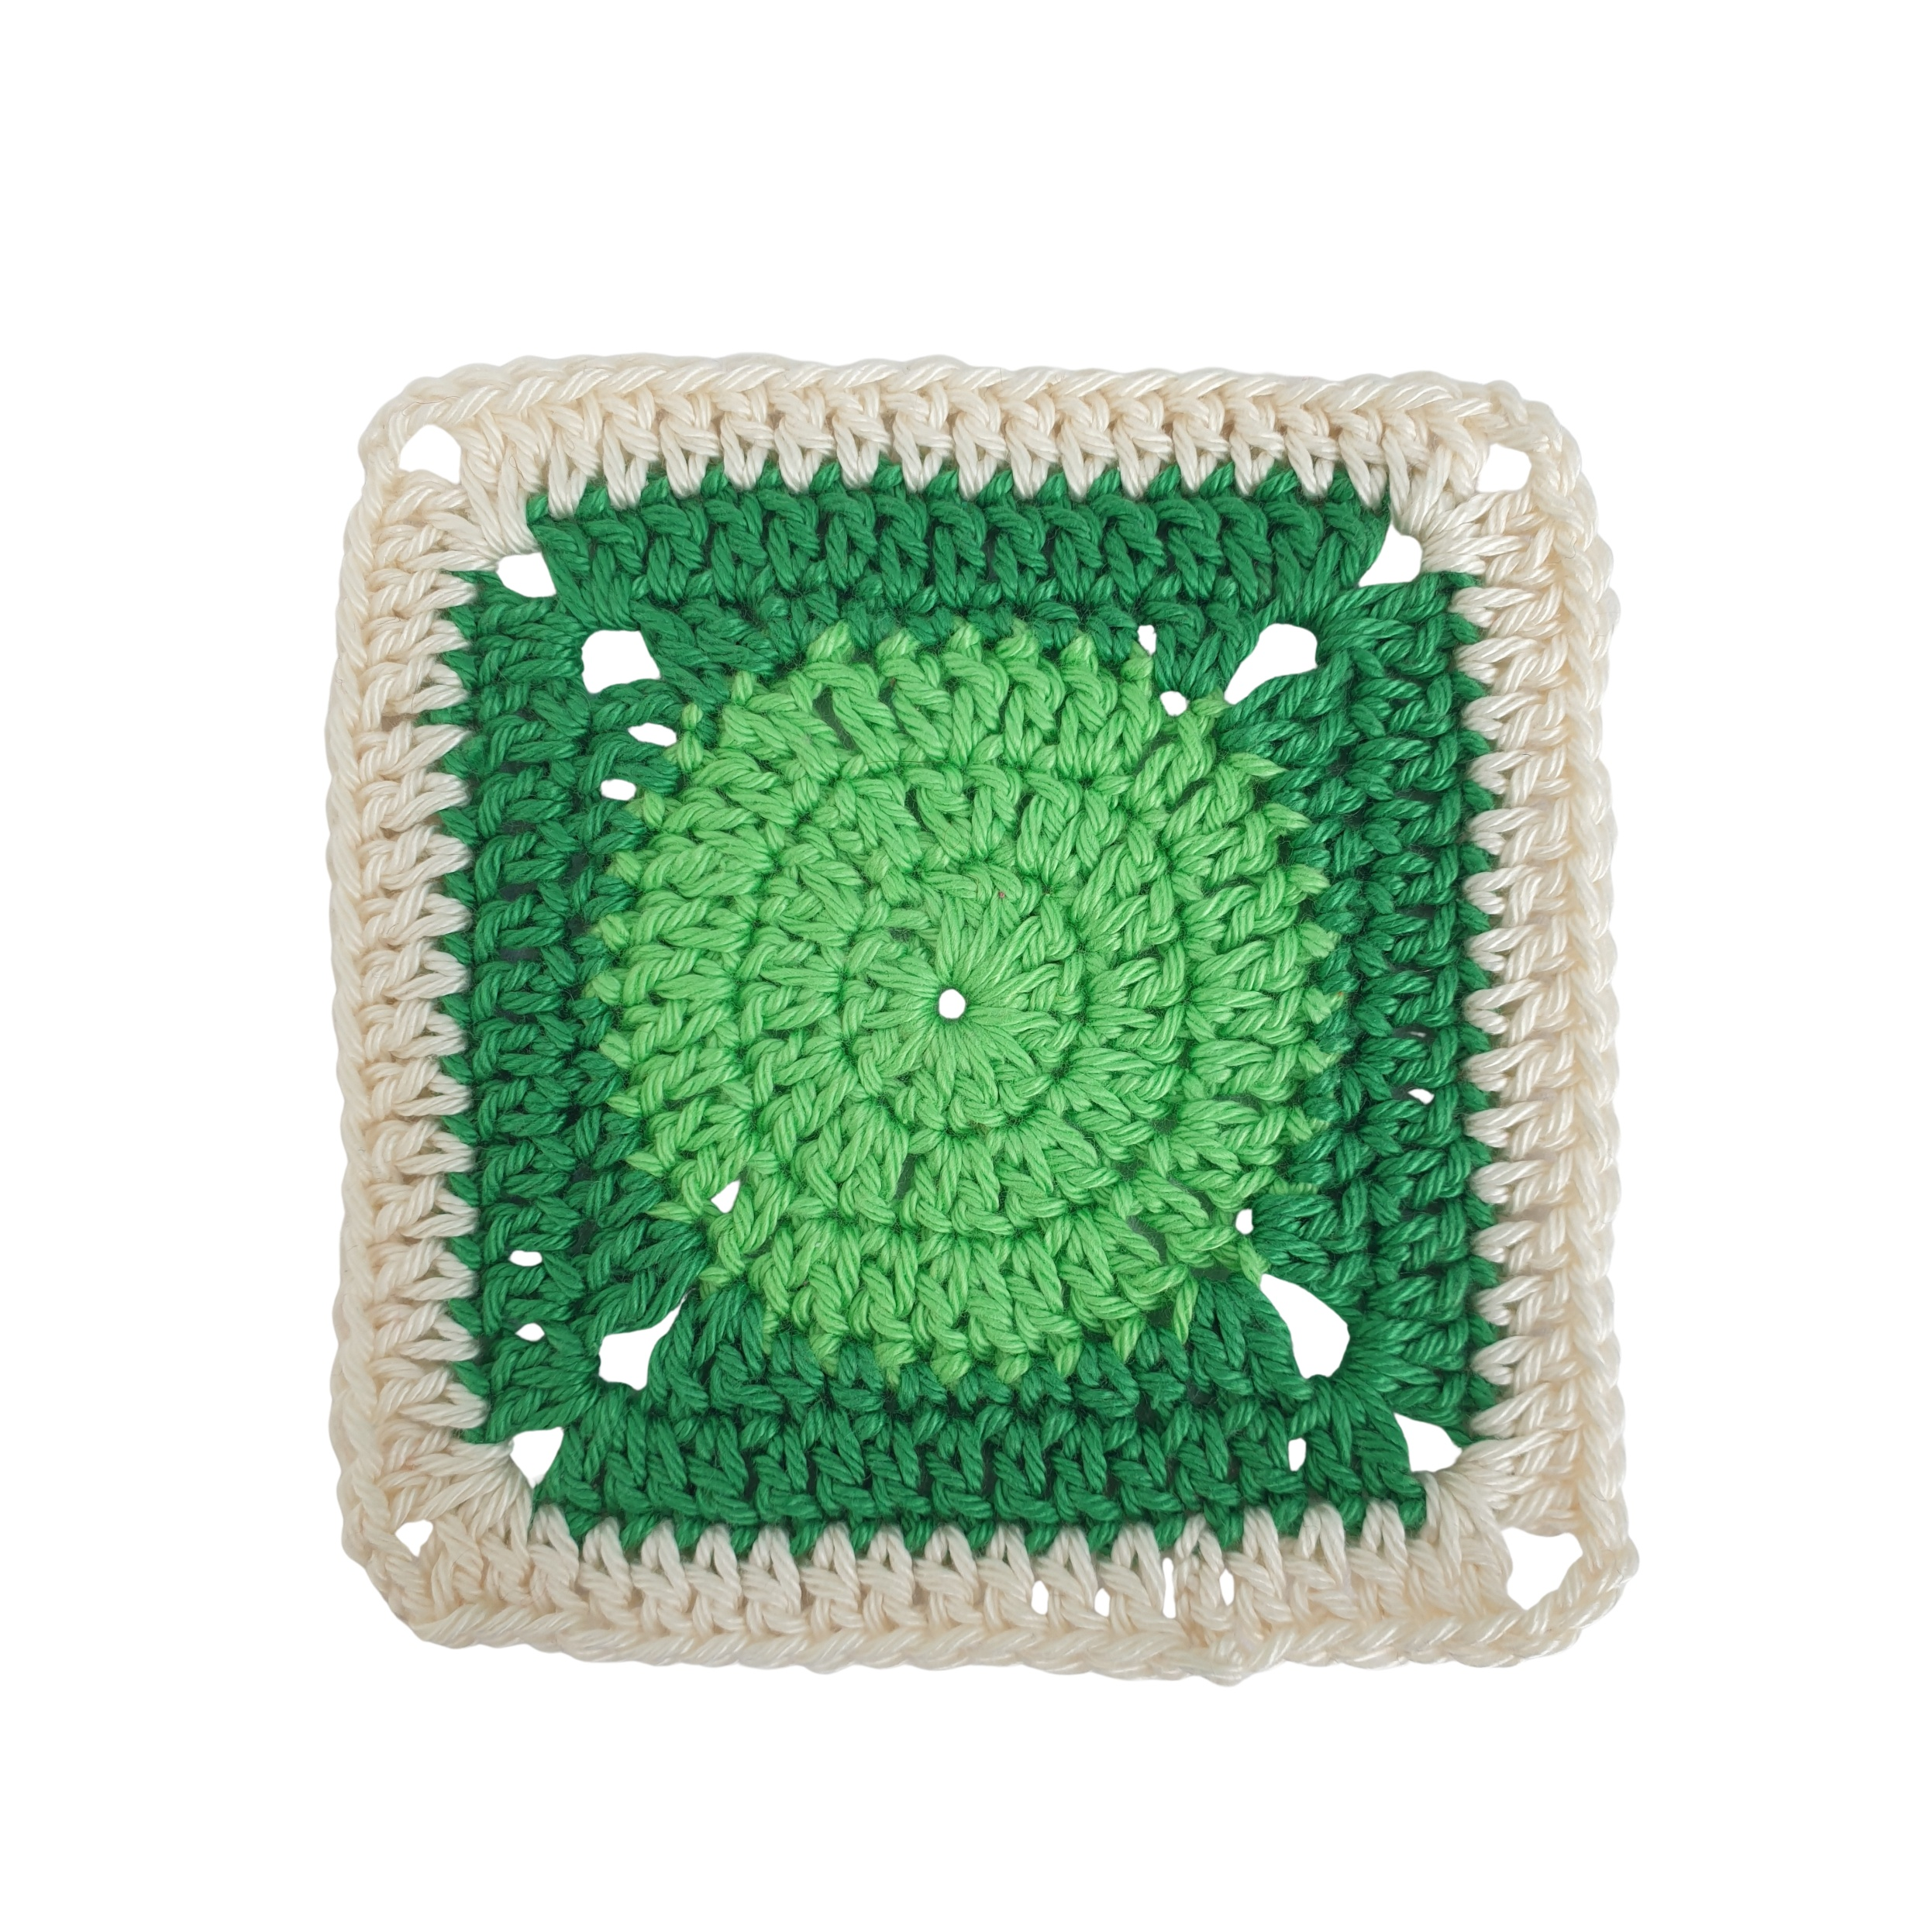

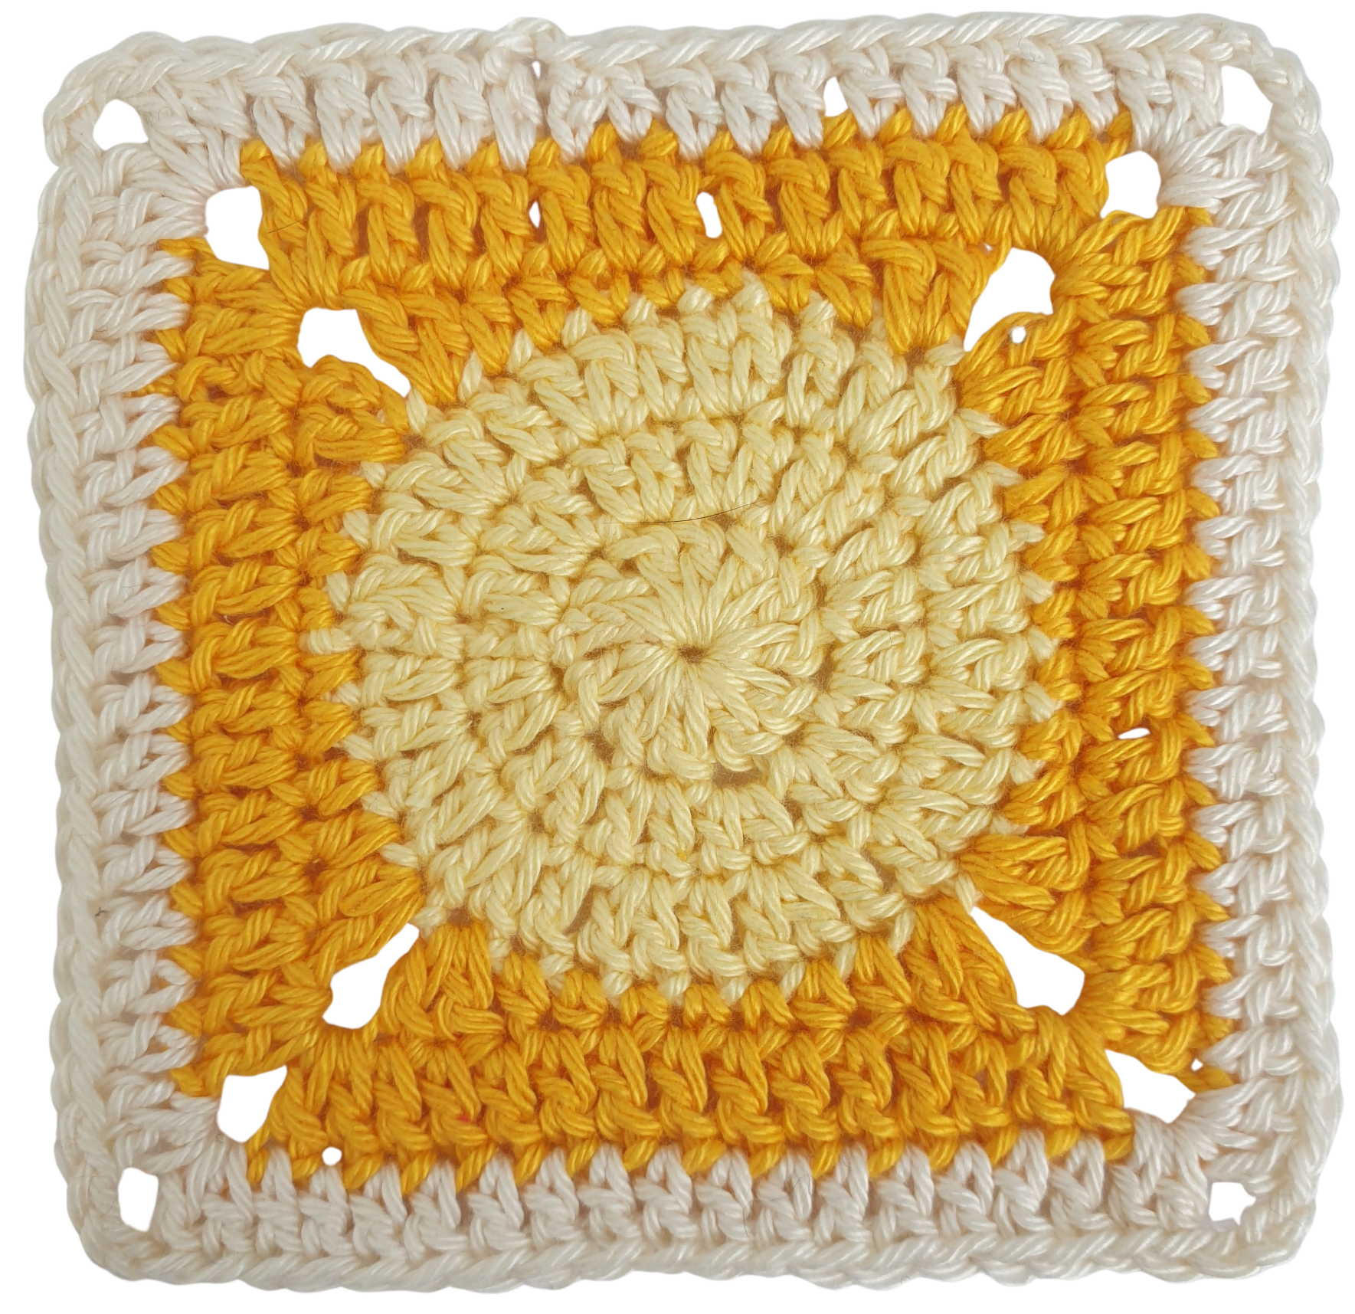
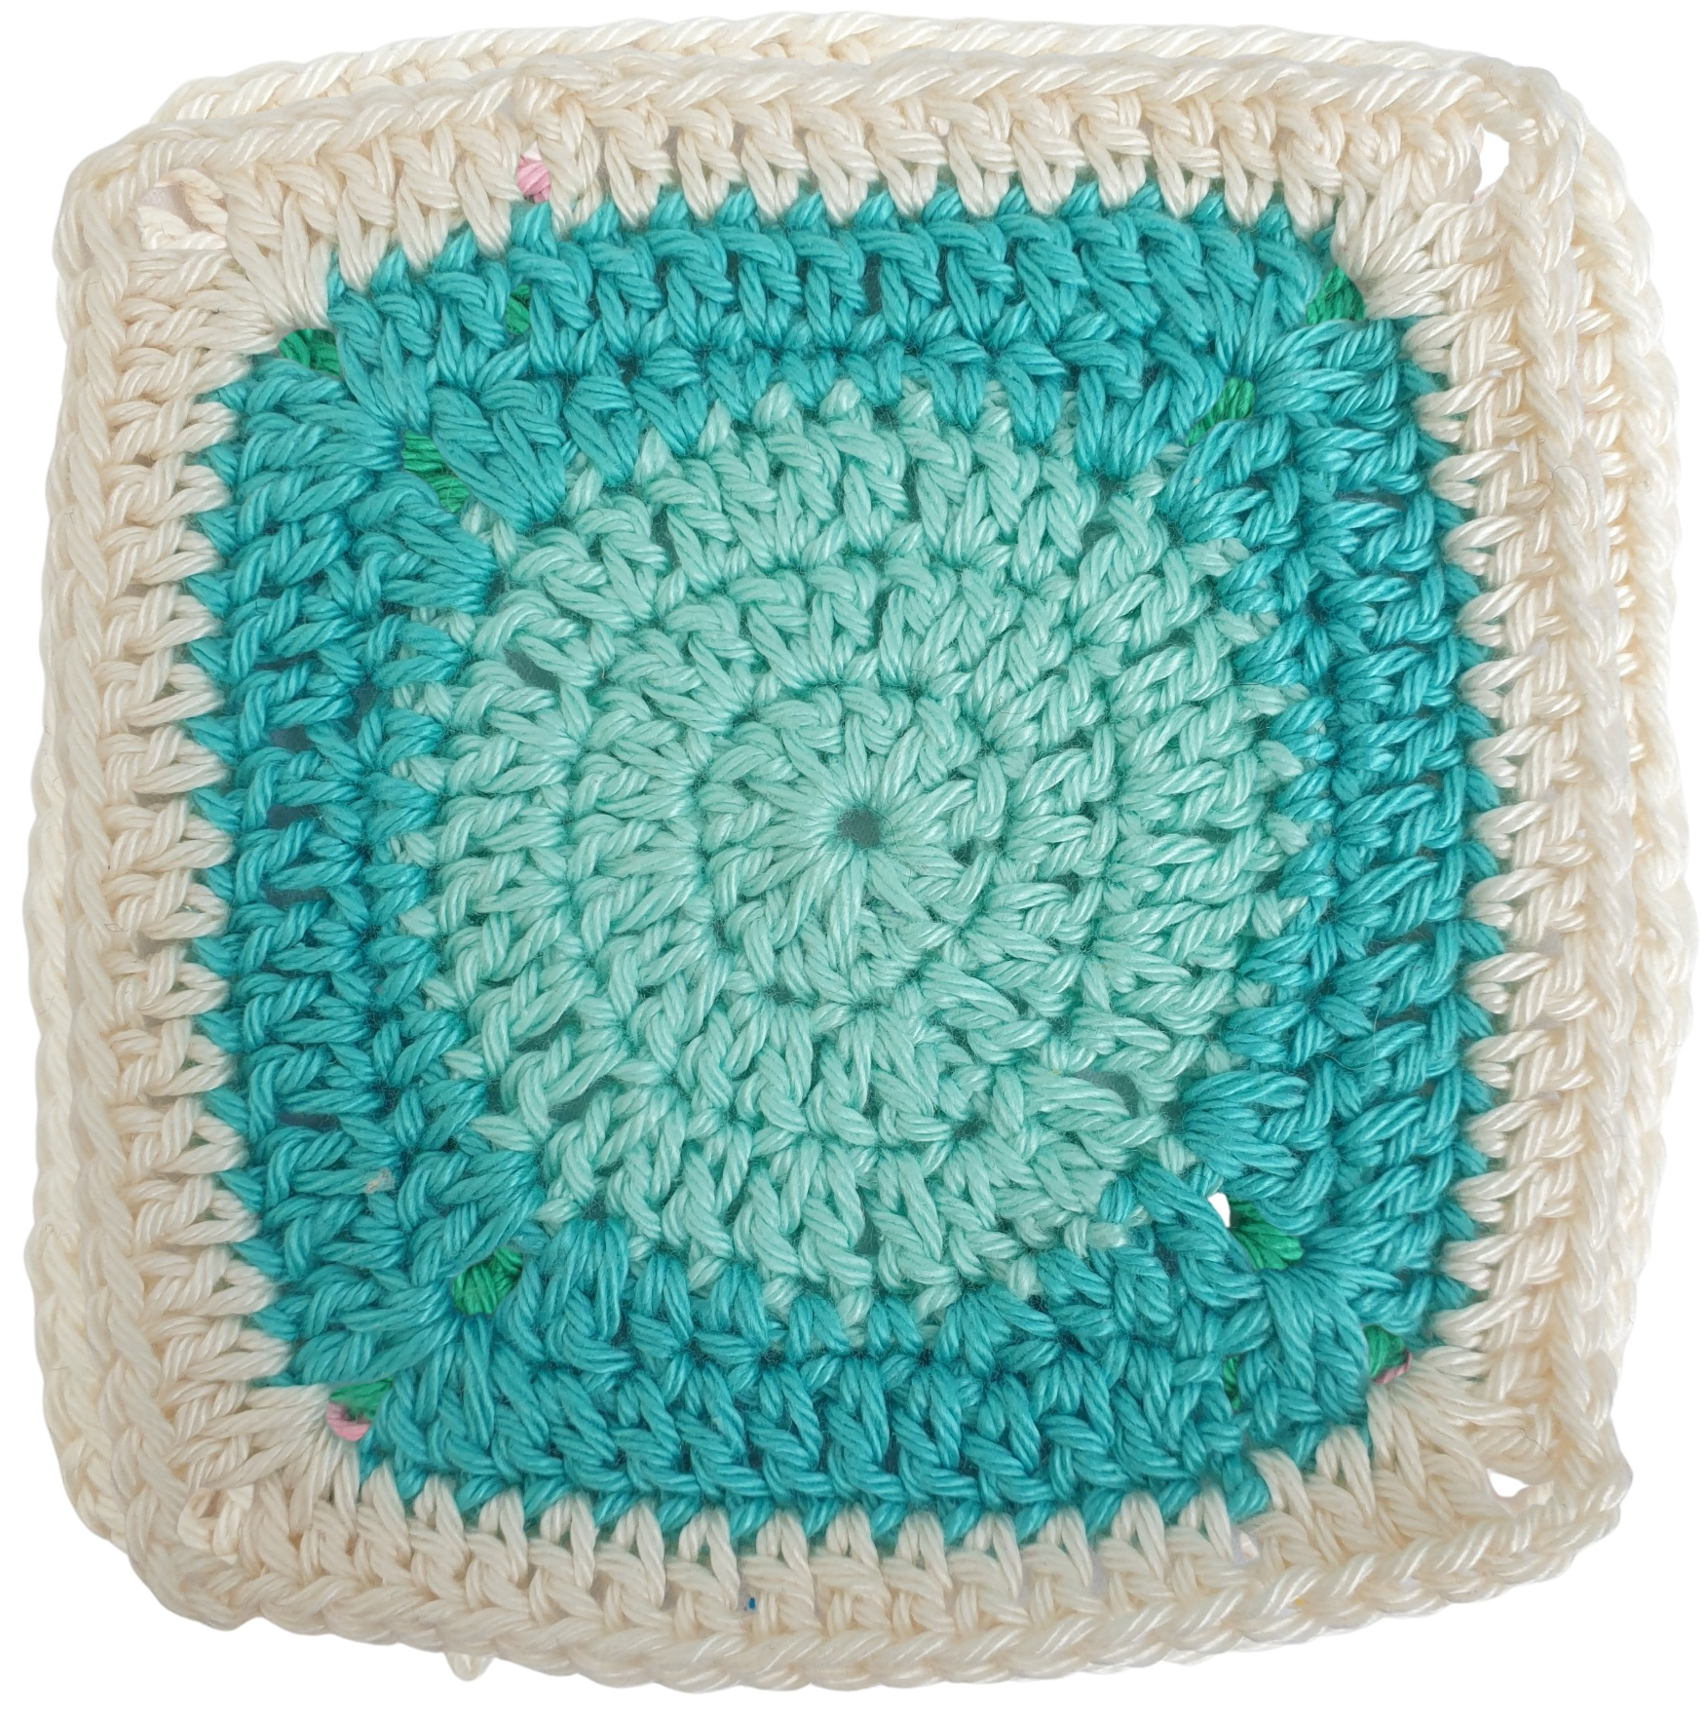
Make and Mend Library Project
Beth Tyrrell, Liaison Librarian for Engineering
beth.tyrrell@setu.ie
https://libguides.itcarlow.ie/makeandmendproject

Slide 2
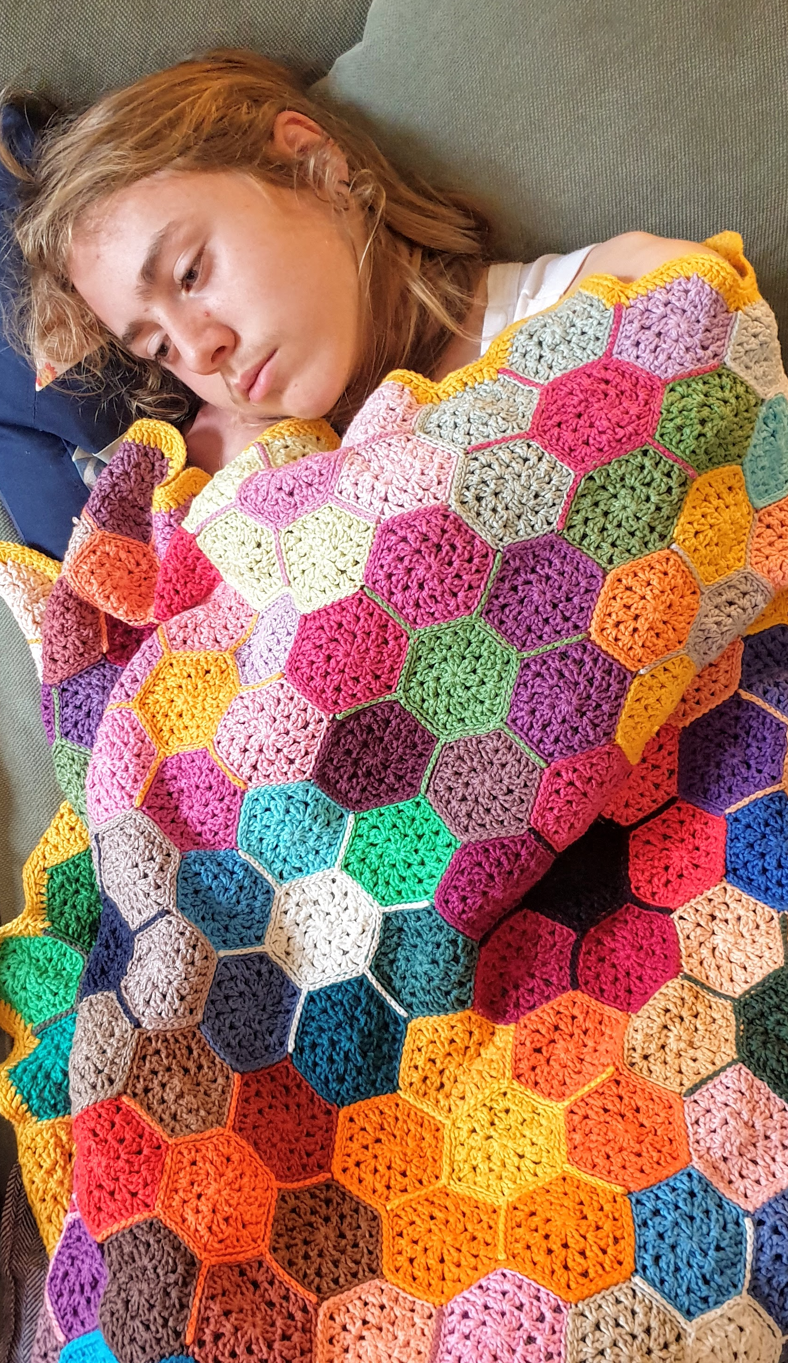
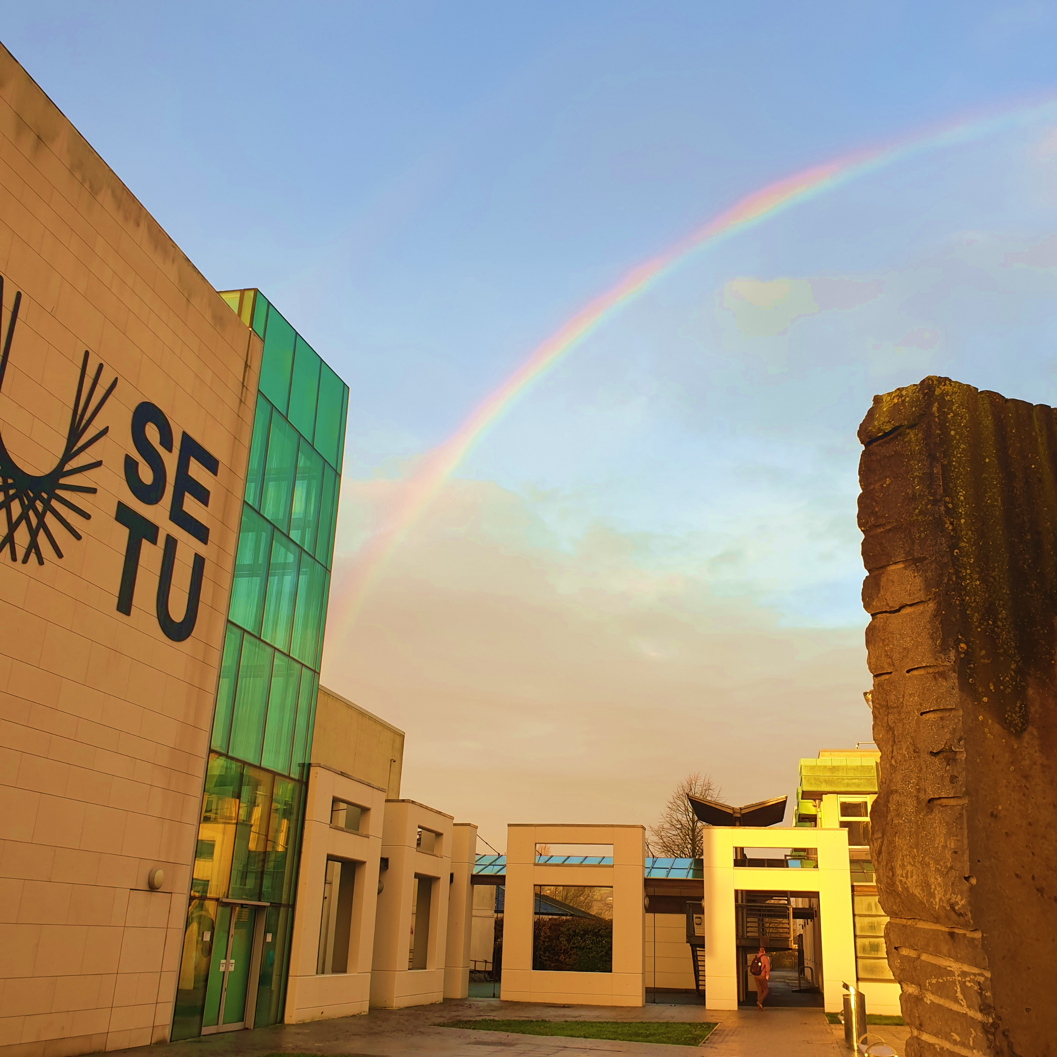
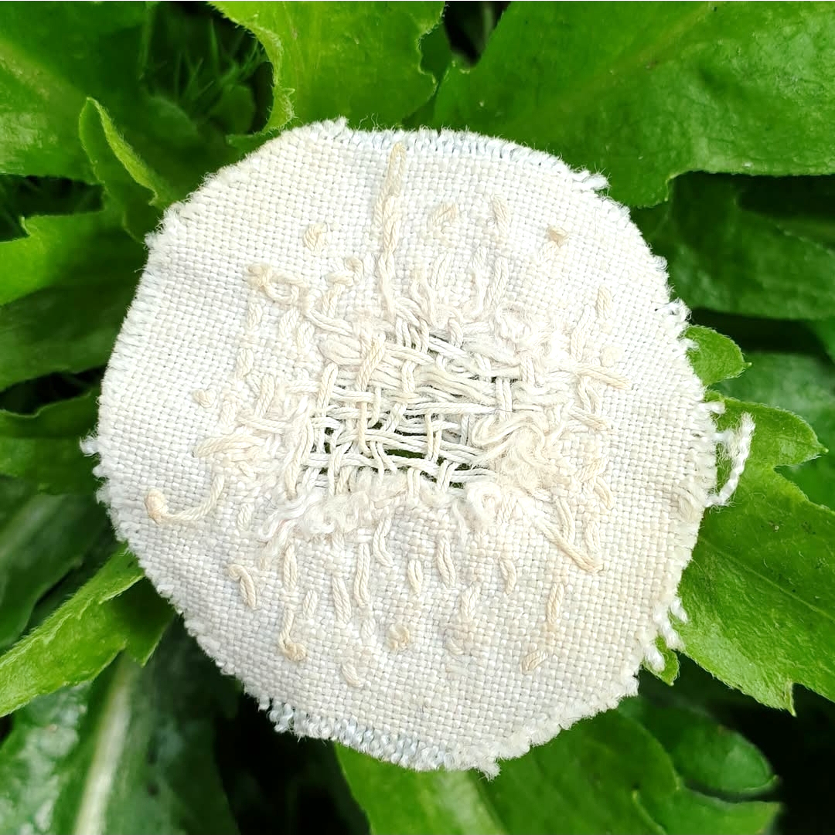
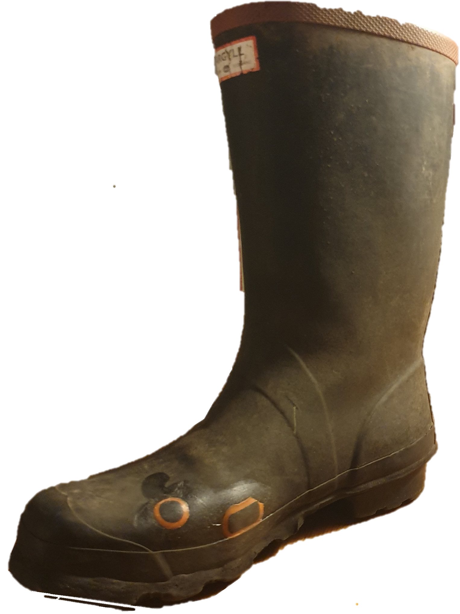

Slide 3
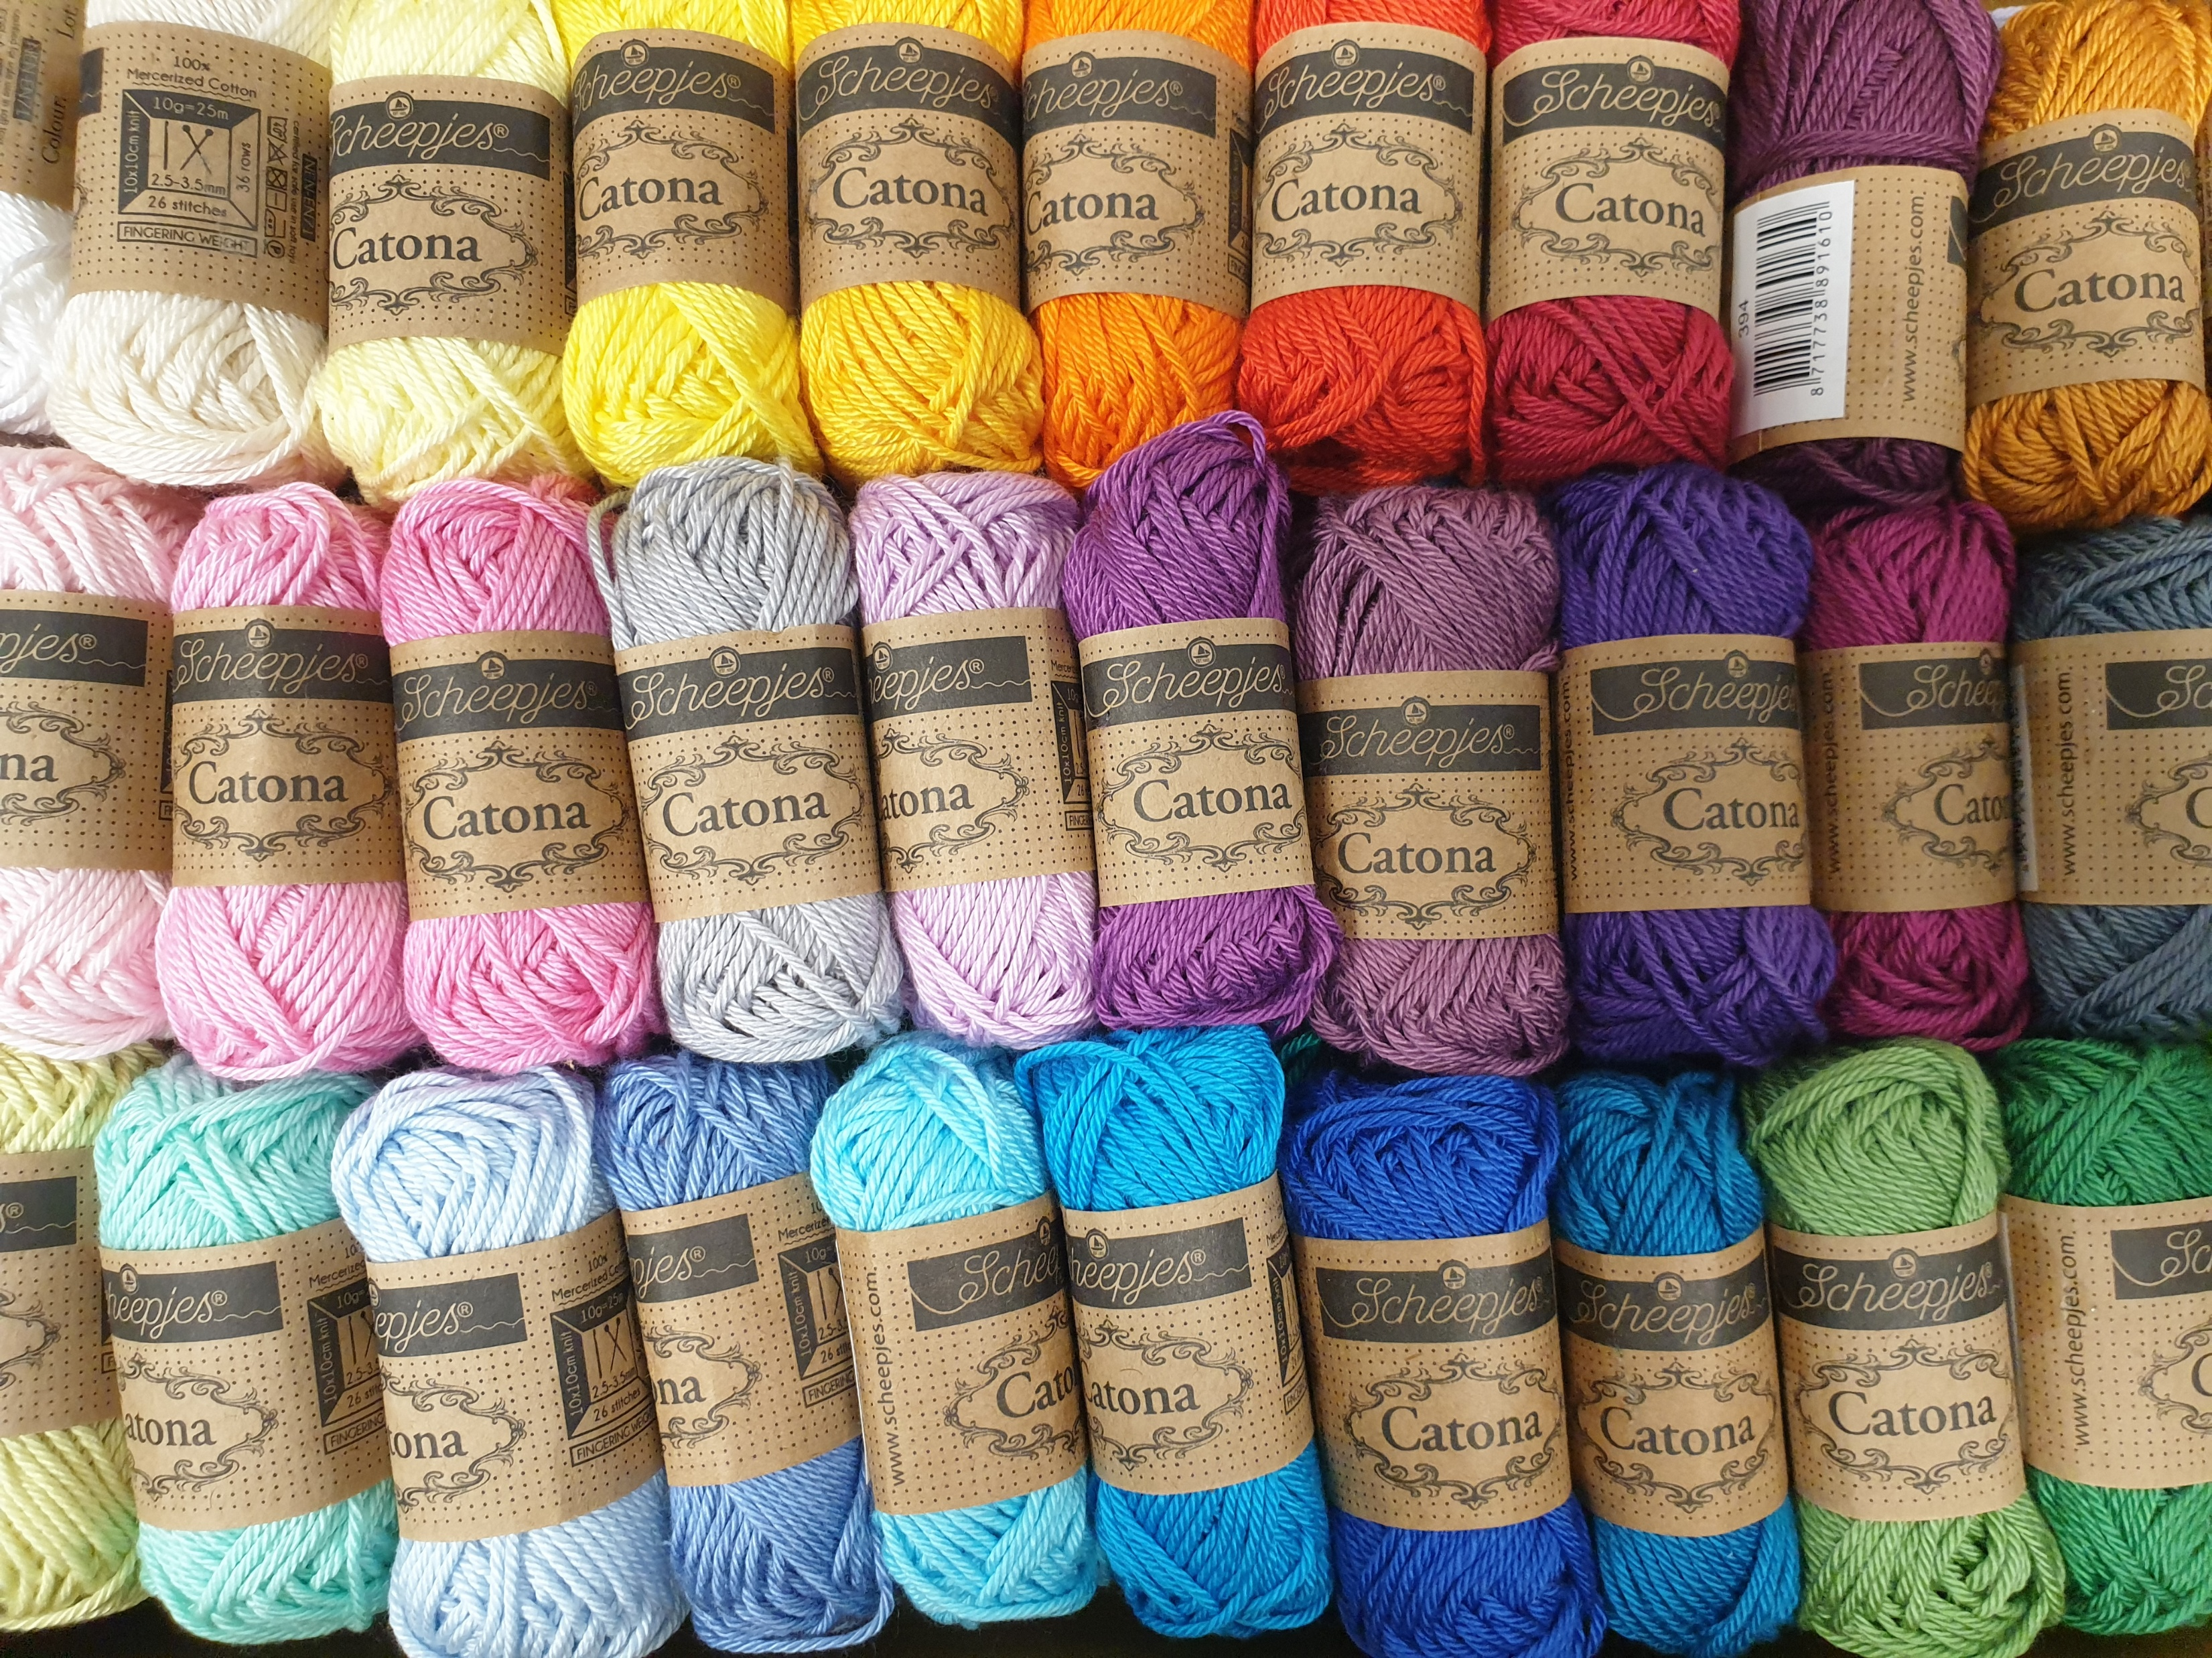
SATLE Funding:
“SATLE – the Strategic Alignment of Teaching and Learning Enhancement Funding in Higher Education – is a €5m funding allocation administered by the Higher Education Authority’s National Forum for the Enhancement of Teaching and Learning in Higher Education.
The current focus of the SATLE allocation in on promoting innovation, collaboration, and the enhancement of teaching and learning practices across Irish higher education institutions, with an emphasis on sustainable development, digital transformation and academic integrity.”
National Forum for the Enhancement of Teaching and Learning in Higher Education. (2025).
The Make and Mend application:
“Fast fashion has a substantial negative impact on the environment globally (Kim et al. 2025), with the global south bearing the worst consequences (Bonelli et al., 2024). This project aims to engender and promote a culture of sustainable fashion in the community of SETU Carlow students and staff, in line with the theme ‘Education for Sustainable Development’ specifically Chapter 2 of the ESD Implementation Plan 2022–2026: ‘learn what we live and live what we learn.’”

Slide 4
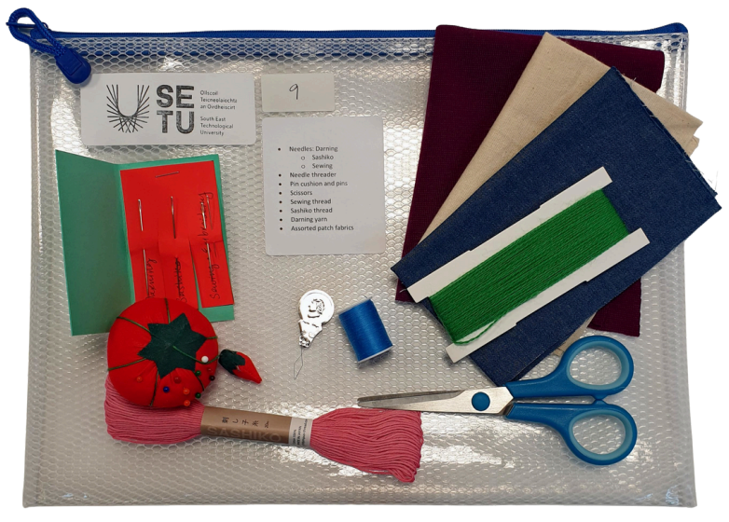
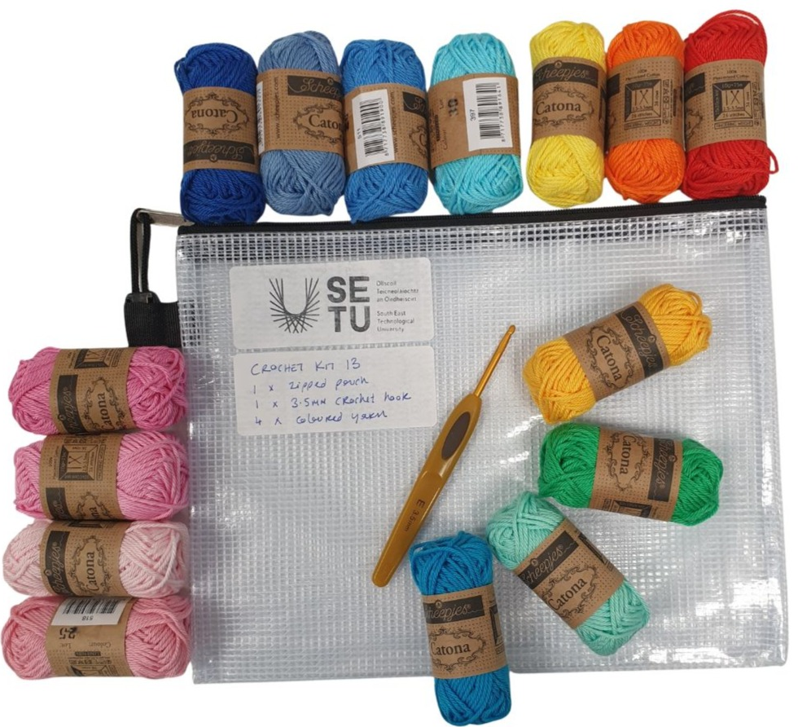
The Kits
Fifteen crochet kits:
a zipped pouch
a 3.5mm crochet hook
your choice of 4 colours of yarn.
Twelve mend and patch kits:
Darning supplies (needle, yarn, mushroom)
Patch supplies (needle, thread, fabric)
Sashiko supplies (needle, yarn, calico, template)
Scissors, pin cushion and pins.

Slide 5
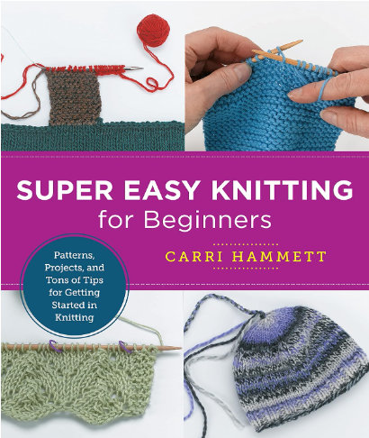
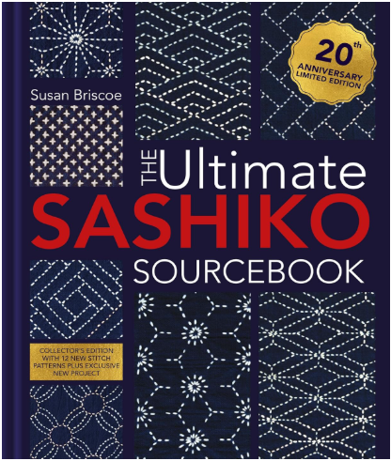
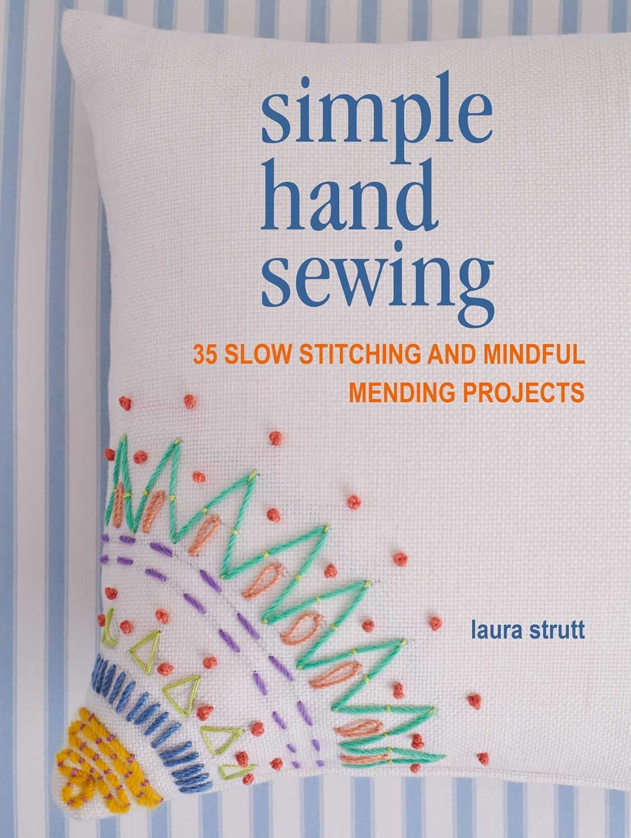
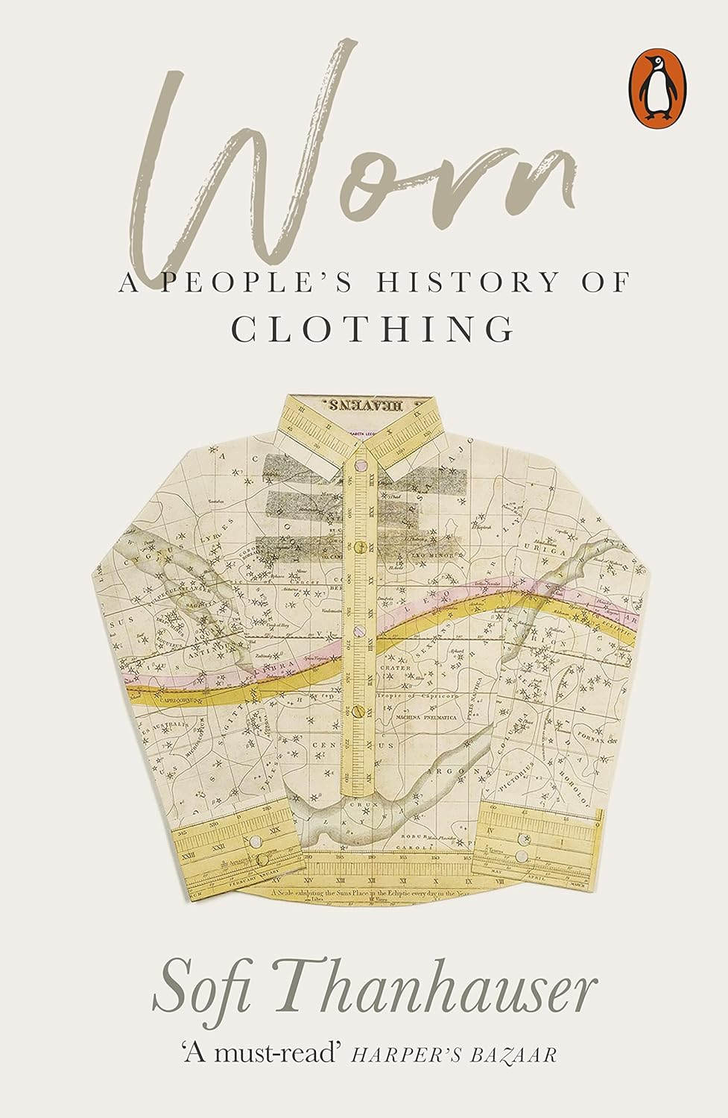
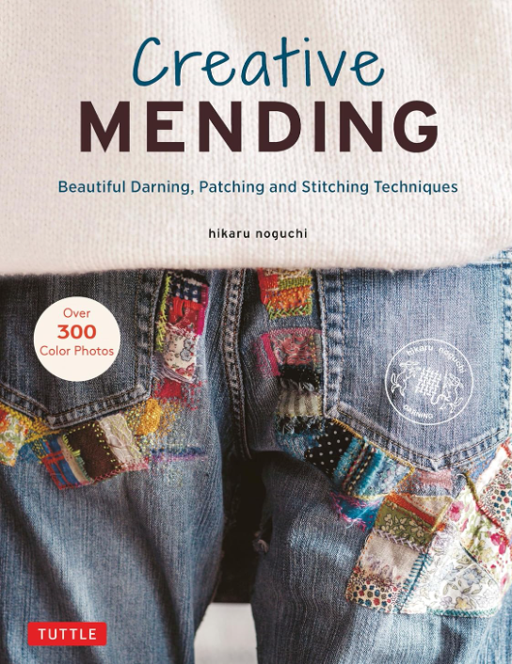
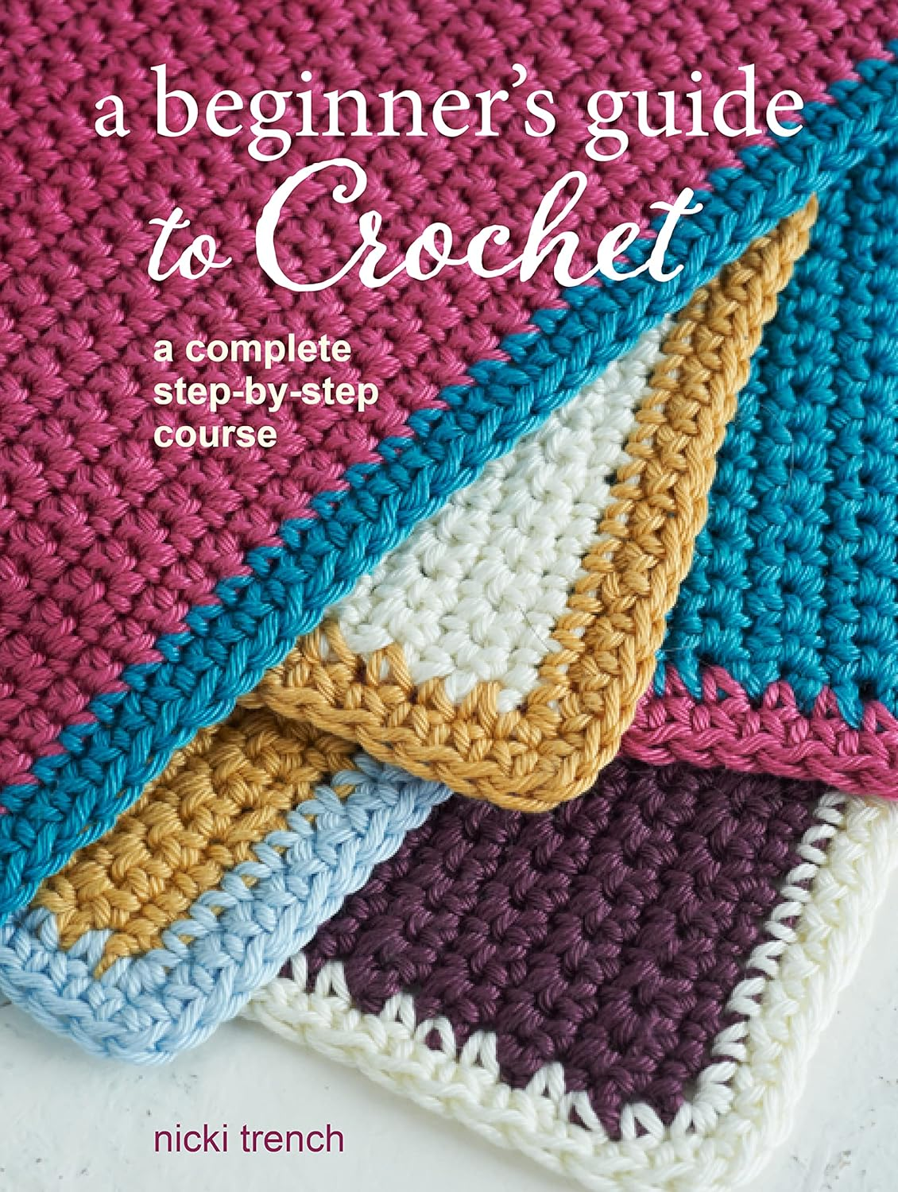
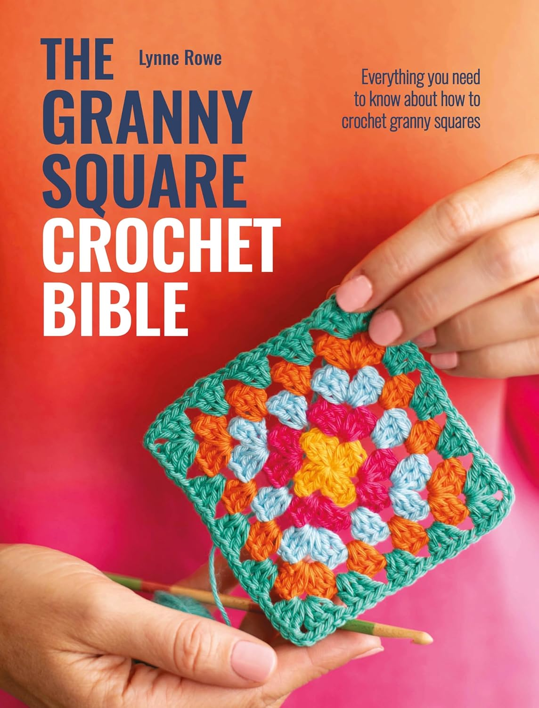
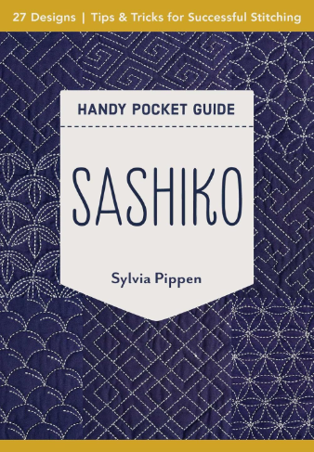
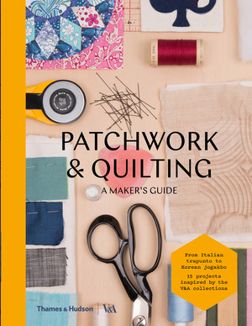
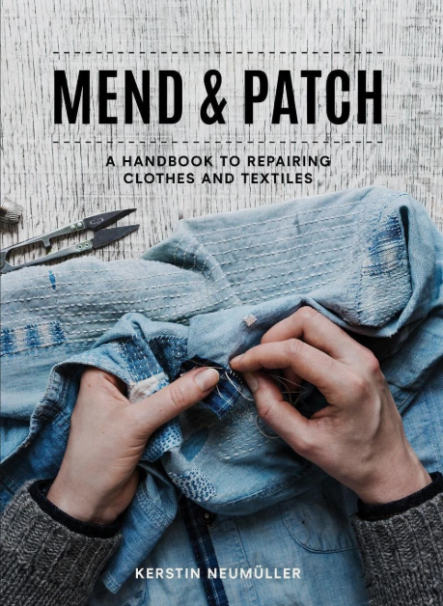
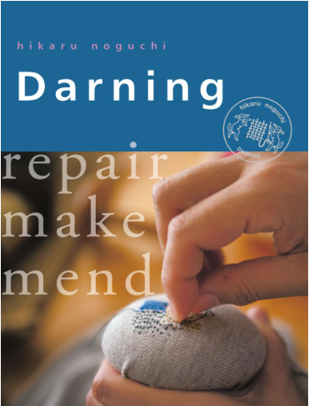
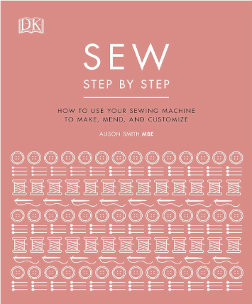
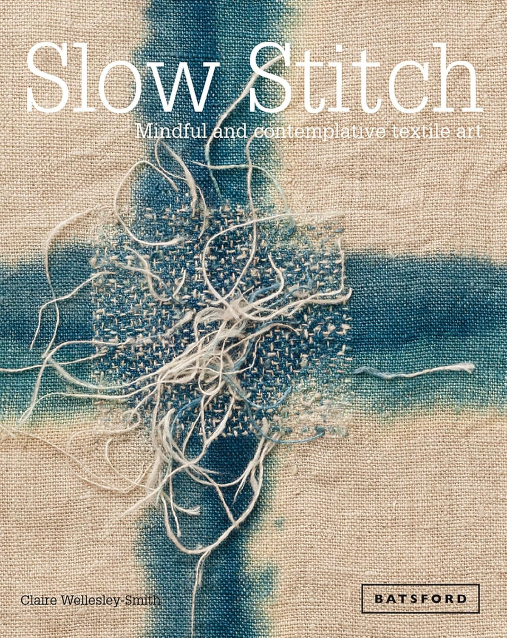
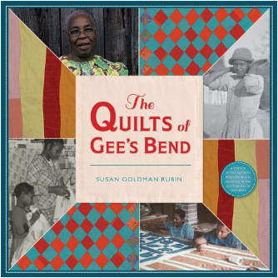
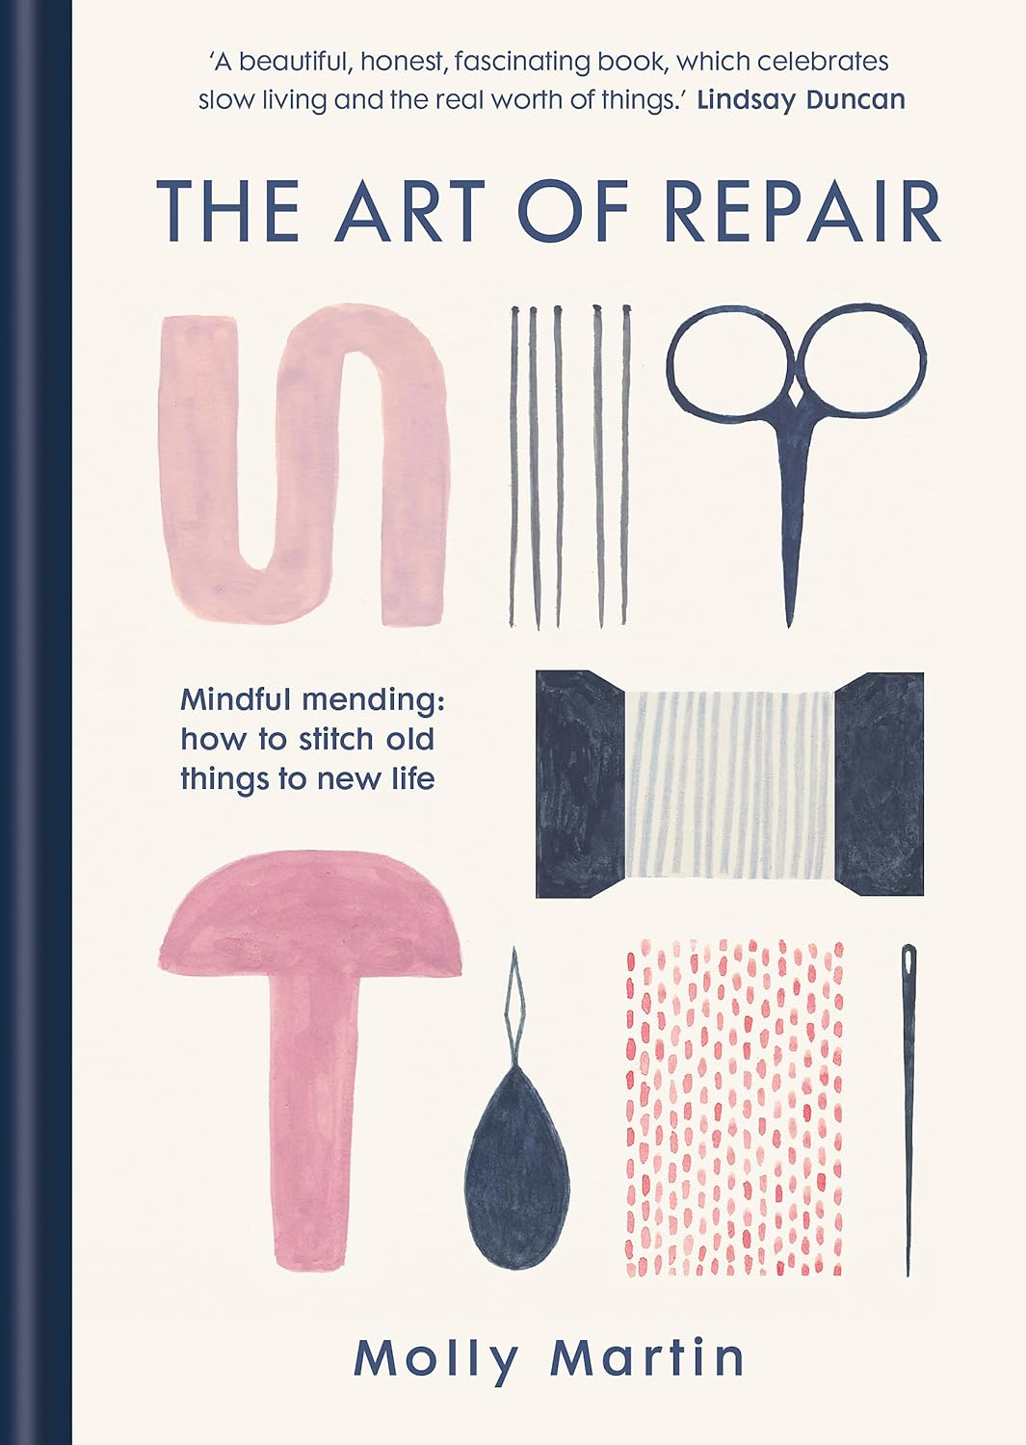
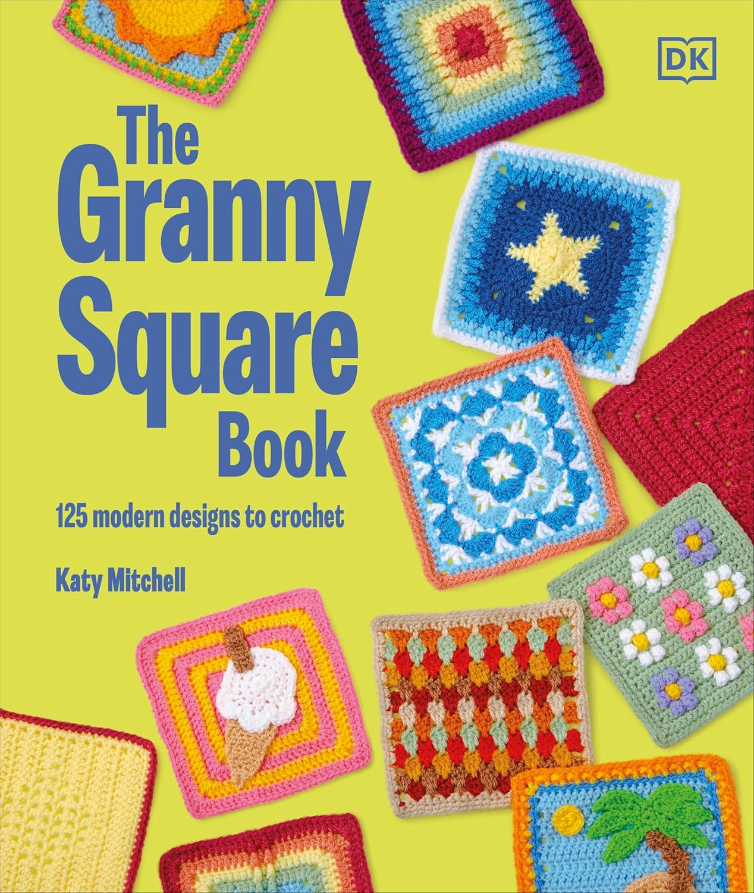
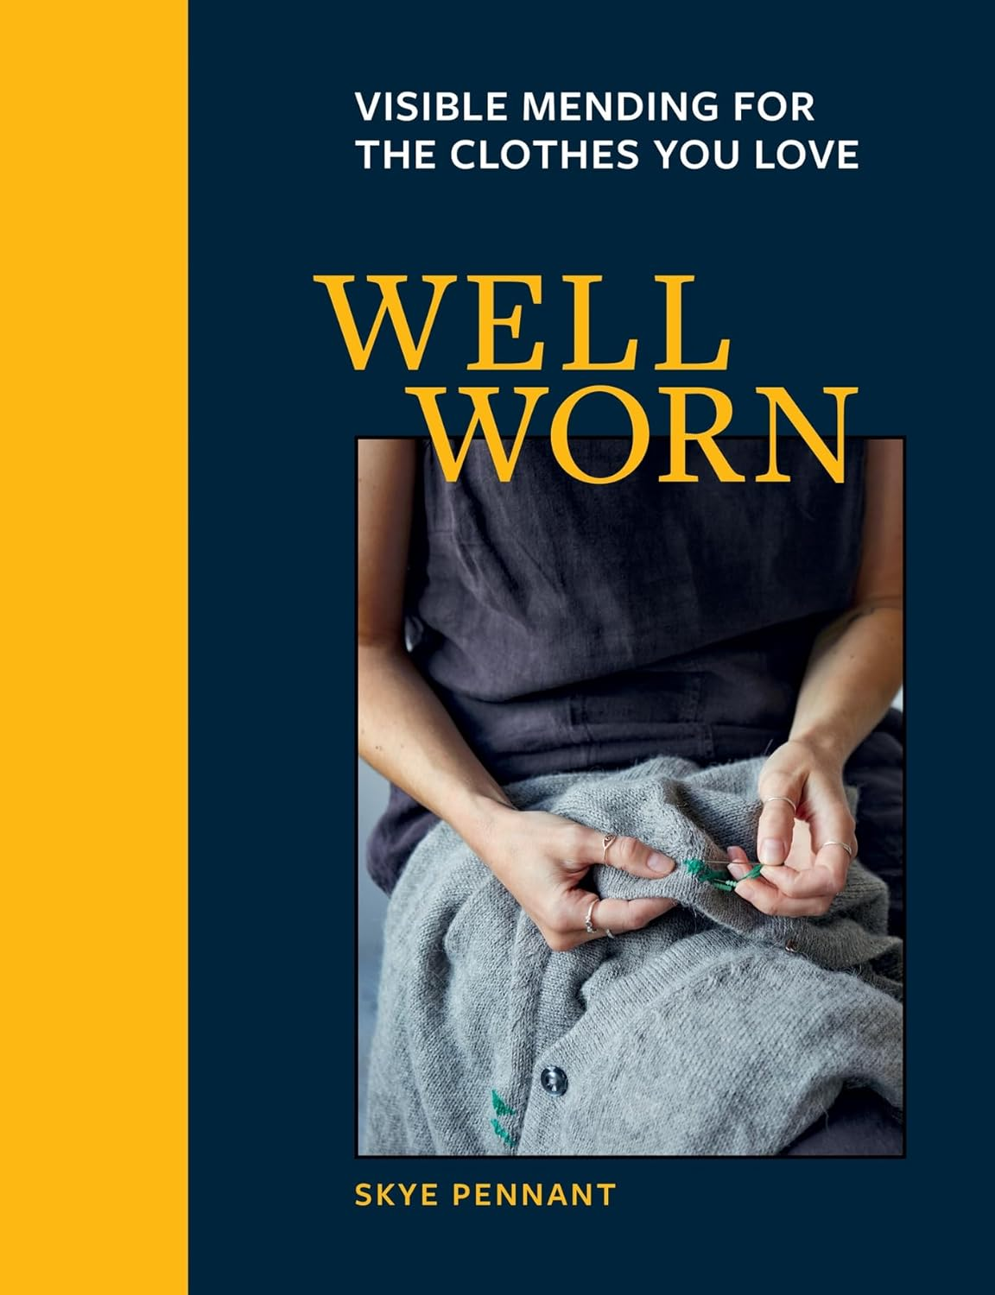
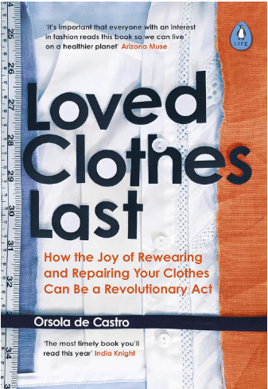
The Books

Slide 6
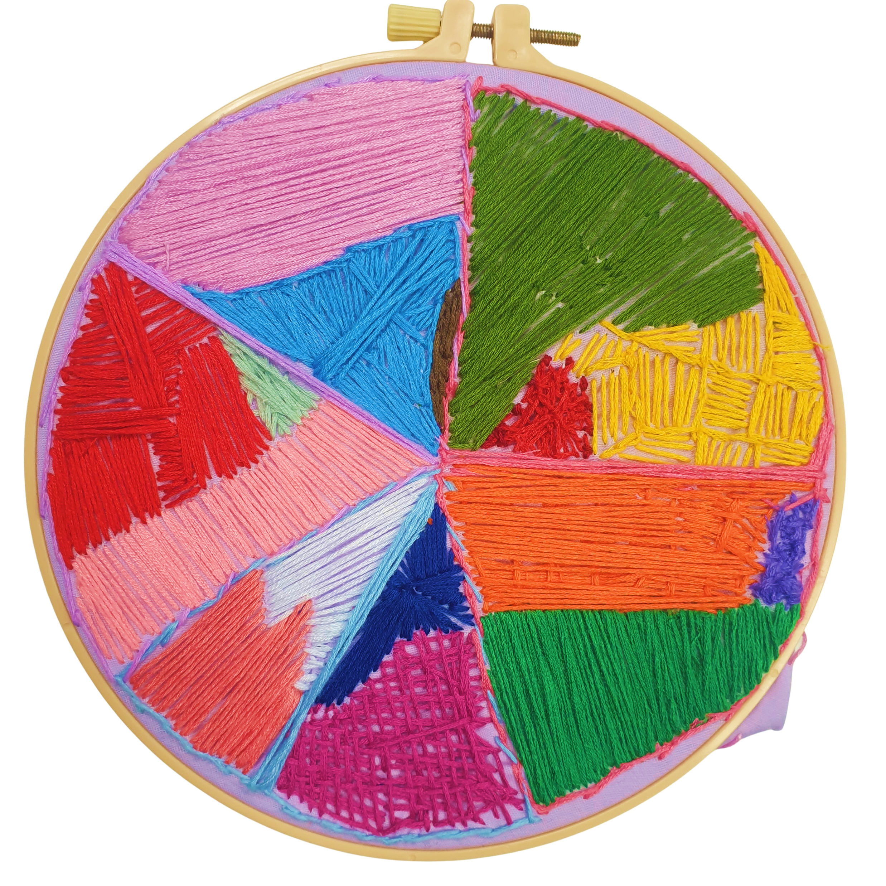
Community of Practice
Defined by Etienne and Beverly Wenger-Trayner as a group of people who "share a concern or a passion for something they do and learn how to do it better as they interact regularly."
3 Pillars:
Domain
Community
Practice
“Members of a community of practice are practitioners. They develop a shared repertoire of resources: experiences, stories, tools, ways of addressing recurring problems—in short a shared practice.” Etienne and Beverly Wenger-Trayner

Slide 7
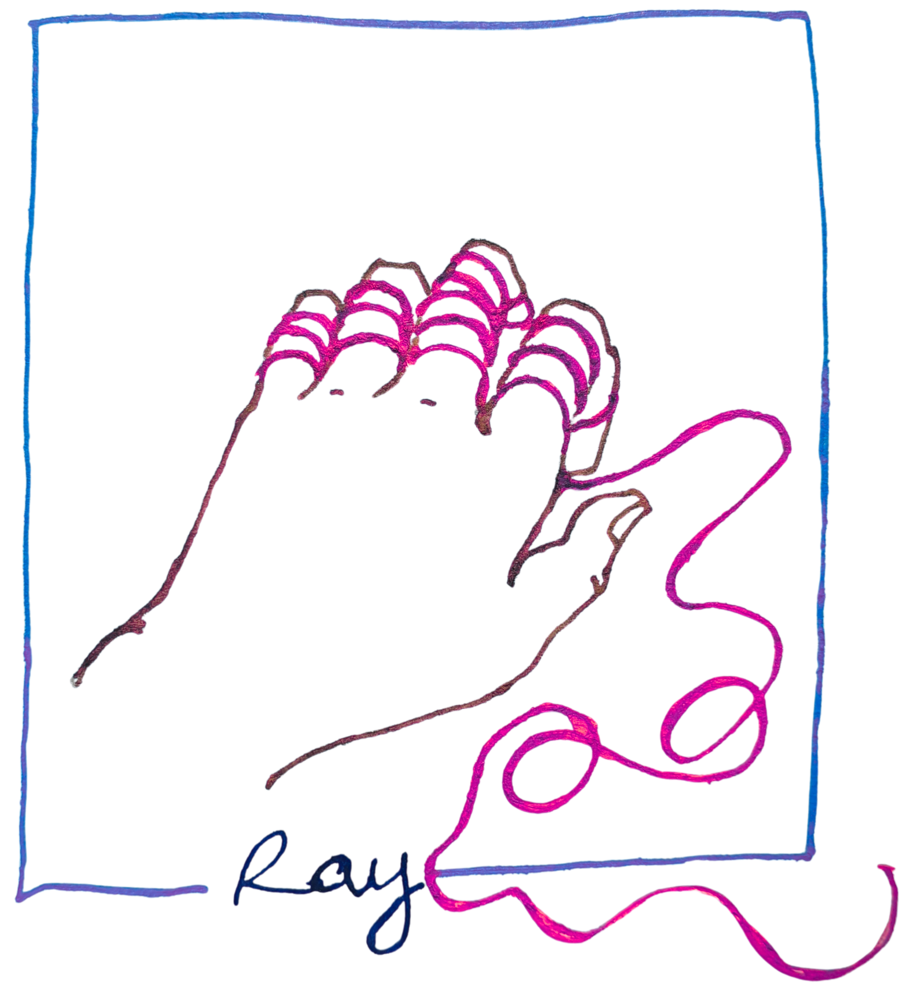
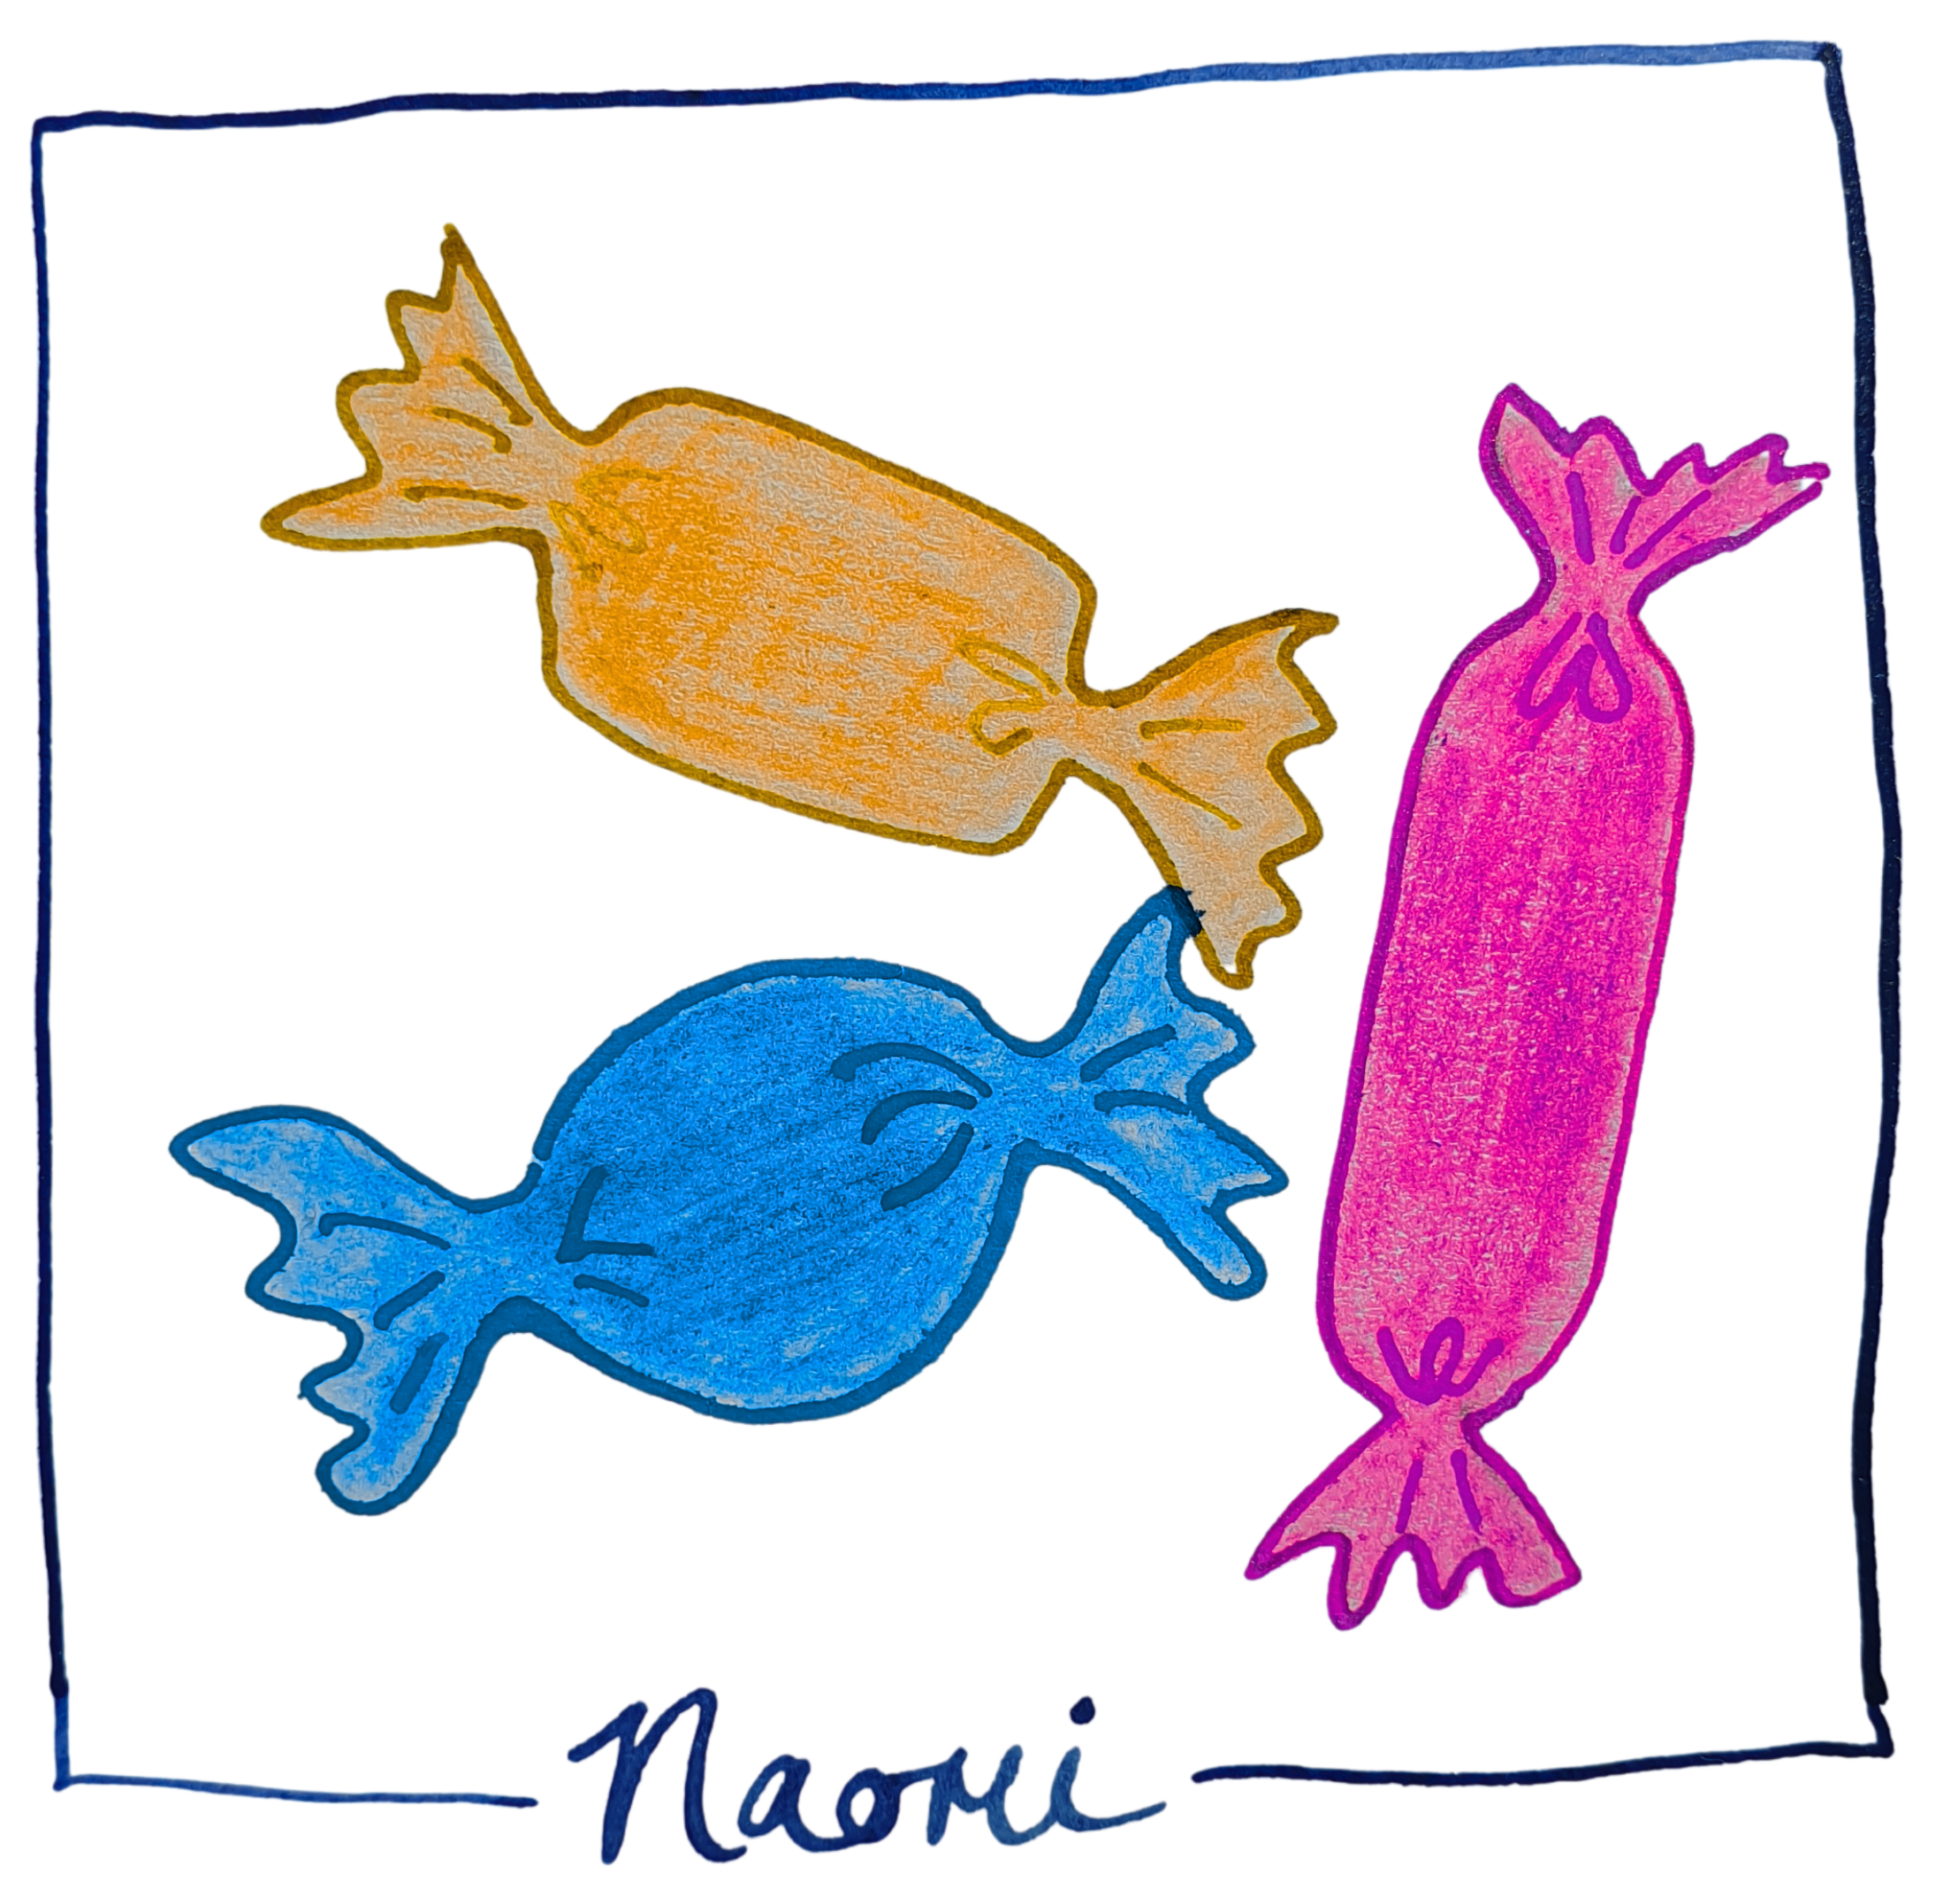
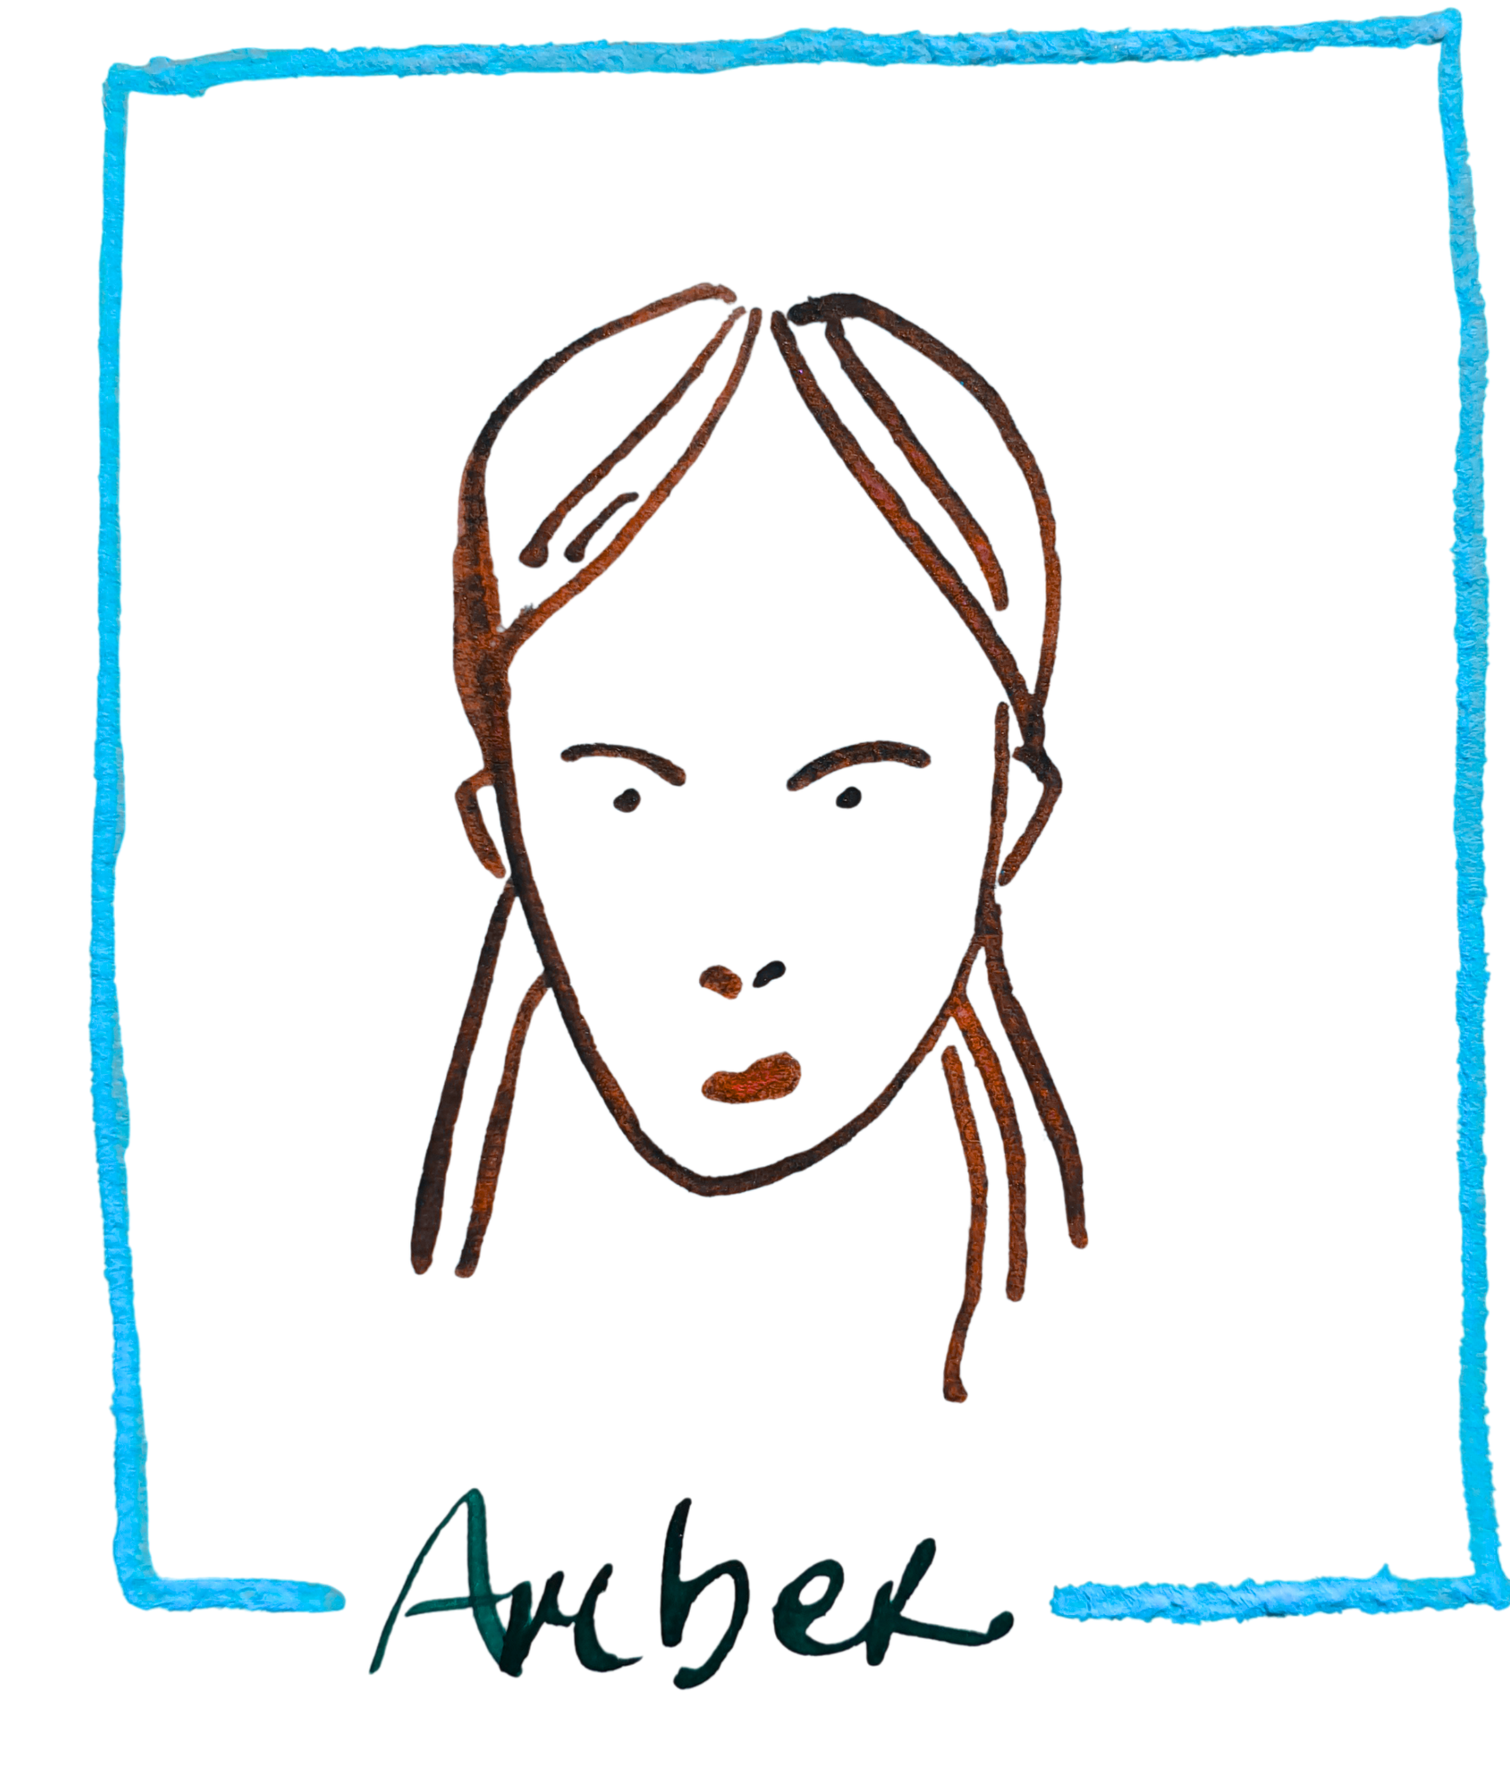
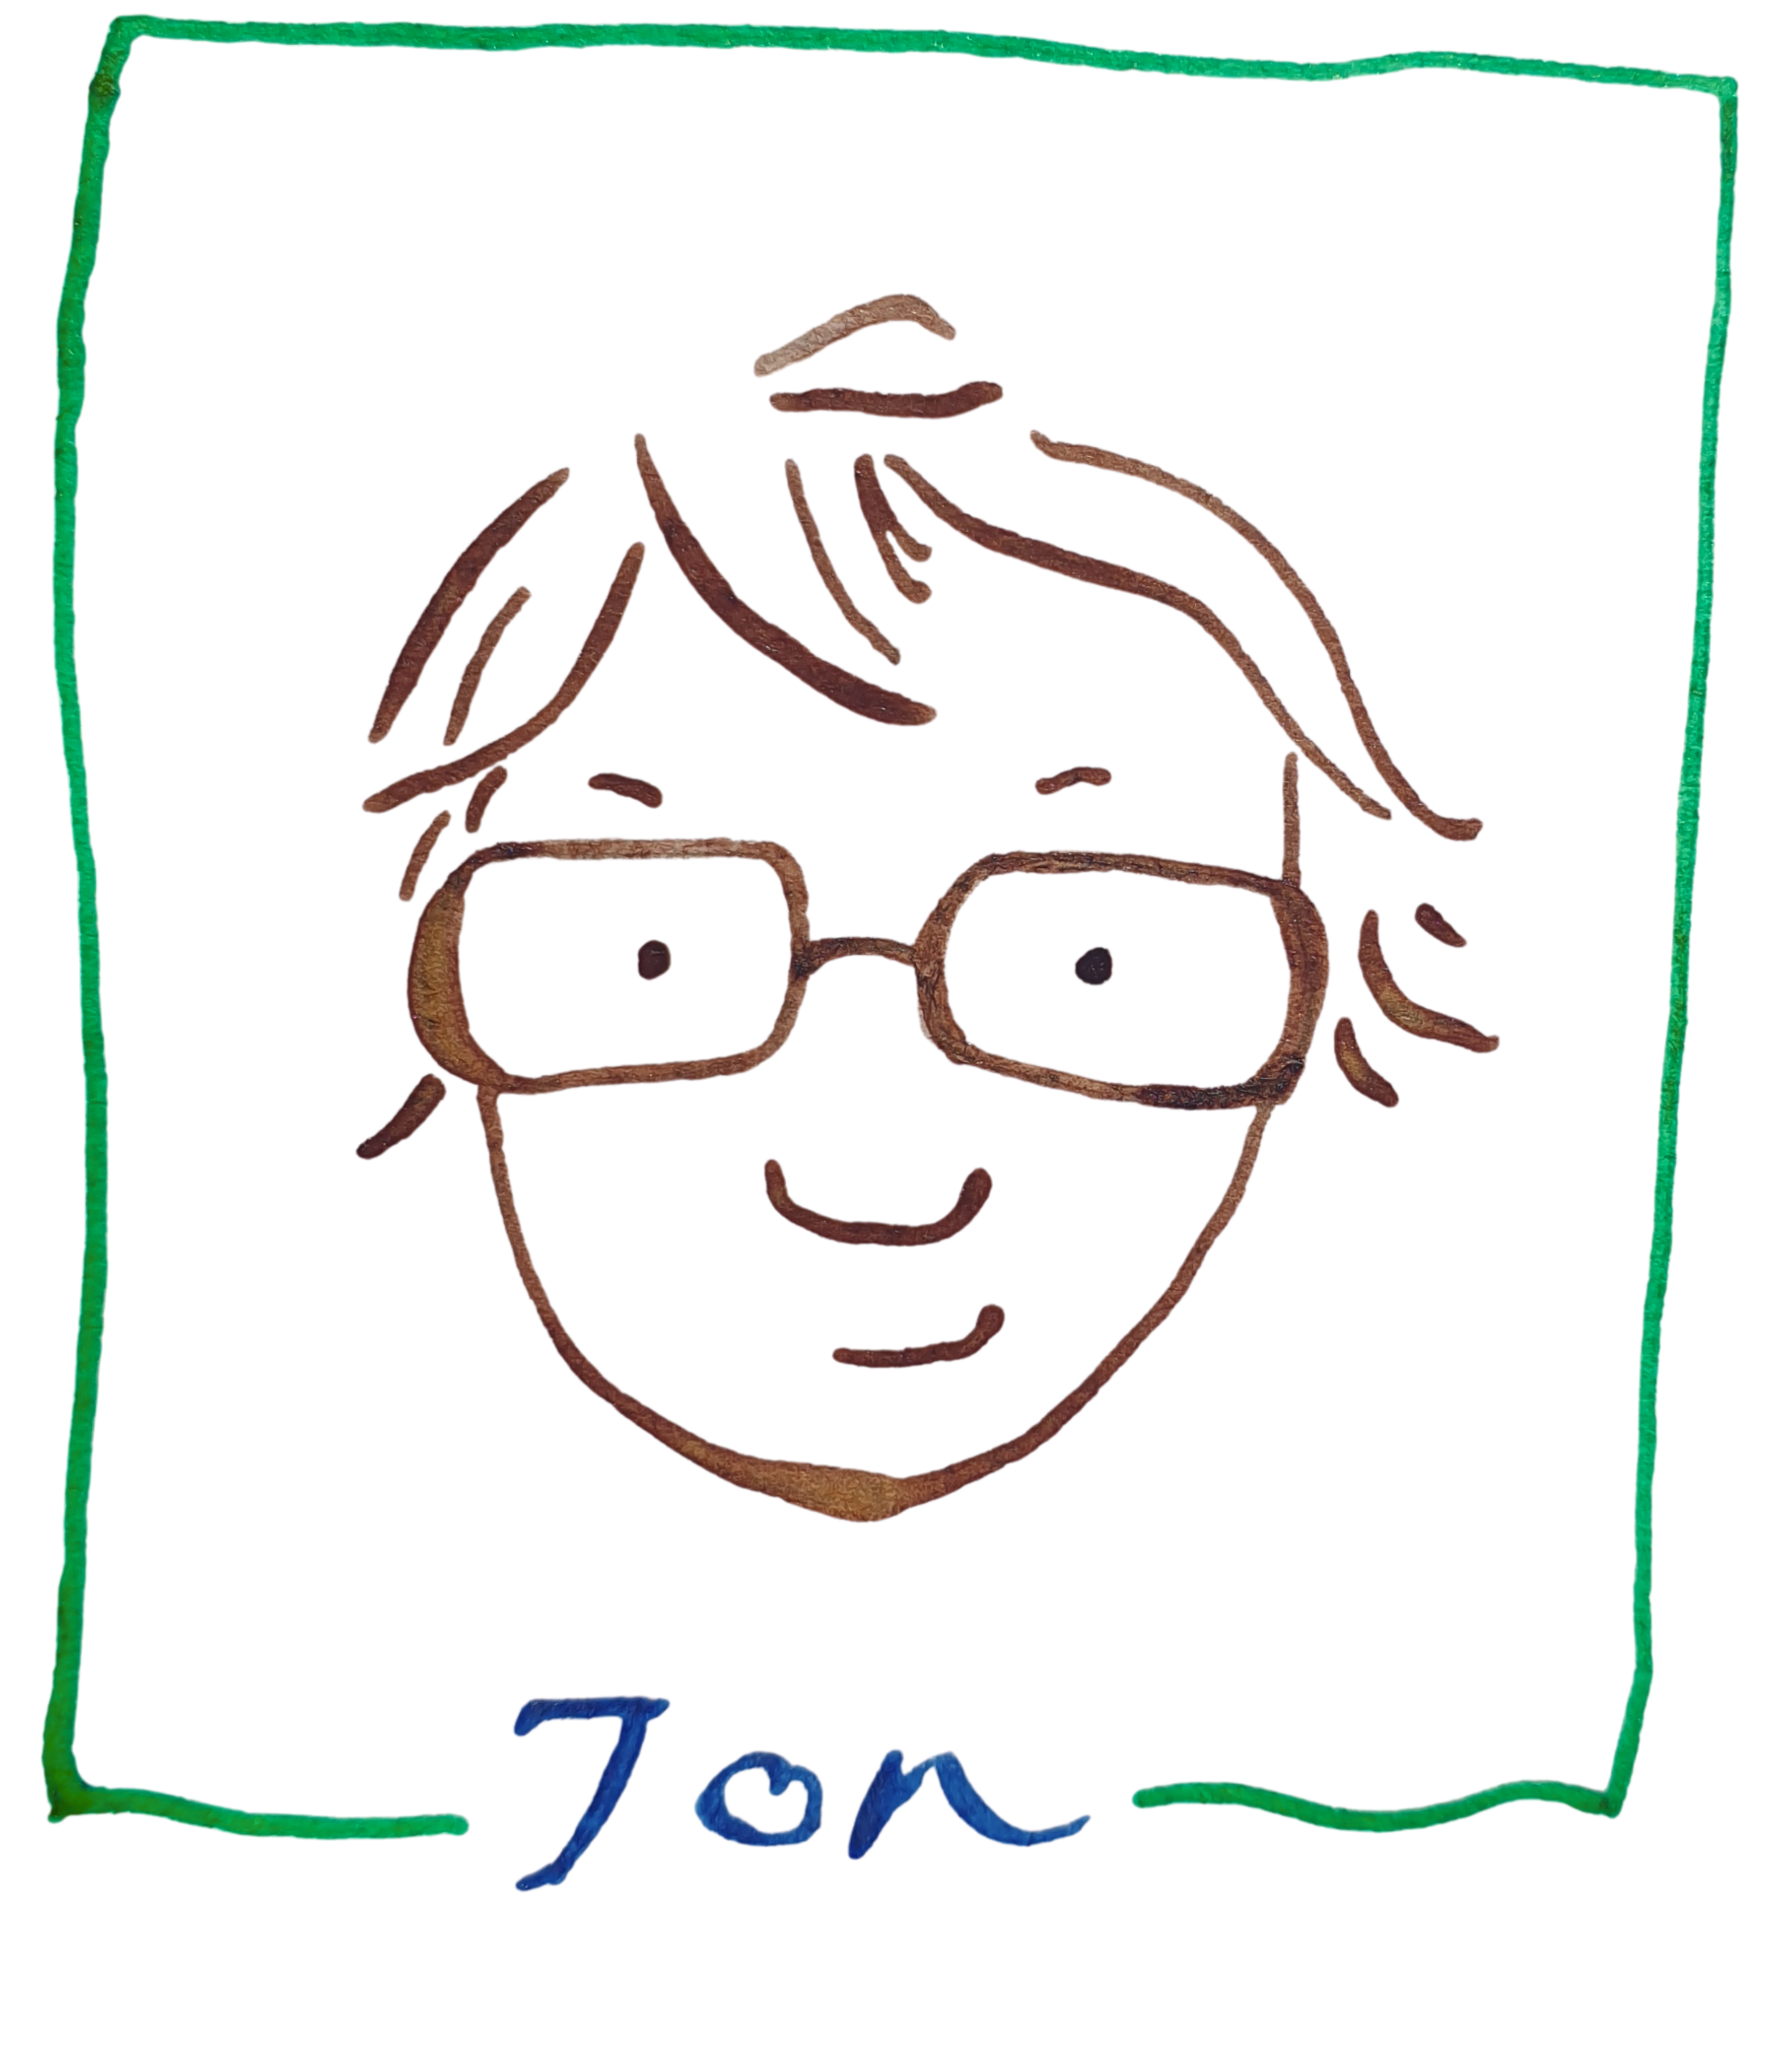
Community Builders
and how they build

Slide 8
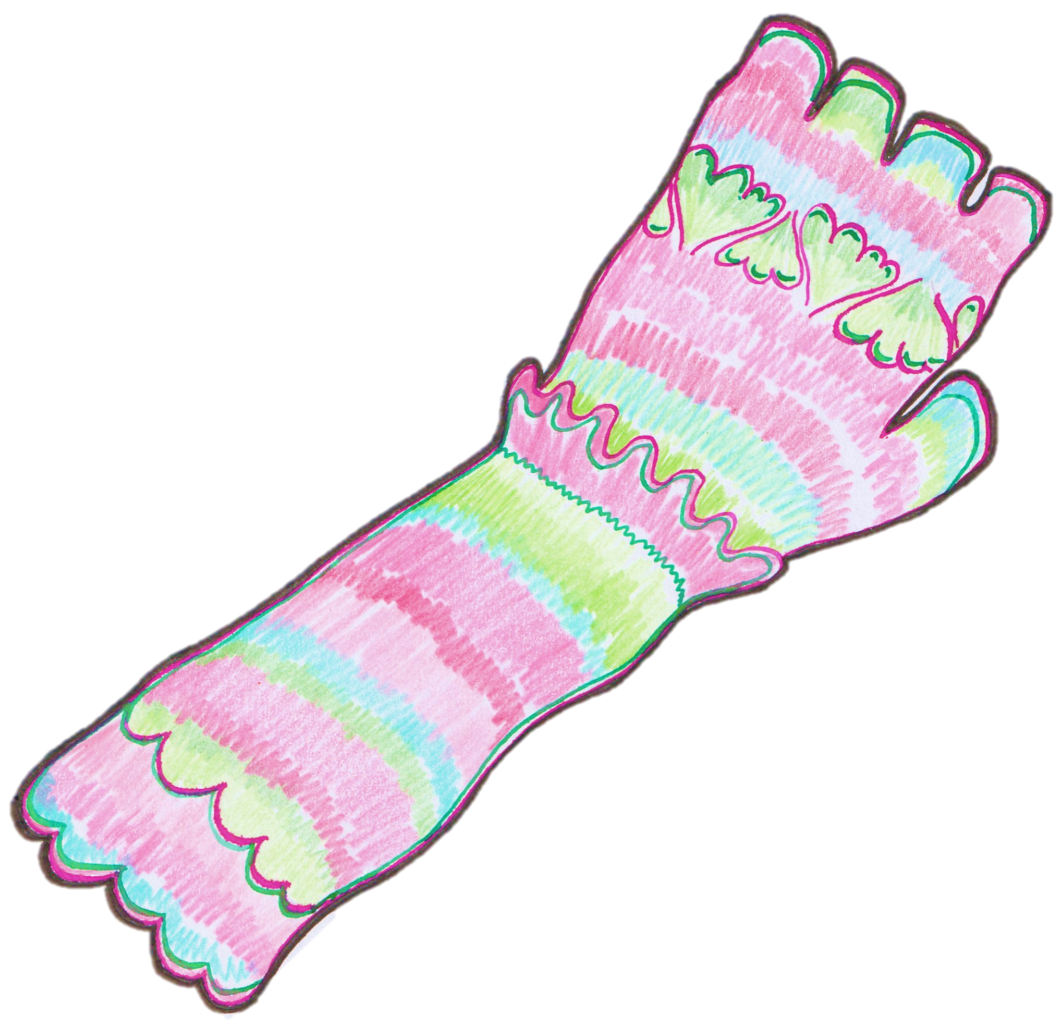
"To repair something (anything) in the modern world is a defiant act."
Martin, M. (2021). The art of repair: Mindful Mending: How to Stitch Old Things to New Life. Short Books.

Slide 9
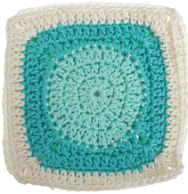
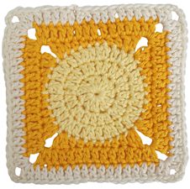
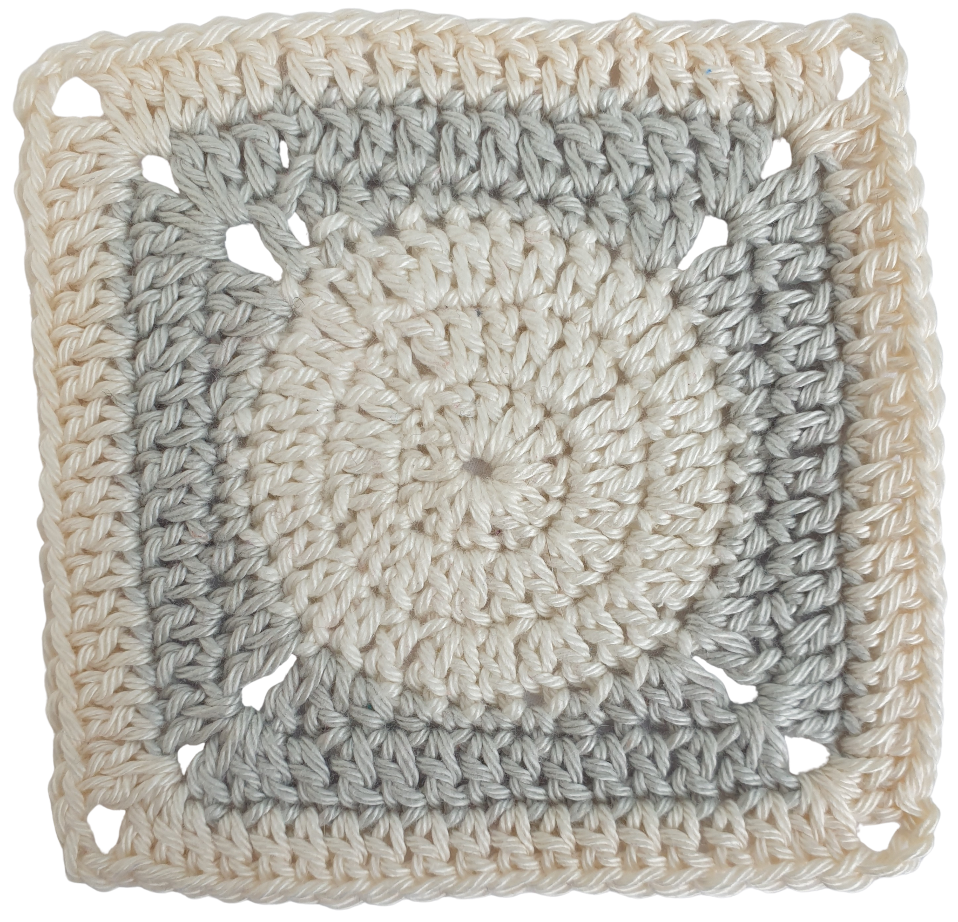
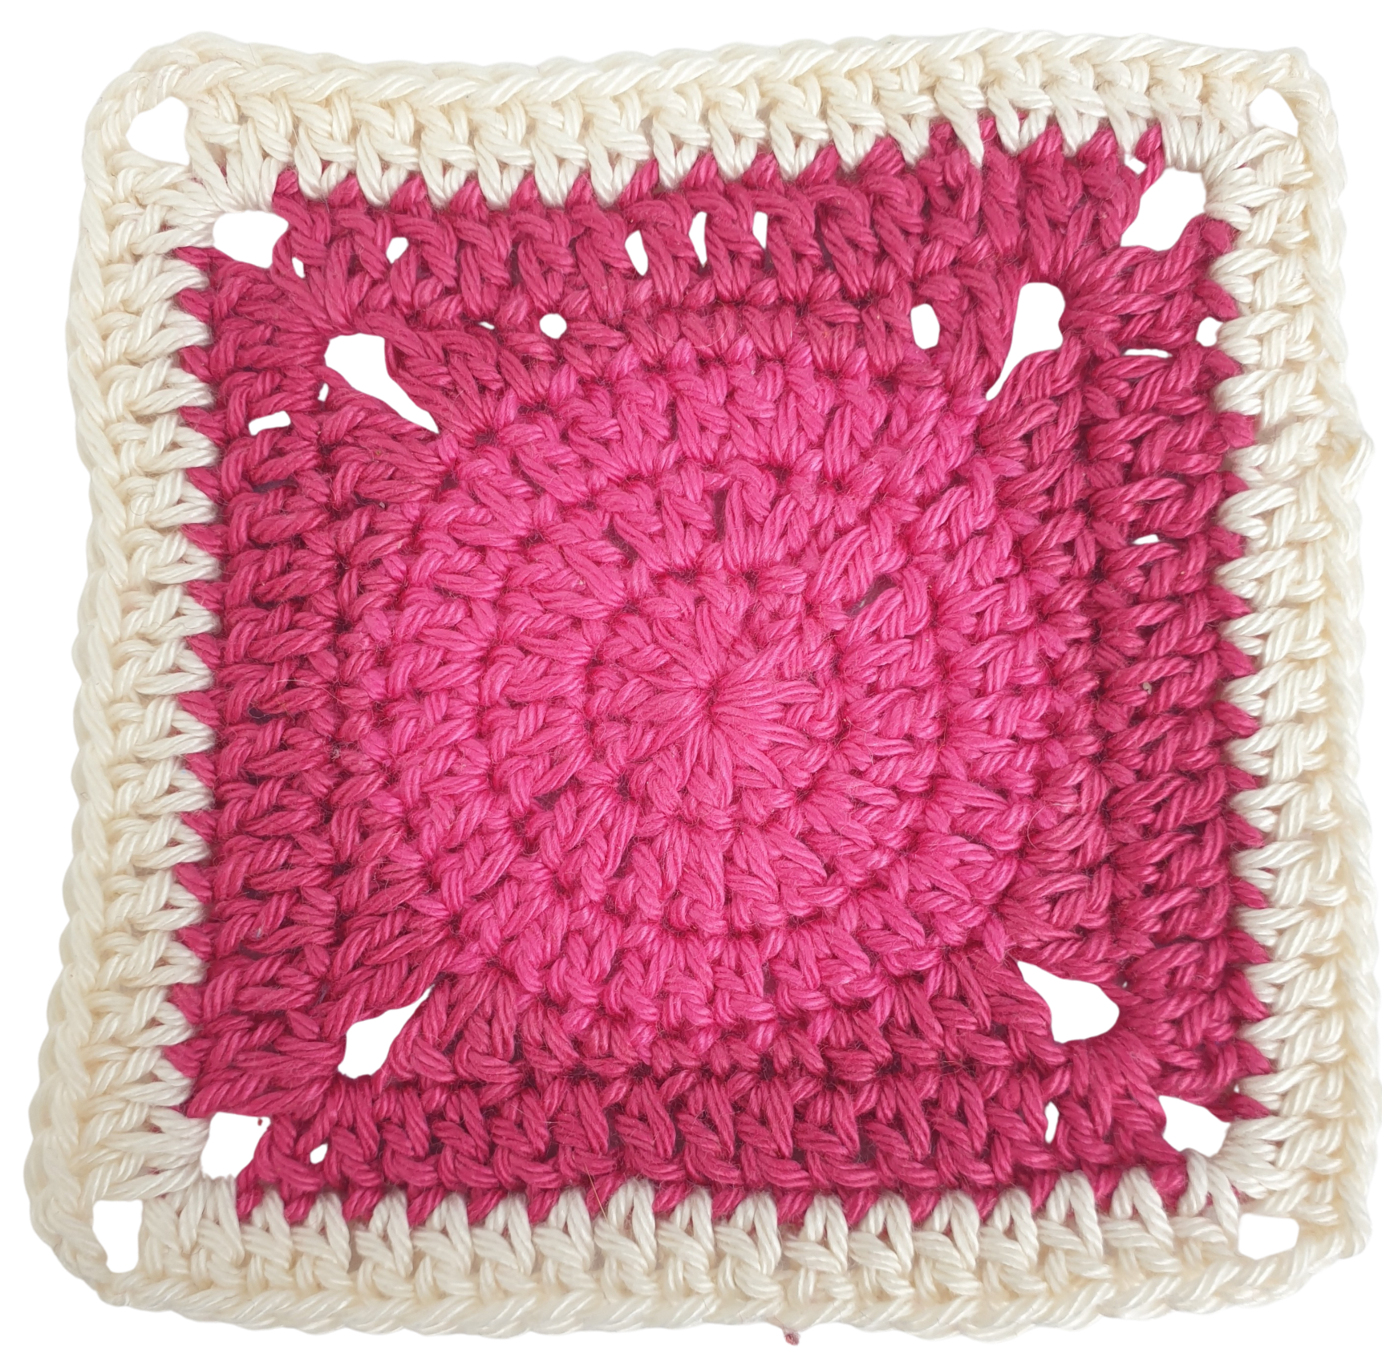
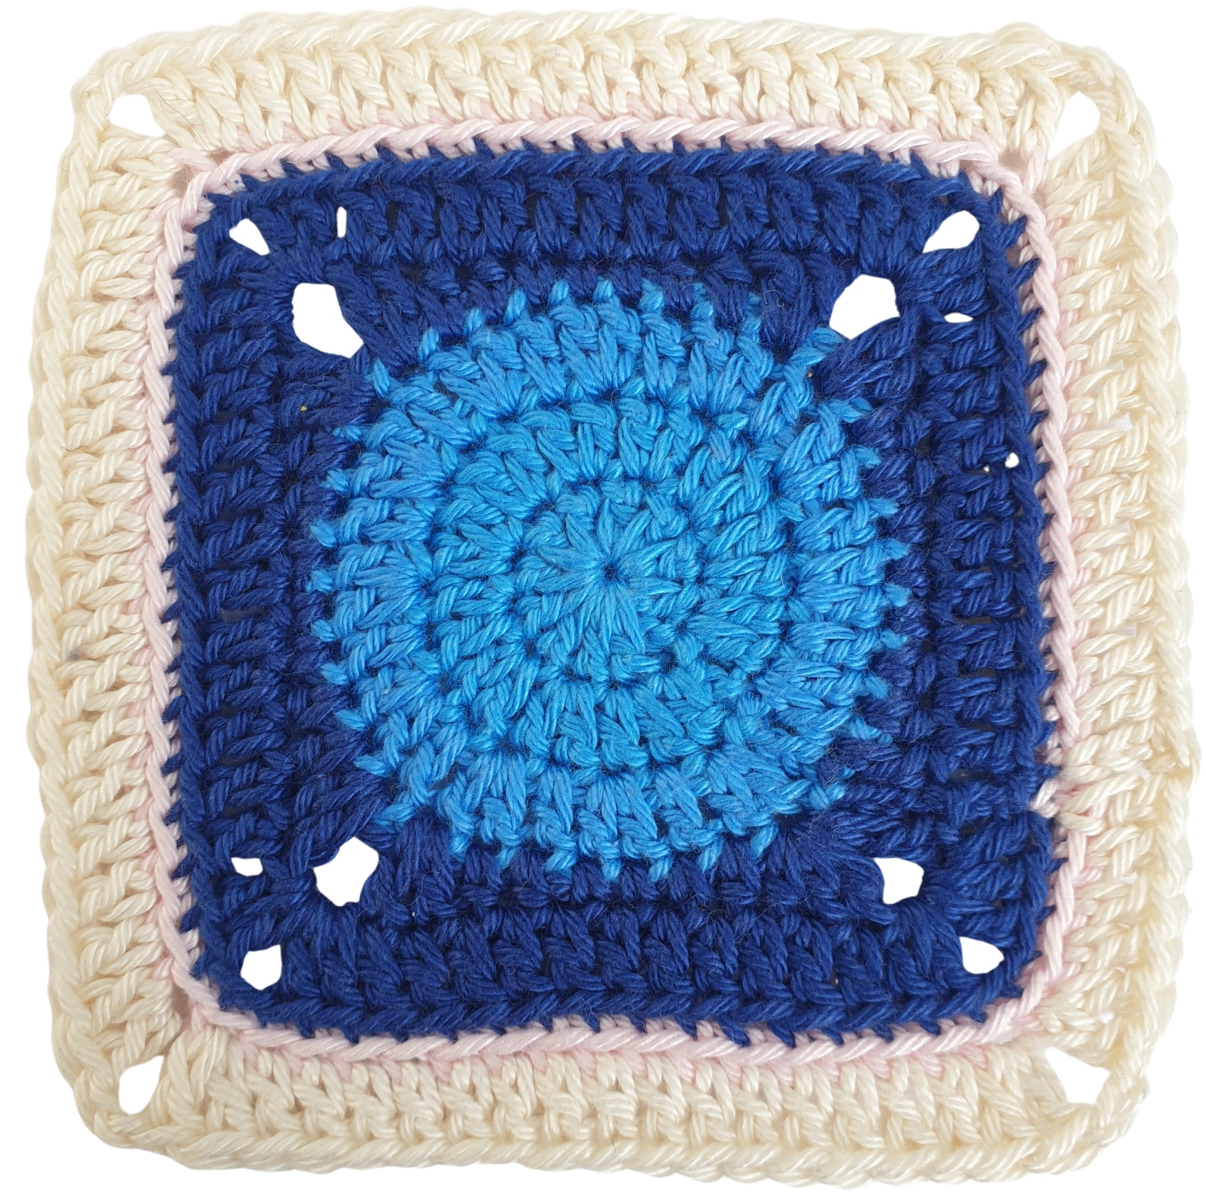
References
Bonelli, F., Caferra, R., & Morone, P. (2024). In need of a sustainable and just fashion industry: identifying challenges and opportunities through a systematic literature review in a Global North/Global South perspective. Discover Sustainability, 5(1). https://doi.org/10.1007/s43621-024-00400-5
Kim, Y., Acaf, Y., & Kim, J. (2025). Fast fashion’s environmental CSR through NGO collaboration: The impact of collaboration level and environmental focus on CSR authenticity and consumer responses. Public Relations Review, 51(3). https://doi.org/10.1016/j.pubrev.2025.102585
Martin, M. (2021). The art of repair: Mindful Mending: How to Stitch Old Things to New Life. Short Books.
National Forum for the Enhancement of Teaching and Learning in Higher Education. (2025). Strategic Alignment of Teaching and Learning Enhancement Funding in Higher Education. teachingandlearning.ie. Retrieved March 20, 2026, from https://www.teachingandlearning.ie/funding/
Wenger-Trayner, E., & Wenger-Trayner. (2015, June). Introduction to communities of practice. Wenger-trayner. https://www.wenger-trayner.com/introduction-to-communities-of-practice/

