Slide 1
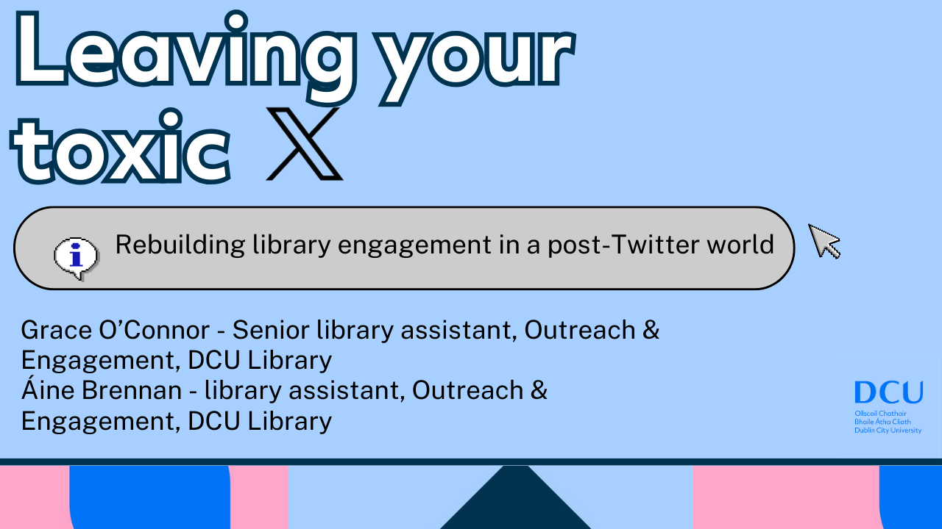

Slide 2
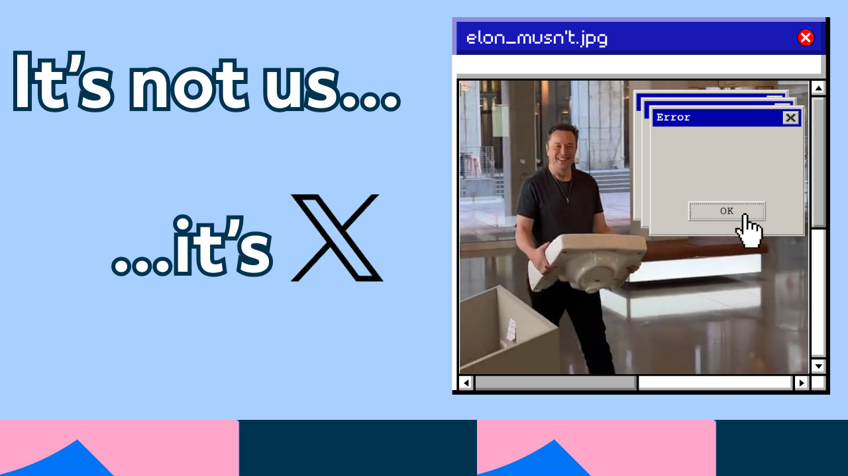

Slide 3
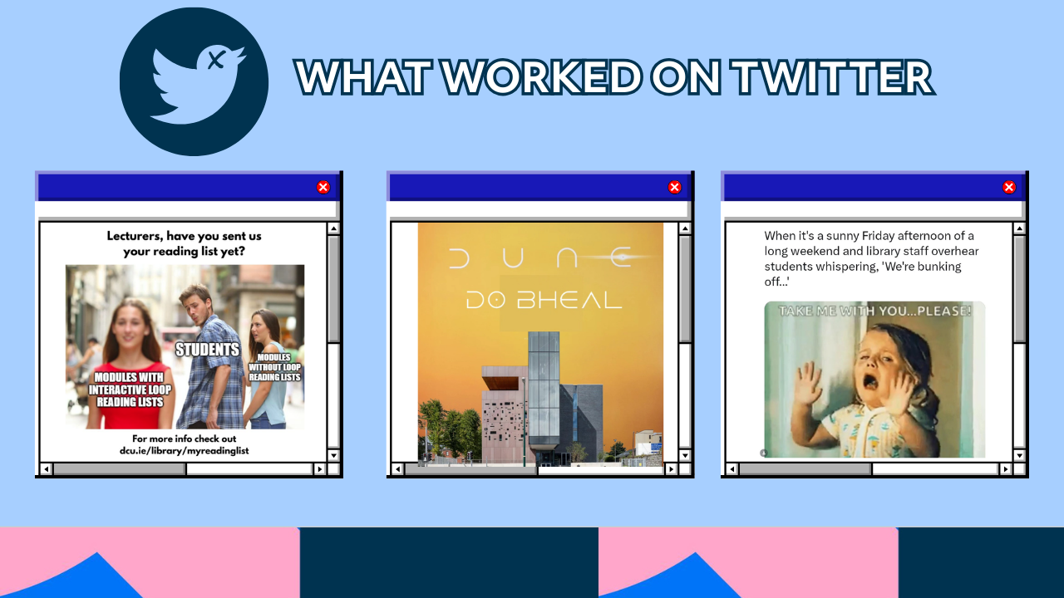

Slide 4
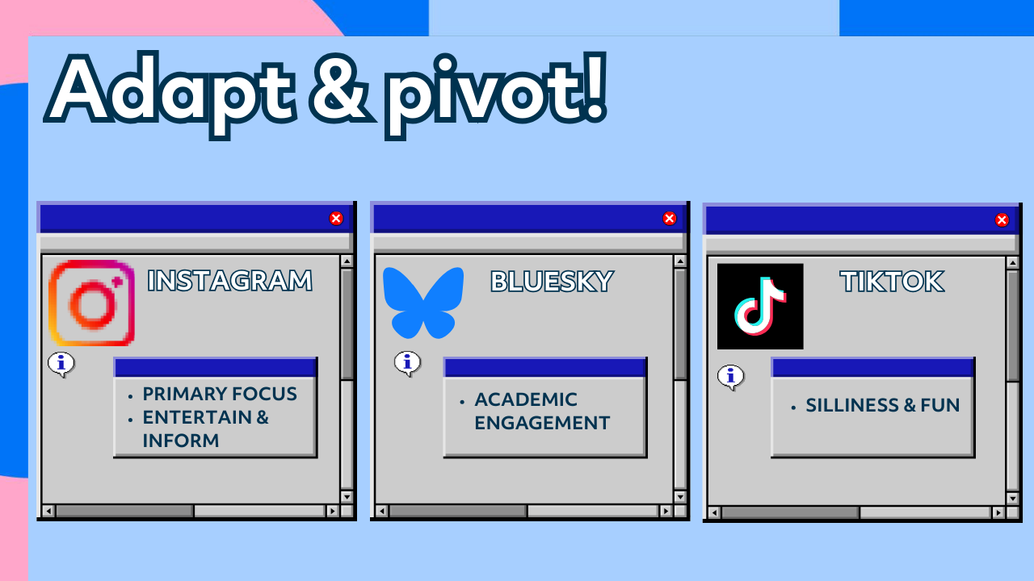

Slide 5
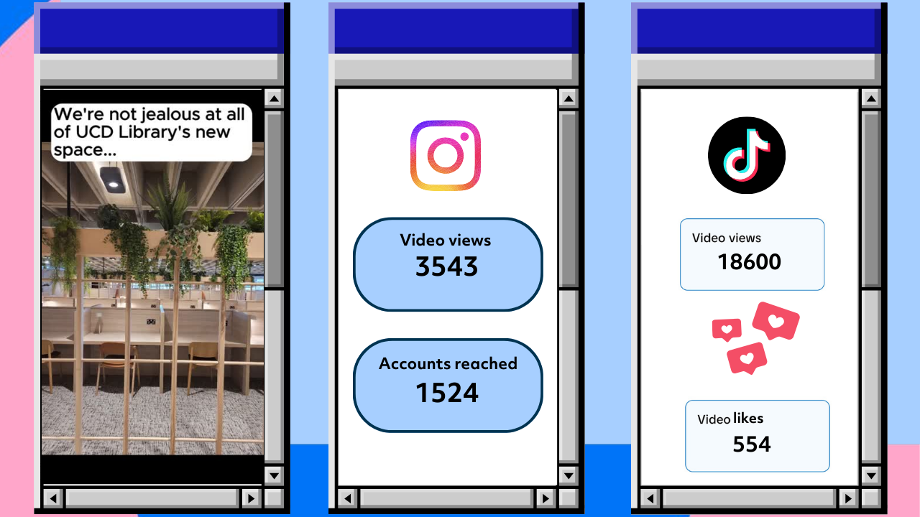
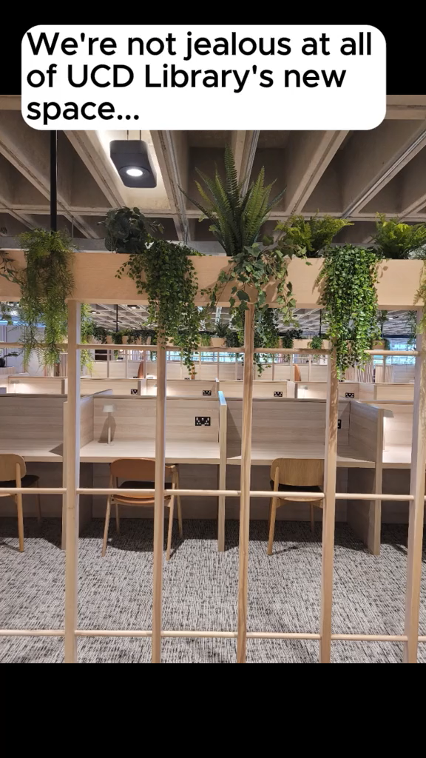

Slide 6
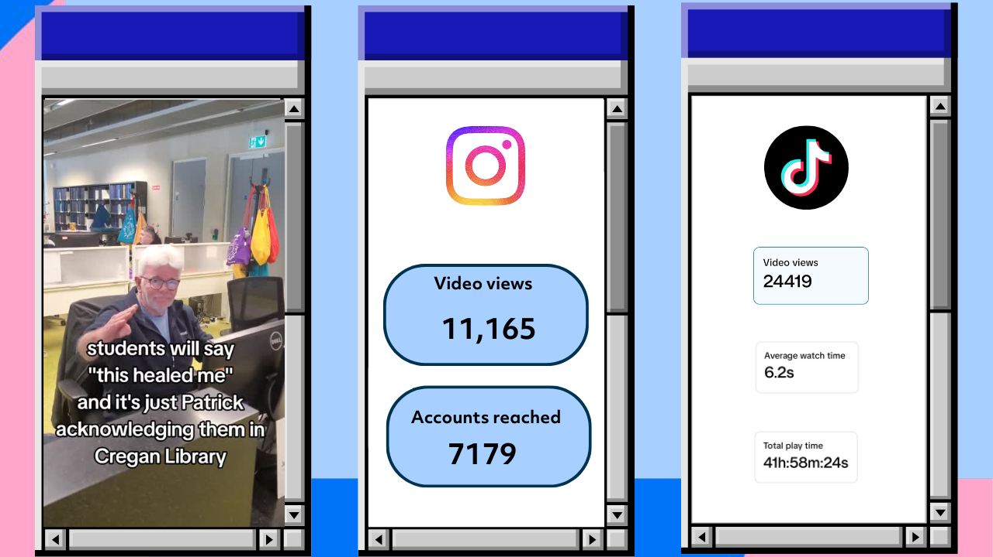
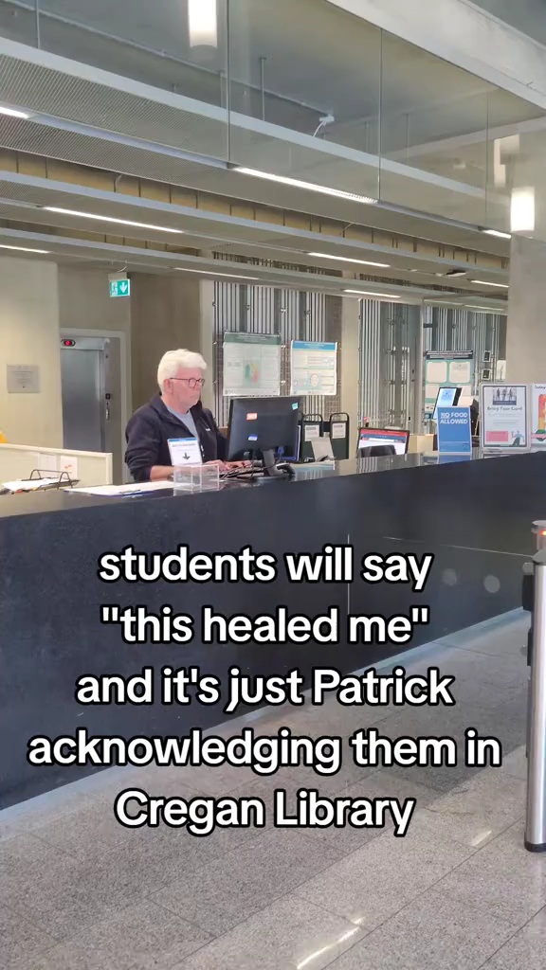

Slide 7
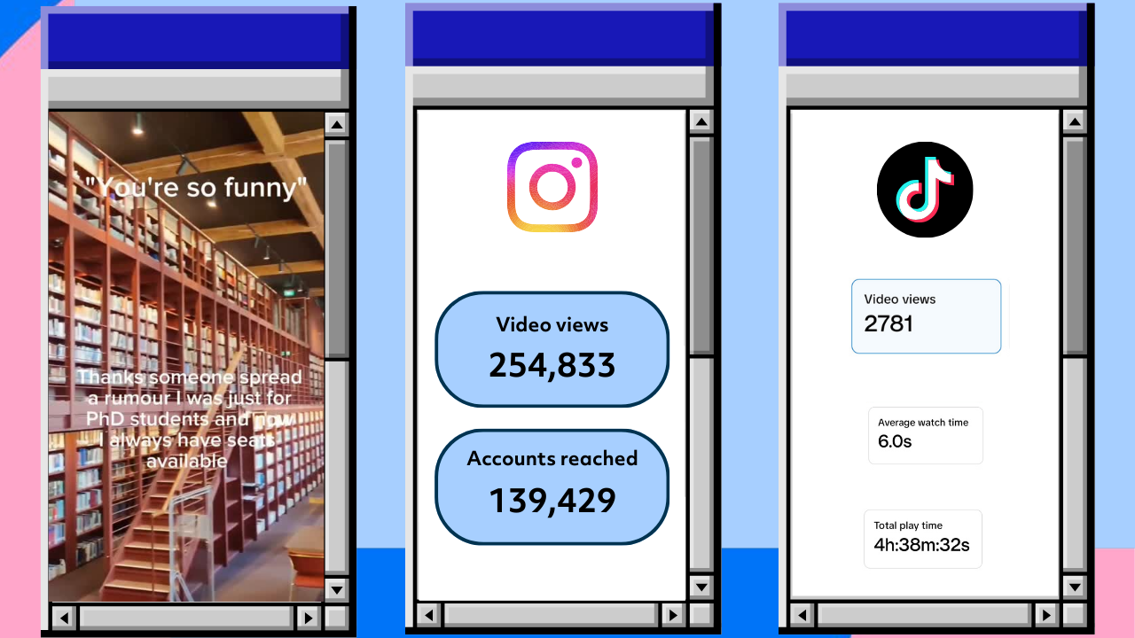
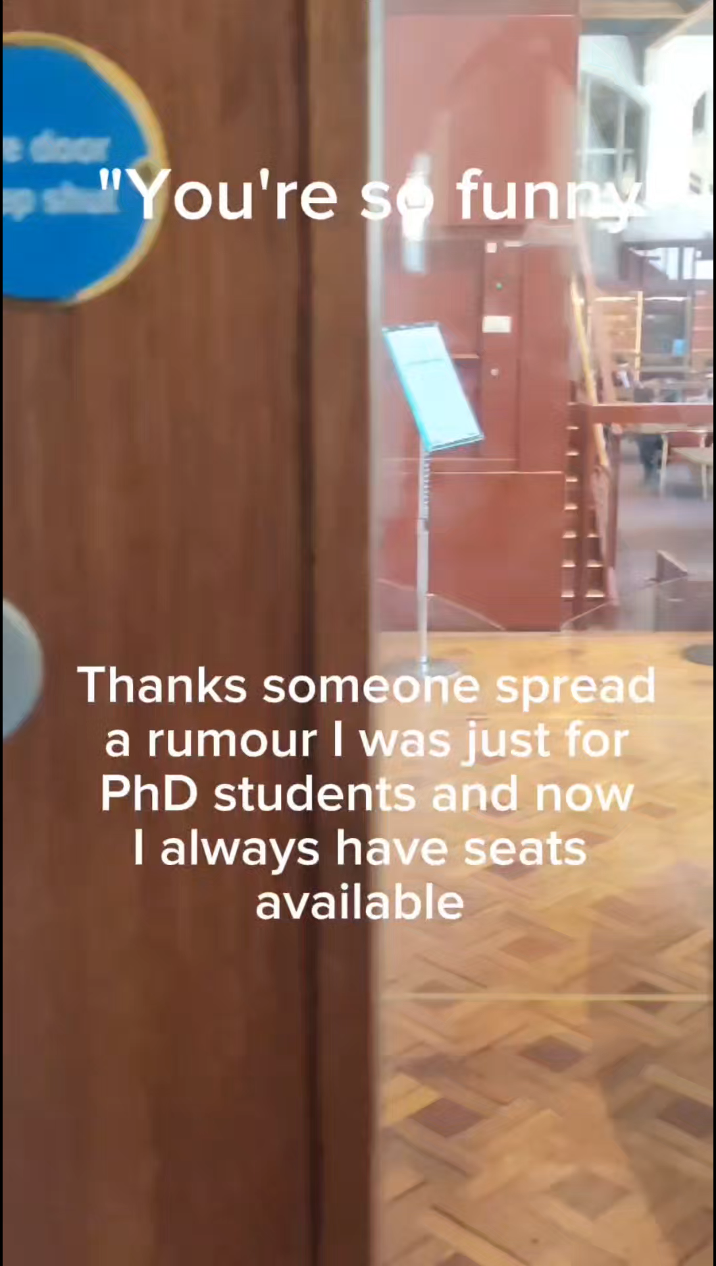

Slide 8
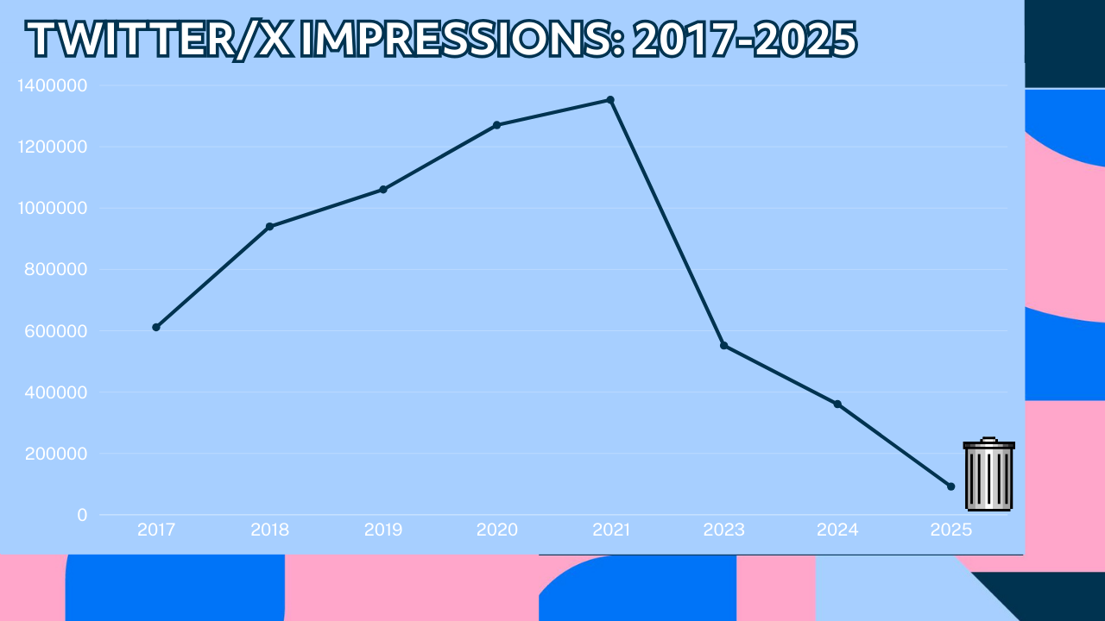

Slide 9
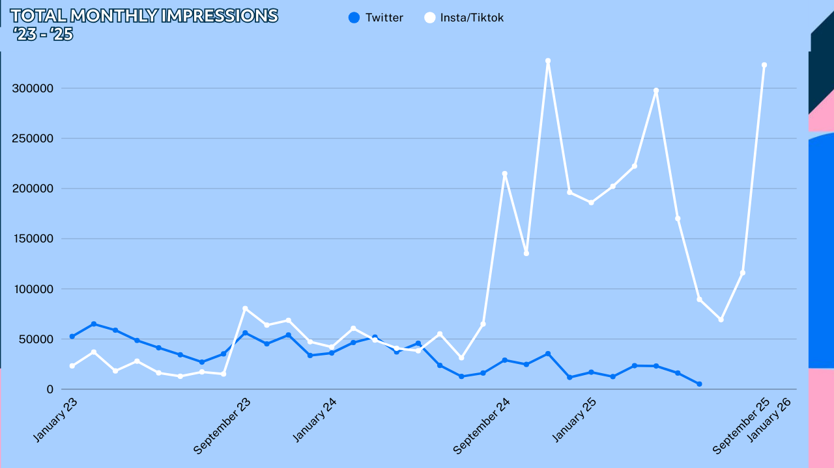

Slide 10
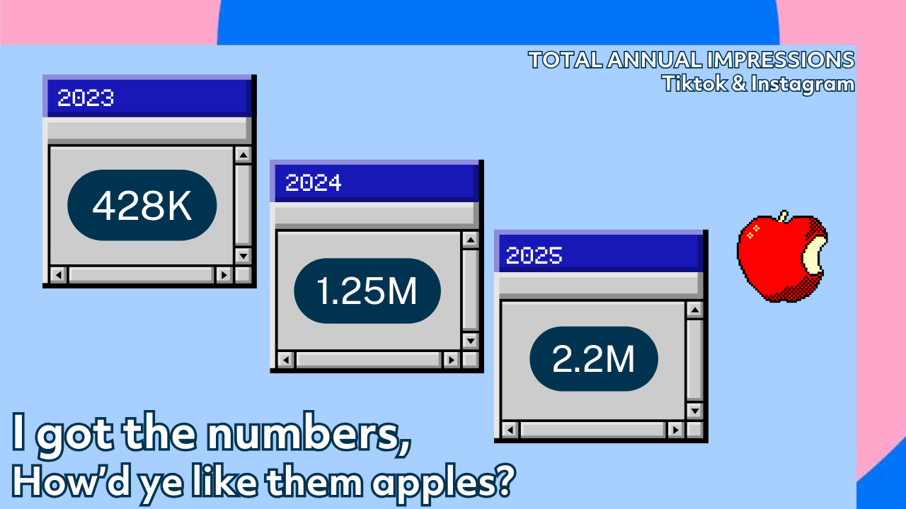

Slide 11


Slide 12
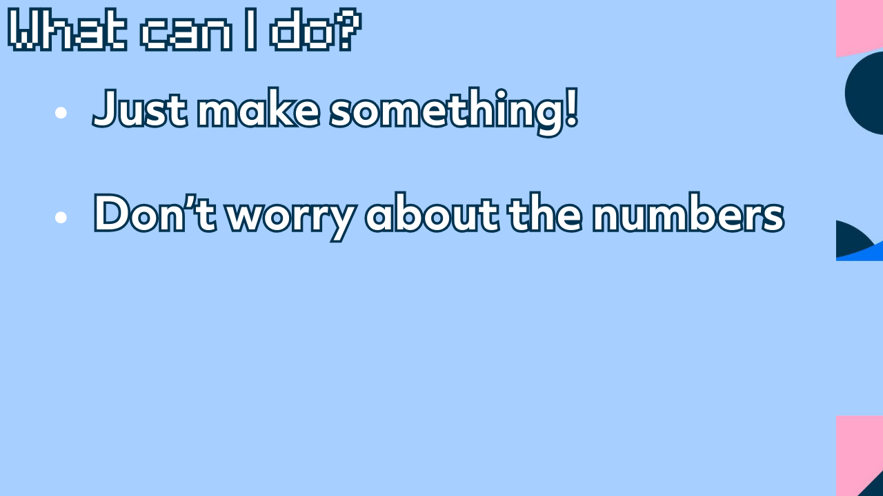
Notes:
The first thing I’d say, to managers especially, is let people try things. Playfulness isn’t unprofessional. Yes, libraries are spaces of serious academic research, but its also the space where students just hangout and have the craic, and your social platforms can reflect this. If you want to try something funny, go for it. The worst that can happen is the alghorithm ignores it, and we’ve definitely had that happen with thing we thought we do great numbers. Which brings me to my next point…

Slide 13
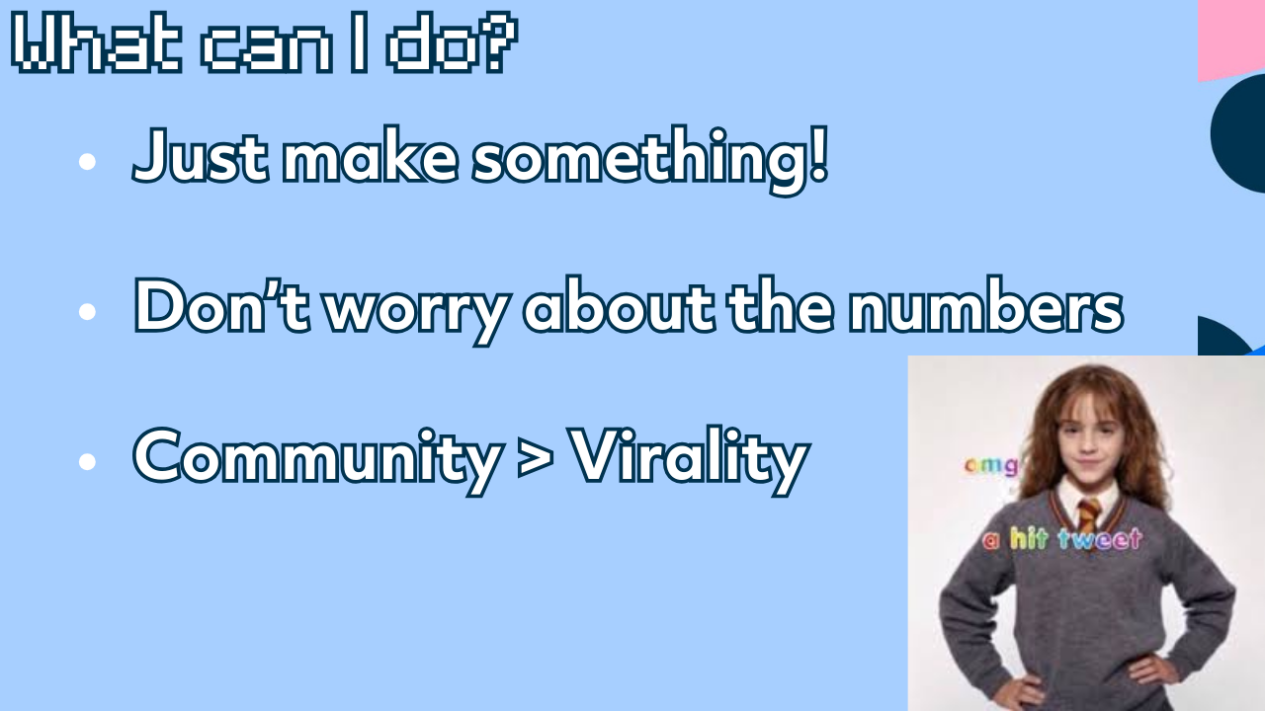

Slide 14



Slide 15
