Slide 1

30 years of navigating new information landscapes: purpose, practice & possibility
Ann O’Sullivan – Library Manager
A&SL Conference 24 March 2026

Slide 2



Reflections on an evolving career
Context
Change & Challenges
Contemplating the future

Slide 3





Context

Slide 4
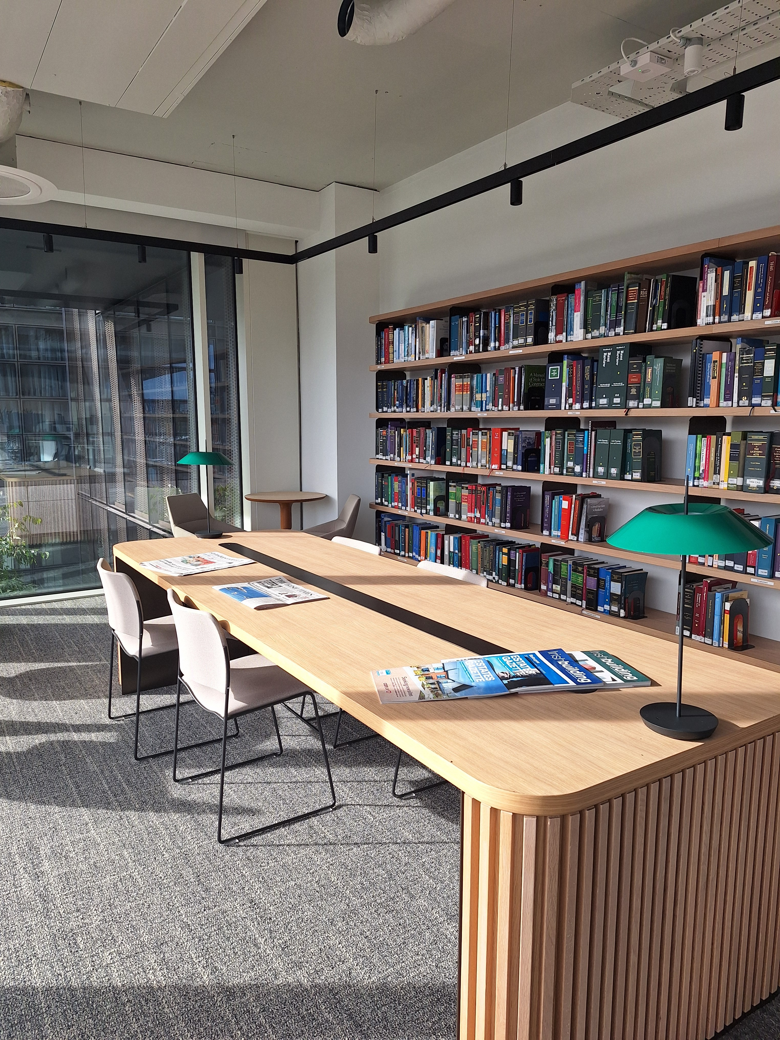
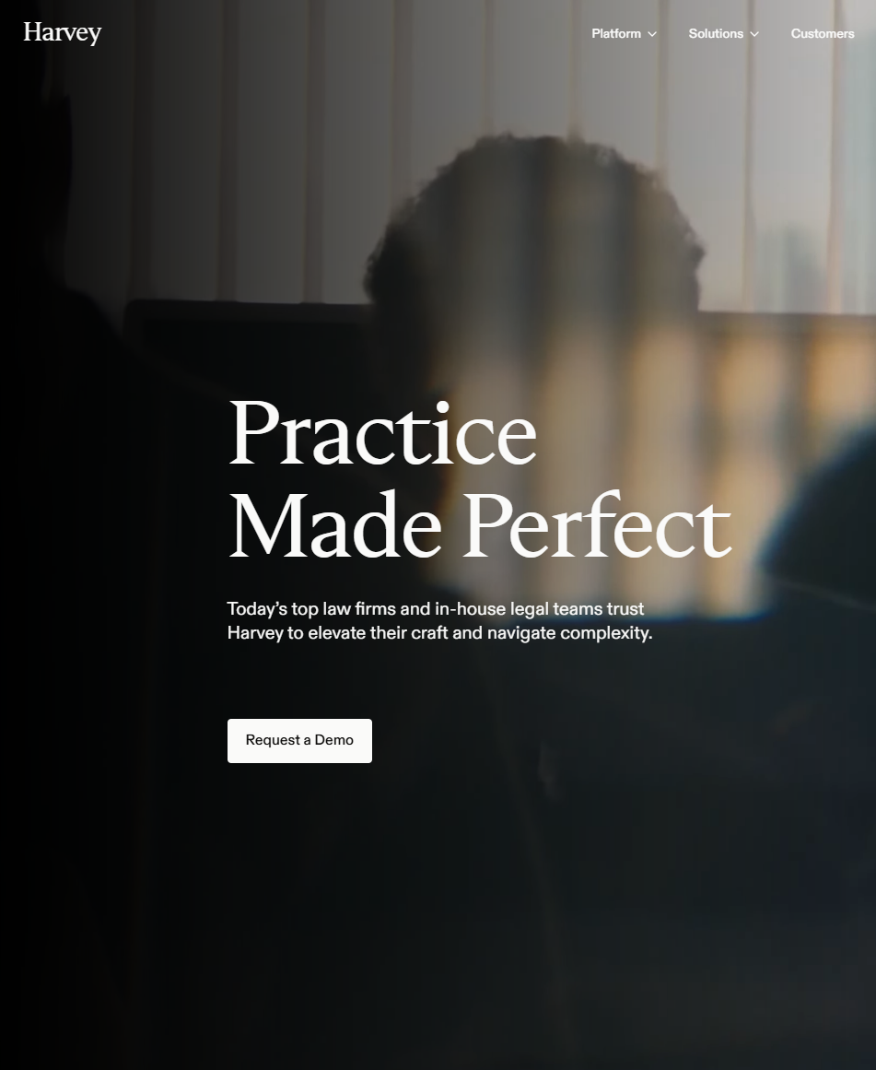
The future
is present

