Slide 1



Standing Firm: The Role of Public Librarians in Defending LGBTQ+ Resources Amidst Rising Disruption
Claire McGuinness, UCD
with Páraic Kerrigan, Crystal Fulton, Eugenia Siapera, Faye Carrie, Feargal Keenan

Slide 2

Outline
Context: Librarians, Social Responsibility and Vocational Awe – the Cost of Doing Good Work.
Project Background: Contested Spaces – How Irish public libraries became a target for anti-LGBTQ+ agitation.
Project description: What we did and how we did it.
Project Findings: Librarians’ Voices – Narratives of Disruption, Trauma and Resilience.
Discussion and Recommendations: Moving forward in Challenging Times.

Slide 3
Context: The cost of doing good work (1)
“Information service in the interest of social, cultural and economic well-being is at the heart of librarianship and therefore librarians have social responsibility”
(IFLA Code of Ethics for Librarians and other Information Workers, 2012)
“I want people to know when they meet a librarian that they are dealing with someone who has made a lifelong commitment to fighting inequality and injustice and to securing universal freedom of thought and expression” (Nick Poole, CILIP CEO, 2019)

Slide 4
Context: The cost of doing good work (2)
The Risks of Vocational Awe
“When the rhetoric surrounding librarianship borders on vocational and sacred language rather than acknowledging that librarianship is a profession or a discipline, and as an institution, historically and contemporarily flawed, we do ourselves a disservice […] Because the sacred duties of freedom, information, and service are so momentous, the library worker is easily paralyzed. In the face of grand missions of literacy and freedom, advocating for your full lunch break feels petty”(Fobazi Ettarh, 2018).
“Recognising and balancing vocational awe is crucial to maintain a healthy work–life harmony and to prevent burnout” (Helen Rimmer, 2024).

Slide 5
Context: The cost of doing good work (3)
At heart, this is a story of librarians, who went above and beyond
Our project recounts the efforts of public librarians dedicated to safeguarding the freedom of all individuals, particularly those from marginalised communities, to access information and educational resources without the threat of censorship.
“Recent censorship efforts undermine intellectual freedom and threaten the core values of libraries. The LAI strongly opposes any restrictions on library collections or services and stands against intimidating library staff. Libraries must remain inclusive spaces for all community members” (Library Association of Ireland, 2023).

Slide 6
Context: Trauma and public librarians
Trauma in library work is an emerging research area, highlighting that library staff across all demographics experience trauma and, in some cases, PTSD, often without adequate training to handle challenging interactions with patrons.
The ongoing Trauma in the Library Project in the US highlights rising stress from patron conflicts, censorship, and workplace harassment.
Verbal abuse and physical assault are common, leading to anxiety and depression, intensified by a lack of managerial support.
Public librarians face trauma defending LGBTQ+ materials, worsened by media coverage and social media attacks.

Slide 7
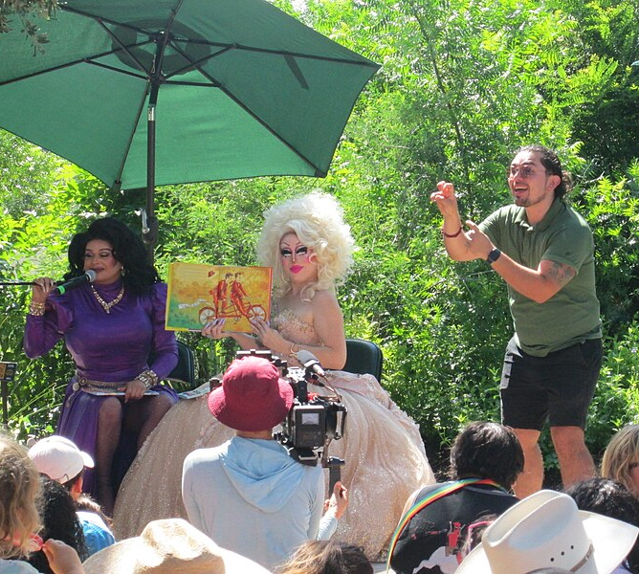
Libraries as Contested Spaces (1)
Libraries, schools, and even bookshops have become contested spaces in recent years, especially regarding LGBTQ+ materials and events.
Mirrored in the US, far-right and conspiracist groups have escalated their demonstrations, spreading disinformation and moral panic.
Drag Story Times have been a particular target of agitators - a major 2023 incident in Tralee saw disruptors assaulting library staff during a Drag Story Time event.
Protestors often livestream confrontations, using social media to amplify their message and spread disinformation.
Image source: Wikimedia Commons - Drag Queen Storytime - Waterloo Park ATX - June 10, 2023.

Slide 8
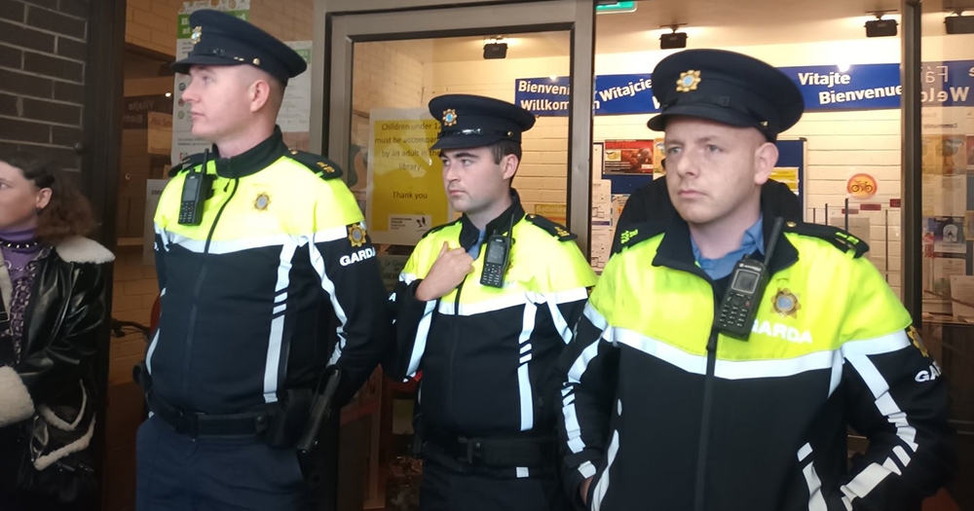
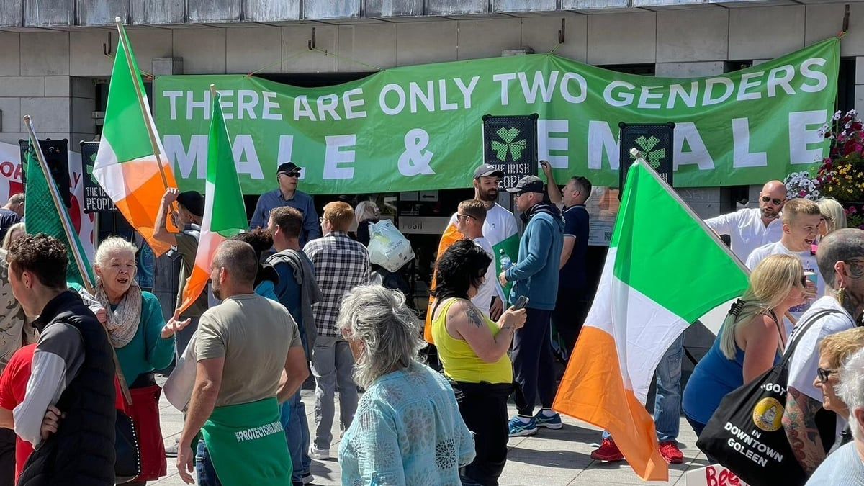
Libraries as Contested Spaces (2)
In April 2023, a widely reported demonstration in Swords, Dublin saw around 30 agitators march to the library, where four agitators, under Garda supervision, aggressively confronted staff over LGBTQ+ books, distributing leaflets listing titles they deemed "unsuitable" for children.
In July 2023, a far-right group staged a protest outside Cork City Library, refusing to remove a banner stating “There are only two genders,” leading to tensions with counter-protesters and the library’s early closure for safety reasons.
Image Source: Gay Community News, 7/4/23
Image Source: RTE Radio One, Morning Ireland, 31/7/23

Slide 9

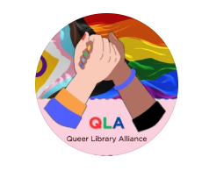


Sectoral Response to Date
FÓRSA, the trade union for public library workers, has actively supported librarians, organised counter-rallies, and called for legal changes to ban repeat offenders from libraries.
The Queer Library Alliance (QLA), a group of LGBTQ+ library staff and allies, was formed in 2023 to combat censorship, support LGBTQ+ library staff, and advocate for inclusivity.
The Local Government Management Agency (LGMA) issued 2023 guidelines to help libraries handle disruptions, while the Library Association of Ireland (LAI) reaffirmed its commitment to intellectual freedom through a powerful statement.

Slide 10
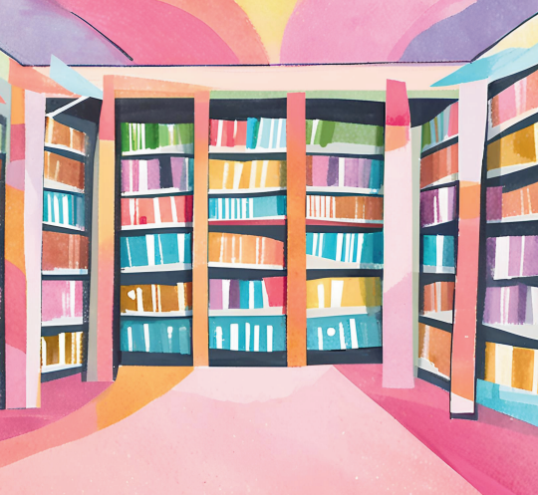
Project Purpose (1)
Research Goal
Our project sought to explore the impact of anti-LGBTQ+ agitation on libraries, librarians, and the communities they serve.
Funded by the Irish Research Council (now Research Ireland) under the New Foundations award scheme, it was conducted by a UCD research team in partnership with LGBT Ireland and guided by a stakeholder-led Steering Committee.

Slide 11
Project Purpose (2)
Research Questions
How do public libraries in Ireland select, develop, and maintain inclusive collections and programming for the LGBTQ+ community, particularly for youths?
What are the experiences of library staff in managing and responding to public complaints, agitation or disruption concerning LGBTQ+ materials and programming?
How do library staff perceive the impact of disruption and agitation regarding LGBTQ+ materials on their workplace safety, professional responsibilities, and broader library community?

Slide 12
Project Design
Method: Qualitative design included 26 semi-structured interviews with library staff and 3 stakeholder interviews, carried out via Zoom from June–October 2024, all anonymised to ensure confidentiality.
Participants: We recruited 19 managerial and 7 non-managerial public library staff, with some non-managerial staff facing scheduling conflicts or organisational gatekeeping which prevented them from participating.
Data Analysis: A collaborative coding process ensured consistency, with inter-coder reliability checks strengthening the credibility of key themes.
Ethical Approval: Received from the Human Research Ethics Committee at University College Dublin before data collection took place.

Slide 13
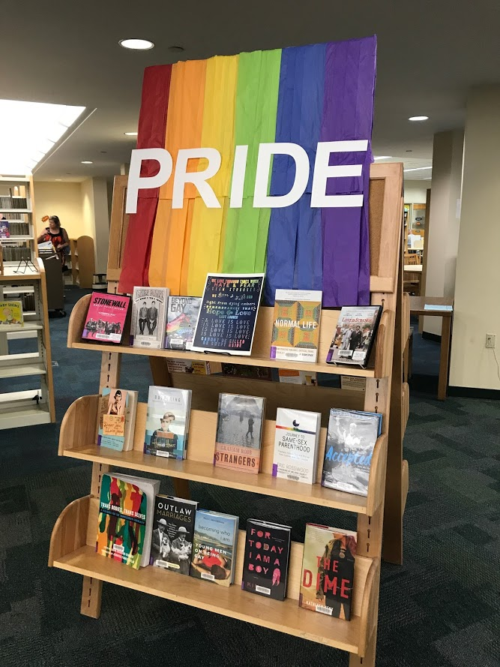
Project Themes
Our findings are presented under six core themes, that reflect the foci of our interviews with the participants.
Collection and programme development.
Dealing with complaints.
Managing agitators: Librarians' approaches and reactions.
Actions of agitators.
Insights into librarians’ experiences and feelings.
Impact of agitators’ use of social media on public library staff.
Image Source: Wikimedia Commons. A 2017 LGBTQ+ Pride book display at the Barbara S. Ponce Public Library in Pinellas Park, FL, by Antonia Green.

Slide 14
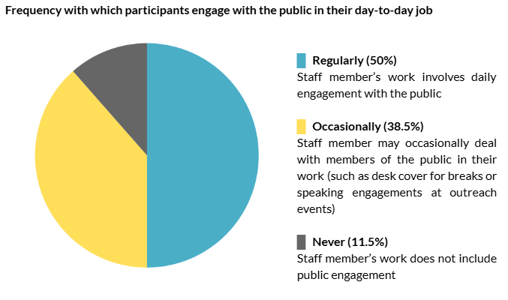
Demographics (1)

Slide 15
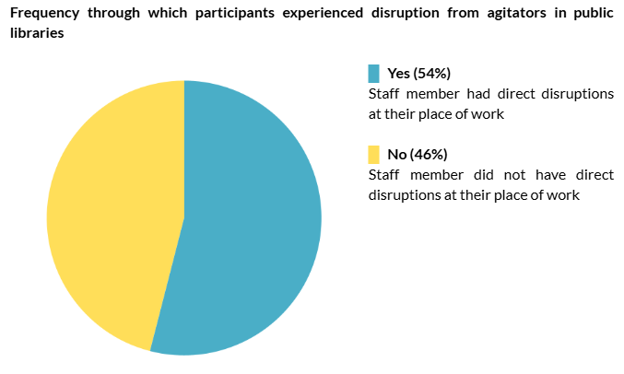
Demographics (2)

Slide 16
Collection and programme development
Librarians told us that they prioritise inclusivity, creating welcoming spaces for all patrons and supporting the LGBTQ+ community through collections and programming.
LGBTQ+-themed materials include mainly books and audiobooks, but collection development is mostly centralised, with budget constraints limiting acquisitions.
Programming includes events such as book clubs, drag story times, and youth drop-in sessions, though some events face low engagement or community resistance.
Some librarians spoke about challenges with collection policies and centralised selection, while some proactively bought LGBTQ+ titles and advocated for better classification. Some libraries also created internal groups to promote diversity, equality, and inclusion.

Slide 17
Participant Quotations (1)
“
“
In all of our collections, be it for children, or be it for adults, we'd be trying to be as inclusive as possible. And that's part of the collection development policy. And then how we buy into [Location X] is each branch buys, each branch has their own budget, and they buy according to the needs, either so that'll be things like looking at best sellers, looking at … maintaining a wide - diverse range of content for everybody, and also then what requests come in from the general public
Everybody would be welcome. We do have a selection of books specific[ally] themed around that topic, but we would have it themed around every other topic. I suppose we just try to make our space as welcoming as possible for everybody … I don't feel we specifically try to make it more welcoming for one group or another, but for everybody
“
“
“
I felt that the library was caving to intimidation. So, what I mean by that is that whereas before all of these books were just on the floor within their correct category. So, some of them were sort of 12-year-old books, some of them 14-year-old… You know. They were all taken off, and the age range was raised, and also it was made very obvious, or it became a big thing that we needed to make sure that parents consented to policing their children's literature and what they were taking up
“

Slide 18
Dealing with Complaints
Library staff told us that they differentiate between regular users who follow formal complaint procedures and agitators who bypass formal channels to stage demonstrations and disruptions.
They spoke about three types of complainant:
  regular users who voice concerns through official procedures,
  agitators who disrupt library operations and
  individuals influenced by social media misinformation who visit libraries to confront staff based on online narratives.
Complaints often follow social media narratives, with some individuals confronting staff based on misinformation and citing misinterpreted legal frameworks.
Public Libraries use local government complaints processes, but staff find them insufficient for handling agitators, leading some to seek external training and develop stock responses to affirm LGBTQ+ materials.

Slide 19
Participant Quotations (2)
“
“
They weren’t aggressive in any way. They told me about the different laws that we were breaking and having pornography in the library, and I knew by what they were saying, cos they had a sheet in front of them, it was very prompted. They were reading what they were telling me about. Also, I didn't recognise them from being in the library previously, and because we're in such a rural area, you would have a fair idea of your kind of local people and local parents that would come in with issues
The incident that I came across was a regular person. They’re not a protester by any means. They’re just a normal parent. They come into the library every week with their child. They came in purposely and went straight for that section and they went straight for the Young Adult, and they picked up a certain book and they say to me “do you think that this is appropriate?” and I approached them because I was at the desk at the time, I went around, and I approached them. I actually know them, and I spoke to them. I said, “Hi, how are you?”. We chatted and because we're familiar with each other, there was no confrontation as such. It was more of a chat. They picked up the book and they said “This is not coming back
“
“
People would come in off the street and just say, “it's a shame…”. You know, “shame on me’ for having a rainbow pride flag up, and that we shouldn't be pushing this on people
“
“

Slide 20
Managing agitators
Libraries have responded to agitation by emphasising preparedness, assigning roles based on staff abilities, and using scenario planning and role-playing exercises to build confidence.
Some librarians monitor far-right agitators online to anticipate disruptions, though this has sparked debate over whether it fuels fear or preparedness.
Safety measures include panic buttons, stronger ties with the Gardaí, buddy systems for remote branches, and passive resistance strategies, though these can be emotionally taxing.
Some libraries have moved LGBTQ+ events online or downplayed programming to avoid agitation, raising concerns about a chilling effect on inclusivity and open access to information.
  Defining the chilling effect: “If something such as a law, rule, or action has a chilling effect, it tends to discourage discussion, limit freedom, or cause some other harm” (Collins Dictionary, 2025).

Slide 21
Participant Quotations (3)
“
I’m just sending on these videos… [X] might come up to us. And I said [X] maybe you want to share them on…She said, “oh, we’re not going to share them on…That’s only fear mongering and scaremongering people by sharing them. I was like, I don’t believe that. I believe if you watch the videos, you can see they do the same thing when they go to every library. The same spiel, the same words and I felt that if staff watched it, they would know, “well this is what they’re going to say to me”. They’re not going to be surprised if they get called a paedophile
“
One of the things that we discussed when we were going through this was the scenarios. Something we did when we had the drag story time on was to know who would rather not be on the floor… so being conscious that someone else might not be able to deal as well with the confrontation as others, and just to be prepared for that and ensure that it doesn't escalate further. A staff member [not knowing] what to do in the scenario makes it worse. I will give my managers credit for that - they did look at how good people are at dealing with a scenario like that
“
“
“
A lot of my colleagues were happy for the Pride event to go ahead. But [more senior staff] were not happy that the event was going ahead. They said you should never plan [an event like this]. I think they were being overly cautious with all the protests. They didn’t want to unnecessarily attract any negative publicity
“

Slide 22
Actions of Agitators
The librarians told us that the agitators use three main tactics: organised disruptions, online and offline harassment, and targeted complaints against LGBTQ+ materials to intimidate staff and pressure libraries into censorship.
Organised actions involve agitators filming staff, making false accusations, and escalating confrontations into full-scale disruption, sometimes forcing library closures due to safety concerns.
Digital harassment has increased, with agitators using social media, deceptive tactics, and false accusations to target librarians, while also misrepresenting LGBTQ+ books and filing pseudo-legal complaints to justify censorship attempts.

Slide 23
Participant Quotations (4)
“
“
So these would be books that would be specifically about social issues. But none of them had any sexual content in them. None of them even mentioned LGBTQ people, but the she came in and just demanded, so that we remove the books, and when I said no, she asked for basically for the information, for someone she could complain to, and that information had been behind the desk, but it had gotten so quiet that it had been removed, and so I had to go and get someone to find it again. And as I was waiting, she leaned in, looked at me very closely, and said, 'Yeah, I can tell you're the sort that likes to groom kids
Then we did a few pride story times, and we had [X] and his crew set up on the library, filming everybody. We did a couple more pride story times later that summer, and then kind of people were just kind of coming off the street and be shouting abuse at the people trying to at staff trying to do the right story times, and also at the parents for bringing their children to events like this as well. So yeah, we have people coming in to complain about pride, displays, and pride, story times, and just our general collections as well. It was quite intimidating to be honest, and you know, because they would come in in groups, and you.. kind of… they'd immediately kind of come up and just be kind of in your face, and they'd be recording, and they'd be coming in very aggressively. And you know they would be accusing library staff of being paedophiles
“
“
They were threatening you if you don't remove this book, everybody's gonna see this video. No, you're a paedophile, know. You're a groomer, you're facilitating, grooming. You're facilitating paedophilia, and you're supplying pornography to children
“
“

Slide 24
Librarians’ Experiences and Feelings
The librarians reported significant emotional and physical impacts, including stress, trauma, and anxiety, either from being directly targeted by agitators, or the fear that their library could be next in line.
Workplace tensions sometimes arose due to differing views among staff on agitators’ actions. Some staff felt unable to discuss concerns openly, while extreme voices overshadowed moderate discussions on library materials.
Many librarians expressed frustration at weak or reactive responses from upper management, particularly regarding concessions to agitators, yet remained committed to fostering inclusion and supporting diverse communities.
While the disruptions have been traumatic, the librarians are resilient and remain committed to their role. They view their work as essential in fostering inclusion and community support. Their support for each other is unwavering, and they spoke about having a strong community around them.

Slide 25
Participant Quotations (5)
“
“
there were certain things that we couldn't really discuss [with] the staff members, because with each other, which otherwise we possibly would have… could have looked to each other for support, because there was differing views within the staff themselves, not necessarily supportive of the protesters, but certainly there was very much unease about the content and within, amongst other staff members there was support of the content
It's such a confrontational situation, and like there is somebody looking you straight in the face and calling you a child abuser. It's just really difficult to deal with in a way that I didn't appreciate was going to be until I was in that situation…I would count myself as somebody who's quite resilient and quite able to deal with confrontation, but it was hard
“
“
“
It was very disheartening. Once they started moving the [books], like, I've met a lot of bullies and bullies don't… And these people are bullies… and they don't, no matter how reasonable you are, they're not going to be reasonable with you... I did find it personally very frustrating, because, as I said, I don't think placating bodies works
“
there's a lot of things that, if I'm on a video on one of these channels they will pick apart me, and they'll call me a paedophile. They call me all these things, and that's not nice to hear like that's horrible to hear about yourself and especially like when they'll name you, like
“
“

Slide 26
Agitators’ Social Media Use
The librarians spoke of feeling vulnerable due to agitators recording encounters and the risk of doxxing, which heightened anxiety over harassment and public scrutiny.
  Dox: To publish personal information about (a person) on the Internet (Collins Dictionary, 2025)
Social media posts about the disruptive events made some parents hesitant to visit libraries, while staff struggled with tensions between civil in-person interactions and online hostility.
Generational differences influenced responses to online criticism, with younger staff dismissing it while older colleagues found it distressing. This contributed to empathy fatigue and collective stress.

Slide 27
Participant Quotations (6)
“
“
parents [were] a little bit nervous about bringing their kids in... any parent [seeing] that on social media is kind of thinking, ‘Jesus... not so sure I want to be in the middle of all that’
So, she [member of staff] had a phone in her face for half year, but she was talking about one of the weekends, after it happened, she went out to [location] with her [family members], like trying to take her mind off it. And her [family member] took phone out and started taking photos of the [family member]. And my colleague just started getting really upset. She's like, “I'm so sorry. But can you just put the phone away? She's like, I just… I can't stand the sight of somebody doing that with a phone at the moment
“
“
You have a really good conversation with [a patron]... and then you see them, you know, giving abuse or making complaints. You kind of start to think... How do I interact with that person moving forward?
“
“

Slide 28
Summing Up - What we Learned
Public libraries face significant challenges from organised, social media-driven agitation, which requires strategic responses in collection policies, programming, staff training, safety measures, and communication to uphold intellectual freedom.
Partnering with LGBTQ+ groups in programme development fosters inclusivity, reduces backlash, and positions libraries as collaborative spaces rather than contested ones.
A cautious approach by sectoral or upper management towards inclusive programming risks a chilling effect, making proactive risk management, staff support, and security measures essential.
Ongoing staff training in conflict resolution, social media navigation, and emerging threats strengthens resilience, while effective communication and external resources support staff facing harassment.
Libraries uphold intellectual freedom and equitable access to knowledge, especially for marginalised groups, making staff support essential to maintaining inclusive and trusted public spaces.

Slide 29
Recommendations
Public libraries should have greater public recognition, transparent operations, and clear communication from management to frontline staff, with staff input to decision-making, and advocacy for equitable information access.
Collection policies and codes of conduct should be publicly accessible, with all staff trained to implement them, while actively engaging with LGBTQ+ communities in collection development and programming.
Comprehensive training covering collection management, safety, and well-being should be provided for all library staff, with CPD opportunities and possible collaborations with initiatives like the Hope and Courage Collective for staff support.
Libraries must ensure safety with clear security strategies, collaborate with social media platforms to address agitators, and provide structured wellness initiatives and updated security protocols to support staff and patrons.

Slide 30
Communication is key
Helen Rimmer advocates for non-violent communication in libraries to foster a workplace rooted in kindness.
Key strategies we can adopt to counter censorship challenges:
Open Dialogue: Encourage respectful discussions about challenges.
Policy Clarity: Ensure staff understand and communicate book selection policies.
Conflict Resolution: Provide training to navigate difficult conversations.
Focus on empathetic, clear communication to manage challenges and create a positive, inclusive environment (Rimmer, 2024).

Slide 31
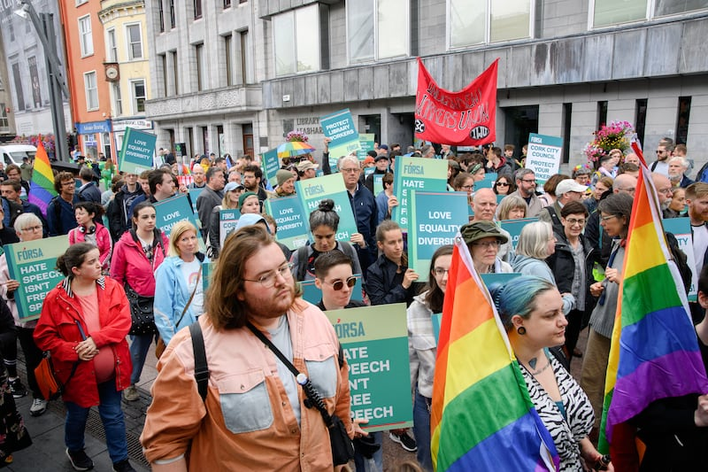
Final Word
“
I love the library. I love working in the library. This hasn’t put a dent in that at all. It was one of, literally one of the most difficult days of my life. Like it was [...] mental-health wise, dealing with this stress, but I'm glad that I was there, as if I was quite able to do it, that I was able. I was proud of myself, coming out of it, like, because I would support my colleagues quite a lot. It really did, what do you call it, crystallised in me that this is definitely what I want to do for the rest of my life, like it's such an important service and can make a difference
Image Source: Irish Times, 14/7/23. Demonstration outside Cork city's central library on Grand Parade earlier this year in support of library workers who have been subjected to harassment by protesters. Photograph: Daragh McSweeney/Provision.ie
“

Slide 32
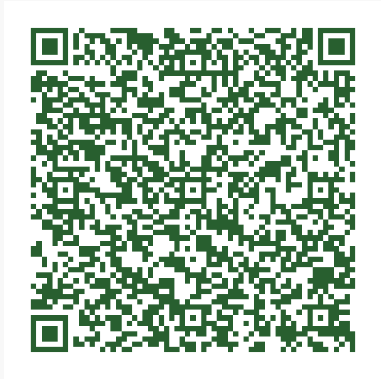
Thank You
This project would not have been possible without the generous participation of public library staff across the country who shared their stories with us, as well as the members of our Steering Group
You can access the full project report here
https://digitalpolicy.ie/publication/report-resisting-hate-and-navigating-agitation-irish-public-library-staff-stand-united-against-reactionary-challenges-to-lgbtq-materials/
claire.mcguinness@ucd.ie

Slide 33
Questions?

